Slide 1
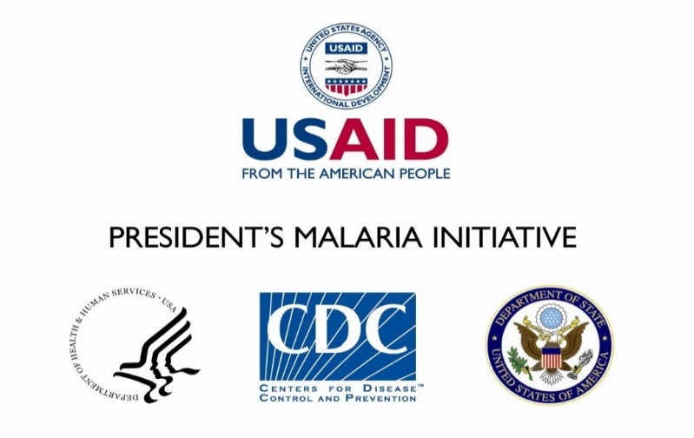

Ruth Kigozi,^{1, 5} JB Bwanika,^{1,} ⁵ Emily Goodwin,^{1, 5} Peter E. Thomas,² Patrick Bukoma,¹ Persis Yonga,¹ Fred Isabirye,¹ Paul Oboth,¹ Carol Kyozira,³ Mame K. Niang,² Kassahun Belay,² Gloria Sebikaari,⁴ James K Tibenderana,⁵ and Sam Siduda Gudoi^{1, 5}
¹U.S. President’s Malaria Initiative (PMI) Malaria Action Program for Districts (MAPD), Uganda, ²PMI,Malaria Branch, Centers for Disease Control and Prevention, United States,
³Health Information Division, Ministry of Health, Uganda, ⁴PMI, United States Agency for International Development (USAID), Uganda, ⁵Malaria Consortium, United Kingdom
Determinants of malaria testing at health facilities: The case of Uganda
  Poster number: 1033
  KEY MESSAGES
  Results
Table 2: Prevalence, unadjusted and adjusted odds ratios of factors associated with malaria testing at health facilities in Uganda
When commodities are available, recent supportive supervision and training health workers to use malaria rapid diagnostic tests (mRDTs) still play a key role in malaria service delivery.
Health facility laboratory infrastructure — such as power supply and the availability of disinfectant — does not influence malaria diagnostic testing, likely due to the widespread use of mRDTs.
Key malaria commodities were widely available: 92% of the health facilities had mRDTs and 85% had the antimalarial drug artemether-lumefantrine.
The majority of the health facilities (86%) tested over 75% of patients suspected to have malaria.
Providing supervision to health workers in the last six months and training at least one health worker in the use of mRDTs increased the likelihood of the health facility achieving the testing target.
Characteristic | Testing at least 75% of malaria suspects n = 1,085 (percent) | Unadjusted odds ratio (95% CI) | Adjusted odds ratio (95% CI)
Health facility type
Public | 693 (83%) | 1 | 1
Private for-profit | 65 (89%) | 1.58 (0.74–3.37) | 1.51 (0.46 – 4.95)
Private not-for-profit | 175 (95%) | 3.78 (1.89–7.58) | 3.08 (1.488 - 6.38)
Location
Rural | 747 (86%) | 1 | -
Urban | 186 (88%) | 1.21 (0.76–1.89) | -
Level of facility
Hospital/Heath centre IV | 71 (81%) | 1 | 1
Heath centre III | 345 (84%) | 1.29 (0.14–1.59) | 1.38 (0.73–2.61)
Heath centre II | 65 (88%) | 1.74 (0.26–2.27) | 2.98 (1.51–5.89)
Clinic/drug shop | 39 (89%) | 1. 86 (0.35–3.06) | 1.54 (0.35–6.8)
Supervision in last 6 months
Yes | 241 (92%) | 1 | 1
No | 641 (84%) | 0.49 (0.30–0.79) | 0.56 (0.33–0.94)
Availability of malaria management guidelines
Yes | 382 (88%) | 1 | 1
No | 502 (85%) | 0.91 (0.82–1.01) | 0.91 (0.82–1.02)
Availability of clocks/times
Yes | 459 (88%) | 1 | 1
No | 422 (85%) | 0.75 (0.52–1.07) | 0.92 (0.61–1.32)
Availability of power supply in the lab
Yes | 666 (88%) | 1 | 1
No | 214 (82%) | 0.65 (0.44–0.96) | 0.65 (0.40–1.04)
Availability of disinfection in the lab
Yes | 835 (87%) | 1 | 1
No | 43 (80%) | 0.59 (0.30–1.19) | 0.79 (0.35–1.83)
mRDT training
No health worker trained | 144 (80%) | 1 | 1
At least one health worker trained | 703 (87%) | 1.74 (1.14–2.64) | 1.72 (1.09–2.71)
Table 1: Availability of key malaria commodities
  Introduction
Characteristic | n = 1,085 | mRDTs (percent) | Artemether-lumenfantrine (percent) |  | Sulfadoxine-pyrimethamine (percent)
Type of facility
Hospital | 32 | 28 (87.5) | 28 (87.5) | 31(96.9)
Heath centre IV | 56 | 50 (89.3) | 51 (91.1) | 54 (96.4)
Heath centre III | 409 | 393 (96.1) | 354 (86.5) | 401(98.0)
Heath centre II | 539 | 482 (89.4) | 444 (82.4) | 496 (92.0)
Clinic/drug shop | 44 | 40 (90.9) | 38 (86.4) | 41 (93.2)
Ownership of facility
Public | 828 | 761 (91.9) | 691 (83.5) | 679 (82.0)
Private for-profit | 73 | 63 (86.3) | 61 (83.6) | 60 (82.2)
Private not-for-profit | 184 | 172 (91.8) | 166 (90.2) | 149 (81.0)
Location of facility
Rural | 873 | 807 (92.4) | 732 (83.9) | 718 (82.3)
Urban | 212 | 189 (89.2) | 186 (87.7) | 170 (80.2)
Overall | 1,085 | 996 (91.8) | 918 (84.6) | 888 (81.8)
The World Health Organization (WHO) recommends prompt malaria diagnosis through microscopy or mRDTs, and treatment with an effective antimalarial as key interventions to control malaria.^{[1]}
Unfortunately, in sub-Saharan Africa, patients and care providers often do not test fever cases before treating them for malaria.^{[2]} To mitigate this risk in Uganda, the National Malaria Reduction Strategic Plan aims to test at least 75% of malaria suspects.^{[3]}
We sought to assess health facilities’ capacity to provide quality malaria diagnosis and treatment in 43 districts.
  Methods
Through a cross-sectional survey, we collected data from all 1,085 public and private health facilities in the 43 PMI-supported districts.
We assessed the availability of malaria management guidelines, laboratory infrastructure, mRDT training for health workers and supportive supervision.
Survey data were matched with routinely collected health facility data obtained from the District Health Information System 2 (DHIS2). Associations between achieving the target of testing at least 75% of malaria suspects and the variables listed above were examined using multivariate logistic regression – see Table 2.
  Conclusion
Our findings underscore the need for malaria control programmes to provide regular supportive supervision to health facilities and train health workers to use mRDTs to ensure testing of malaria suspects and appropriate treatment.
For more information
Malaria Consortium
The Green House, 244-254 Cambridge Heath Road, London E2 9DA
www.malariaconsortium.org
Acknowledgements
Ugandan Ministry of Health
Health facility staff in MAPD districts
PMI
References
¹ WHO. World Malaria Report 2017. Geneva: WHO; 2017. Available from: www.who.int/malaria/publications/world-malaria-report-2017/en/.
² WHO. Global Technical Strategy for Malaria 2016–2030. Geneva: WHO; 2015. Available from: www.who.int/malaria/publications/atoz/9789241564991/en/.
³ Uganda Ministry of Health. Monitoring and Evaluation Plan for the Uganda Malaria Reduction Strategic Plan 2014–2020. Kampala: Uganda Ministry of Health; 2014.

