Slide 1

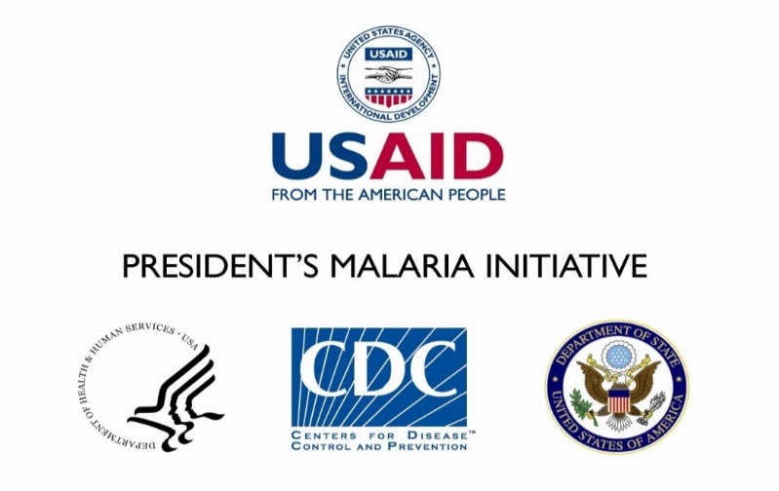
¹Patric Patrick¹, ¹David S. Odongo, ¹Viola Nampera, ¹Peter Miliang, ¹Ruth Kigozi, ¹Jane I. Nabakooza, ¹Julius K. Kuule, ¹JB Bwanika, ¹Sam S. Gudoi, ²Peter E. Thomas, ³Kassahun Belay, ³Gloria Sebikaari, 4Mame K. Niang, ⁴James K Tibenderana,
¹ US Pressident’s Malaria Inititaitive MAPD Project, ²US President’s Malaria Initiative, US Agency for International Development, Kampala, Uganda, ³Centers for Disease Control and Prevention, Atlanta, GA, USA 30329 4 Uganda National Malaria Control Program, Kampala, Uganda ⁵ Malaria Consortium, London, UK ⁶Health Information Division of, Ministry of Health, Kampala, Uganda
Factors associated with severe malaria deaths: lessons from mortality audit conducted in health facilities in Uganda
  KEY MESSAGES
  Results
Mortality could be associated with weak systems for quality management of severe malaria patients.
Cause s could not be identified; thus effective treatment may have not been provided.
Overall, data quality was poor – 62% accuracy of in-patient and out-patient registers and 30% accuracy of the HMIS report
  56 deaths with diagnosis of malaria were identified from in-patient registers instead of the reported 43, reflecting poor data quality with 23% under reporting of deaths
Overall, patients knowledge of diagnosis, treatment and when to return was 64%, while 94.% patient were satisfied with services
Only 34 deaths (61%) had laboratory test result for malaria; of which 26 (76%) were positive result confirming malaria
Table 3: Completeness of Investigation
Test type | Hoima RRH | Fort Potal RRH | Bujubuli HC
 | Percentage
Malaria test | 64 | 46 | 77
Tests for complications | 54 | 50 | 18
Test for alternative diagnosis | 50 | 30 | 56
Average | 56 | 42 | 50
Overall | 49
  Introduction
The Malaria is among the leading causes of morbidity and mortality in Uganda. The National Malaria Control Programme reported confirmed malaria incidence rate of 191 cases/1,000 population and a mortality rate of 9 deaths/100,000 population in its Annual Report 2019. In WHO’s World Malaria Report 2018, Uganda was among the 17 countries that contributed to almost 80% of the global deaths due to malaria. In 2016, Ministry of Health (MoH) adopted clinical audit guidelines to improve quality of severe malaria management in health facilities aiming to achieve ‘near zero’ deaths by June 2020. Between 2017 and 2019, to help strengthen severe malaria management, the US President’s Malaria Initiative supported Malaria Action Program for Districts to conduct a criteria-based review—based on MoH malaria guidelines in hospitals and health centres, seeking to identify factors associated with malaria deaths in health facilities.
Table 1: Health facility systems assessment
Standard | Hoima RRH | Fort Portal RRH |  | Bujubuli HC
A. Health facility functionality | Minimum target → ≥80%
Health facility staffing | 100 | 100 | 100
Triage systems & equipment | 90 | 75 | 57.5
Consultation room presence | 100 | 100 | 100
Consultation room equipment & staffing | 57 | 84 | 54
Resuscitation presence room | 100 | 100 | 100
Resuscitation equipment, staffing & medicines | 52 | 54 | 34
Laboratory presence and equipment | 92 | 72 | 100
Presence of high dependency area, clinical staff, medicines & supplies | 57 | 69 | 0
Total | 81 | 82 | 68
B. Competence/Practise assessment
Availability, knowledge & adherence to case management guidelines | 58 | 47 | 63
Triage practice | 100 | 80 | 80
Resuscitation room practice | 78 | 100 | 0
Treatment practices for malaria, pneumonia and diarrhea | 100 | 79 | 78
Laboratory practice | 100 | 100 | 93
Phamrcy store & Dispensing standards | 100 | 100 | 100
Medicine available | 74 | 64 | 86
Stock outs do not last more than 3 days in the last three months | 66 | 36 | 76
Total | 85 | 75.75 | 72
Score on treatment compliance with guidelines
 | IV Artesunate | IV Quinine | Combined anti-biotic | Other
Hoima RRH | 53 | 0 | 37 | 4
F/Port RRH | 63 | 21 | 38 | 0
Bujubuli HC III | 62 | 31 | 23 | 4
Average | 59 | 17 | 33 | 3
Overall | 28
  Methods
Purposive sample of two Regional Referral Hospitals (RRH) and one Health Centre (HC) that reported highest deaths in the national Health Management Information System.
Validated data quality: compared numbers in reports to in registers
A retrospective criteria-based review of health facility systems and case management practices,: clinical notes, treatment & supportive care as recorded in medical records, i.e. In-patient Admission Forms, In-patient Registers & Laboratory Report Forms.
Qualitative assessment of case management practices using Mortality Audit Form adapted from WHO Line Listing and National Vector Borne Disease Programme of India Forms.
Table 2: Completeness of reporting
 | Diagnosis syndrome | Anaemia | Convulsions | Diarrhoea | Dyspnoea | Bleeding | Oliguria /anuria | Jaundice | Altered sensorium | Coma | Total score | Actual score (%)
1 | Severe Malaria (n = 12) | 2 | 0 | NA | NA | NA | NA | 0 | 0 | NA | 48 | 4
2 | Severe Malaria & Hypoglyceamia (n = 4) | 2 | 0 | NA | NA | NA | NA | 0 | 4 | 0 | 20 | 30
3 | Severe Malaria &severe Anaemia (n = 33) | 33 | 6 | NA | 0 | 0 | NA | 0 | NA | NA | 165 | 24
4 | Severe Malaria ,shock & Acute Kidney Failure (n = 2) | 1 | NA | 0 | NA | NA | 1 | NA | 2 | 0 | 10 | 40
5 | Cerebral Malaria (n = 1) | 0 | 0 | NA | 0 | NA | 0 | NA | 1 | 1 | 6 | 33
6 | Severe malaria, severe anaemia &cardiac failure (n = 1) | 1 | NA | NA | 0 | NA | 0 | NA | NA | NA | 3 | 33
7 | Severe malaria, severe pneumonia, severe dehydration (n = 4) | 0 | NA | 4 | NA | NA | 0 | NA | 0 | NA | 16 | 25
8 | Severe malaria, Anaemia, pneumonia (n = 3) | 3 | NA | NA | 3 | NA | NA | NA | NA | NA | 6 | 100
9 | Severe malaria, convulsions (n = 5) | 2 | 5 | NA | NA | 0 | NA | NA | 0 | 0 | 25 | 28
 | Total achieved | 44 | 11 | 4 | 3 | 0 | 1 | 0 | 7 | 1
 | Sum total | 57 | 55 | 6 | 40 | 38 | 8 | 49 | 30 | 12
 | % | 77% | 20% | 67% | 8% | 0% | 13% | 0% | 23% | 8% | Average | 35
  Conclusion
The systems and practices in place were inadequate to ensure quality healthcare in the three HF. Thus, inadequate recognition and treatment of complications appear to be key factors in malaria deaths, and should be addressed at both system and HW levels. MoH should adopt WHO epidemiological definitions of malaria complications to guide diagnosis and treatment.
For more information
Patrick Bukoma, p.bukoma@malariaconsortium.org
Malaria Consortium
Development House, 56-64 Leonard Street, London, EC2A 4LT
www.malariaconsortium.org
Acknowledgements
Uganda Ministry of Health .
Health Facility Staff working in USAID’s malaria Action program districts
The Presidents Malaria Initiative.

