Slide 1



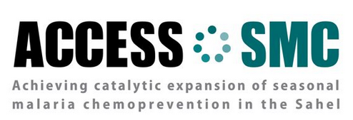

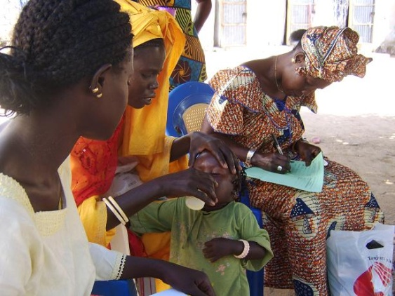
Progress in scale-up of SMC in the Sahel
Issaka Sagara
MRTC Mali
ASTMH Atlanta 2016

Slide 2
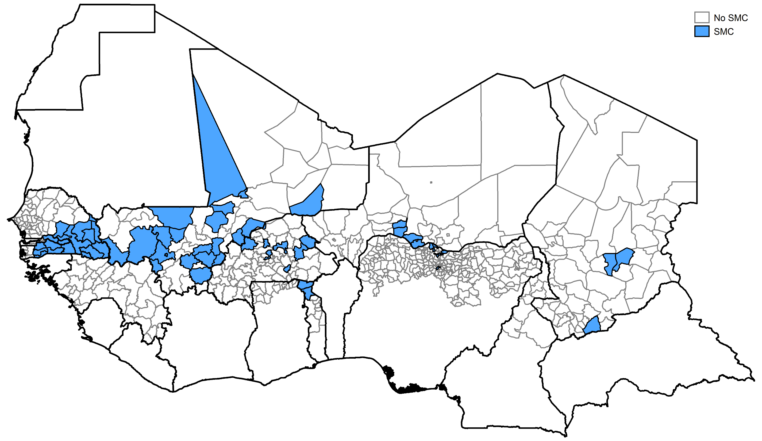
2014

Slide 3
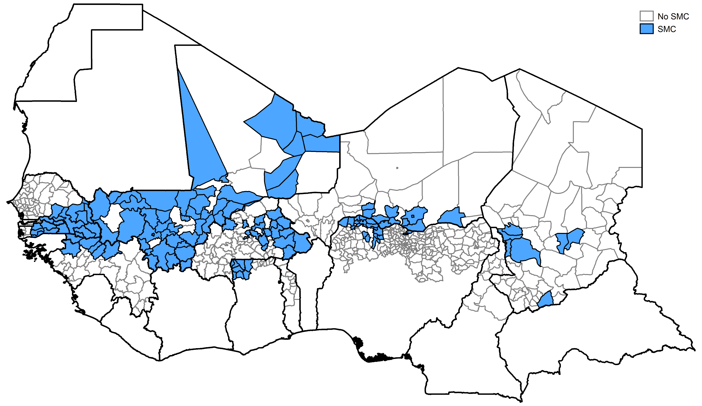
2015

Slide 4
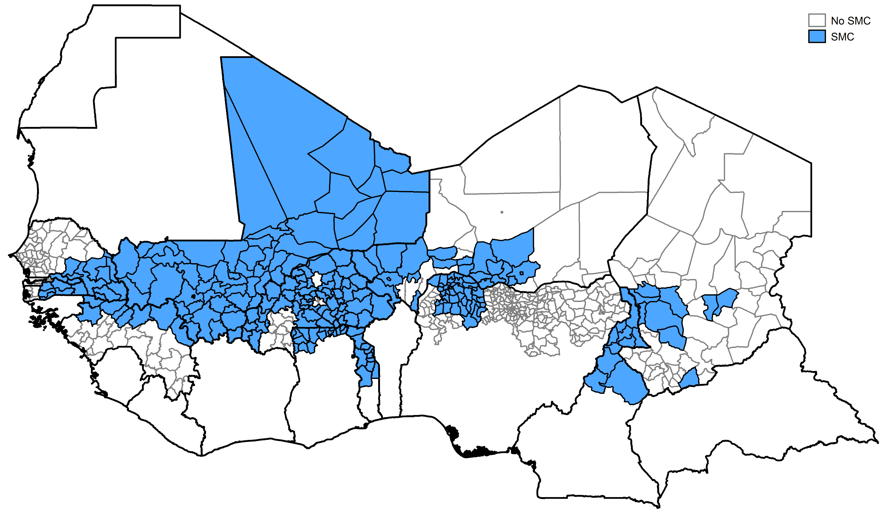
2016

Slide 5
Areas covered by ACCESS-SMC

Slide 6
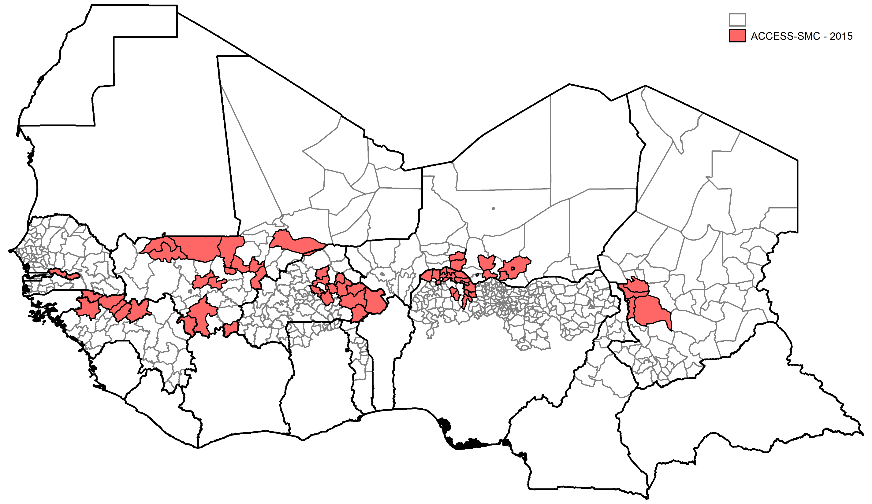
2015

Slide 7
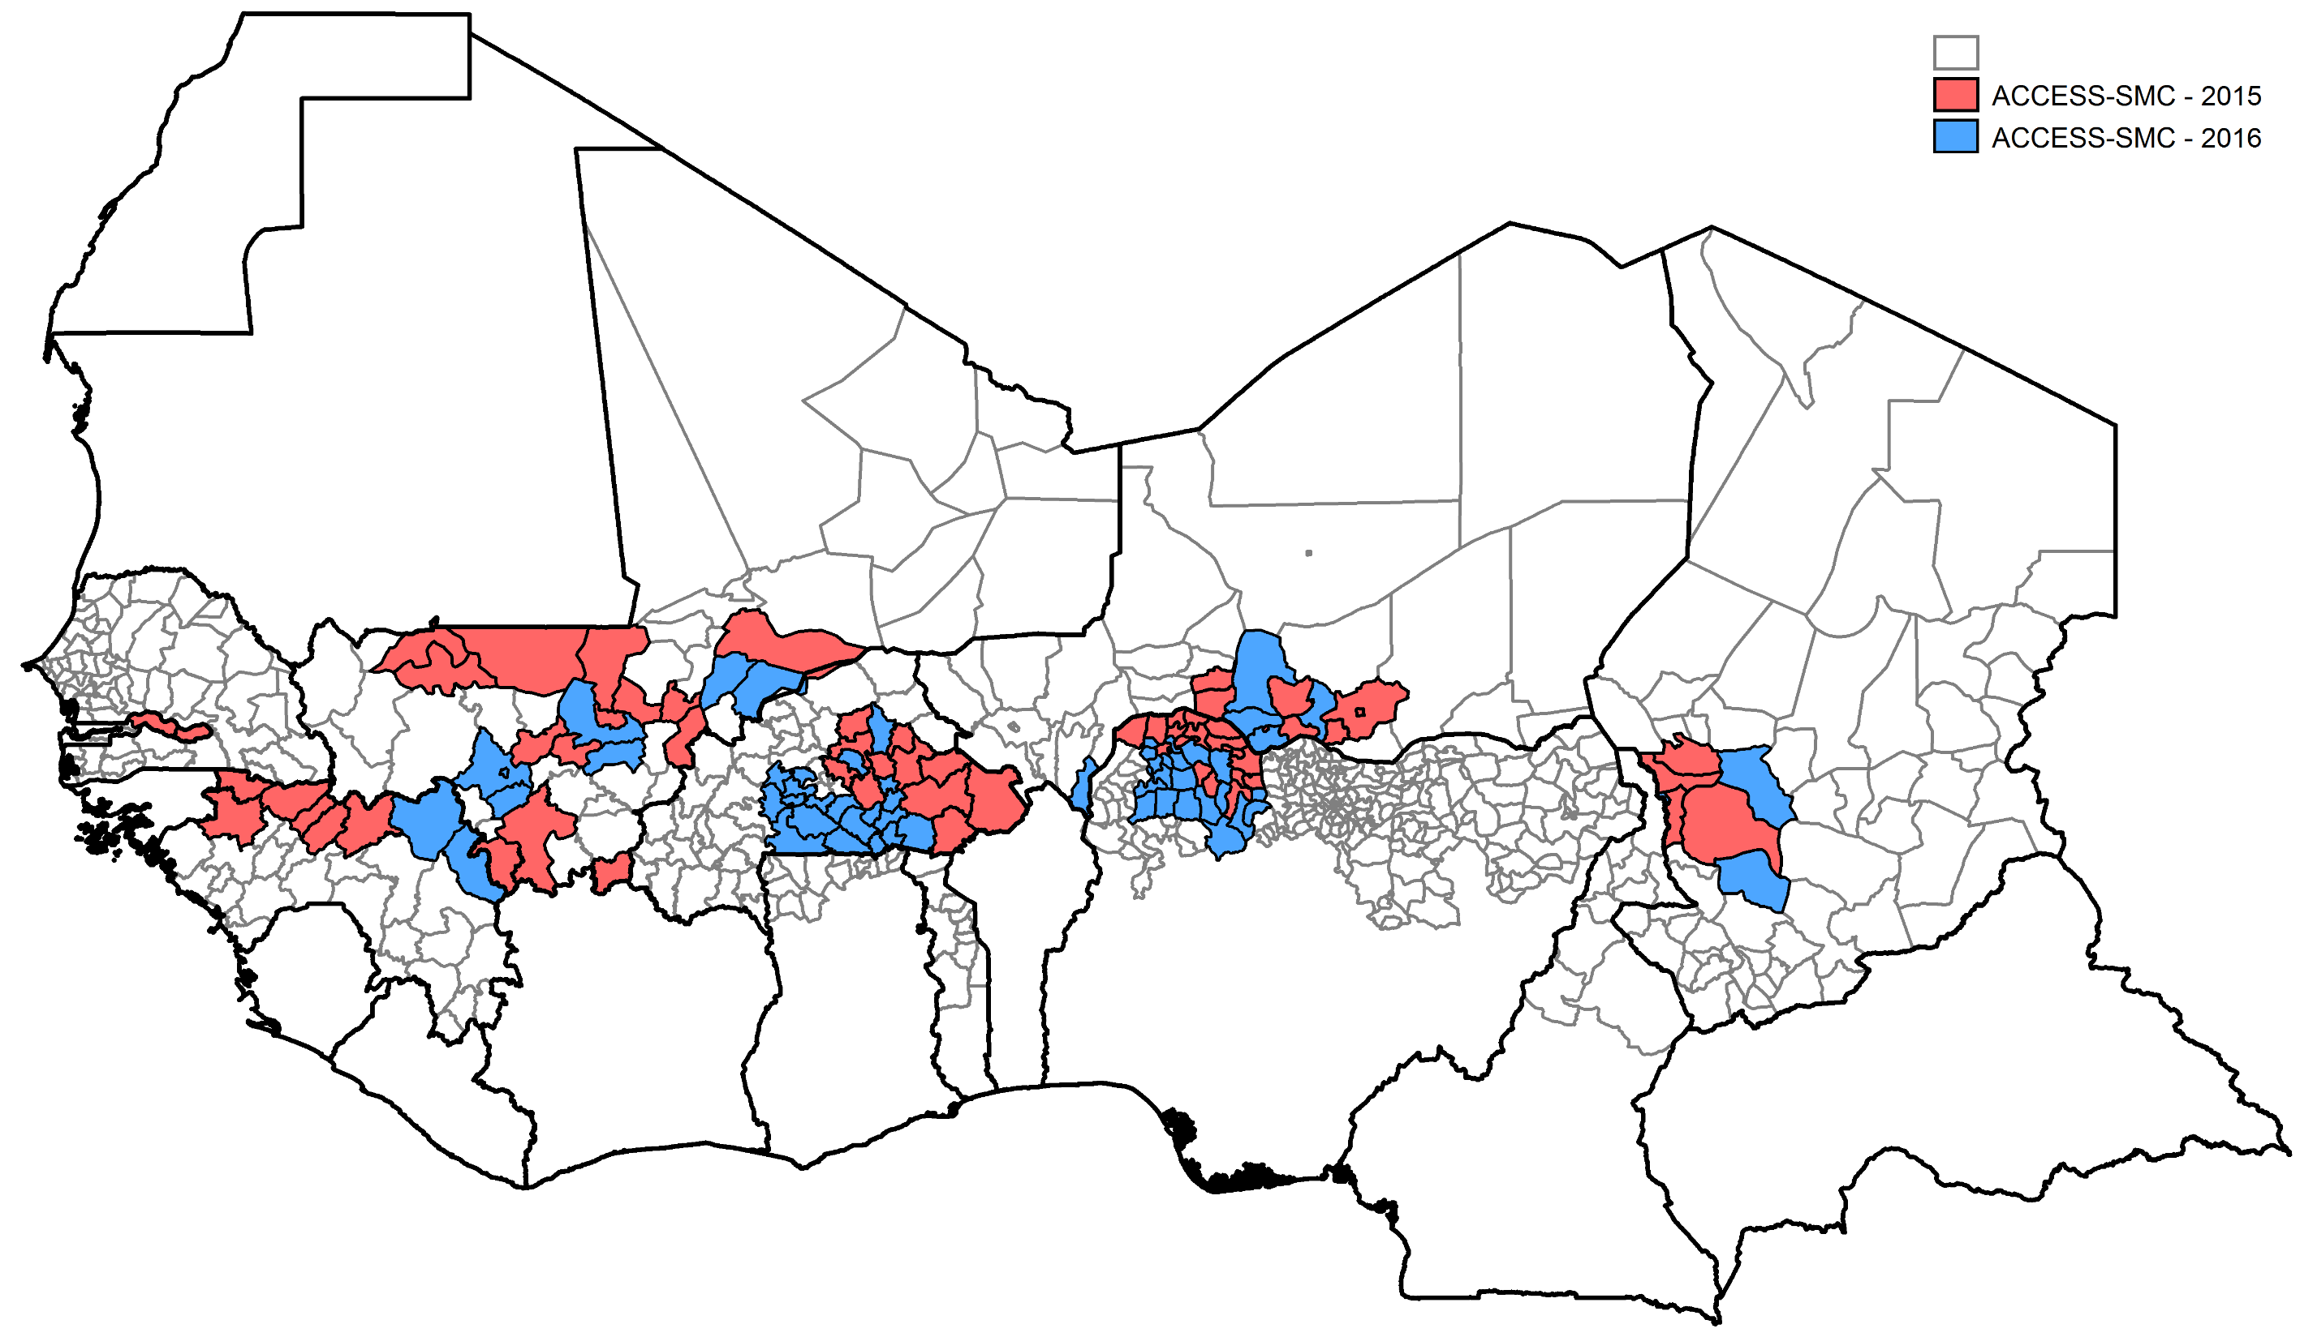
2016

Slide 8
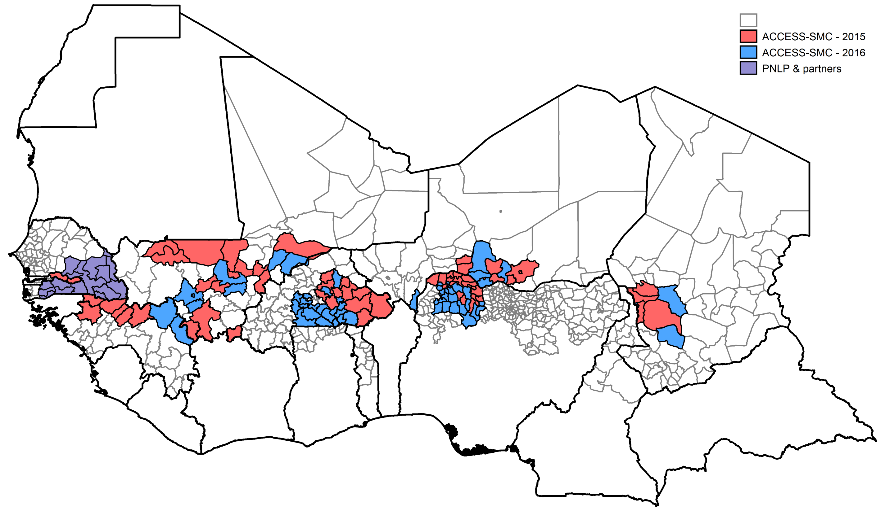
2016
Notes:
Evaluation reported here focuses on red and purple areas.

Slide 9
Monitoring of SMC programmes
in Burkina Faso, Chad, Gambia, Guinea, Mali, Niger, Nigeria (ACCESS-SMC), and in Senegal*
Monitoring of the process of delivery
Surveys to determine coverage
Case control studies to measure efficacy of monthly treatments
Sentinel surveillance for malaria and analysis of national surveillance data on reported malaria cases to assess impact
Safety monitoring by the National PV centre and the PNLP
Surveys to monitor the prevalence of molecular markers of resistance to SMC drugs
Assessment of provider costs of delivery
*SMC programmes in 2016 in Ghana, Cameroon, Togo - not included in this presentation

Slide 10
Primary methods of delivery
Country | Primary delivery method
Burkina Faso | Door-to-door
Chad | Door-to-door
Gambia | Door-to-door
Guinea | Door-to-door
Mali | Fixed point (mobile)
Niger | Fixed point*
Nigeria | Door-to-door
Senegal | Door-to-door
Predominant delivery method was door-to-door
Mobile fixed-point used in Mali
Fixed points also used in Niger (including urban areas)
* Door-to-door in some urban areas at final SMC cycle
Notes:
Door to door most common method. Some countries with primarily door to door provided SMC at some fixed points and for children who were referred if they tested RDT negative. Fixed point delivery includes testing and treatment of febrile children, an advantage over door to door campaigns where febrile children are referred to the nearest health facility.
Explain mobile fixed point in Mali – and advantages of this

Slide 11
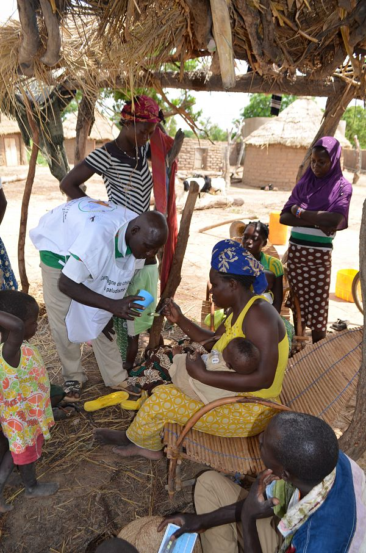
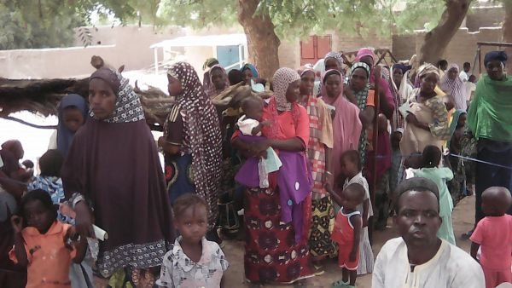
Delivery door to door
or at fixed points
Niger
Burkina
Faso
Notes:
Advantages of fixed points (easier to organise, and provide more complete service including test and treat for febrile children) but concerns that coverage would be poorer and less equitable.

Slide 12
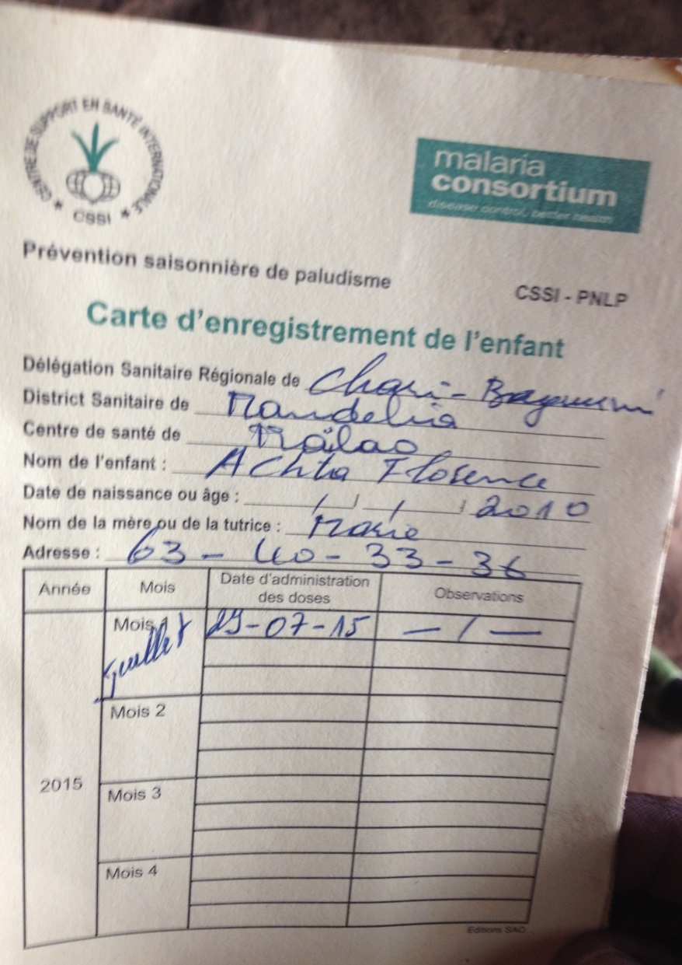
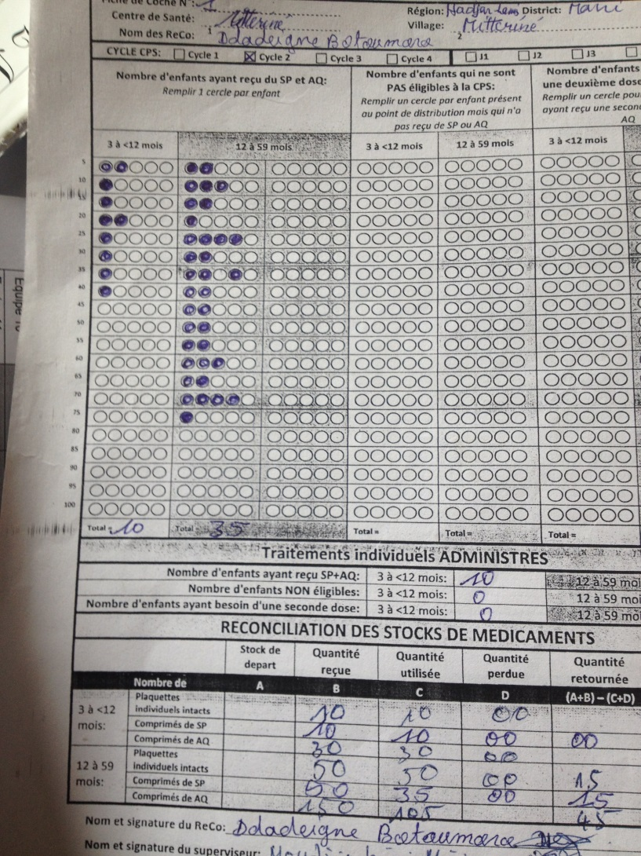

SMC record card and tally sheet (Chad)
Notes:
Recording of SMC treatments. Tally sheets used for quick total of no. treated, no. re-dosed, for reporting and for reconciliation of drug stocks. Family-held record card, can be checked during surveys.

Slide 13
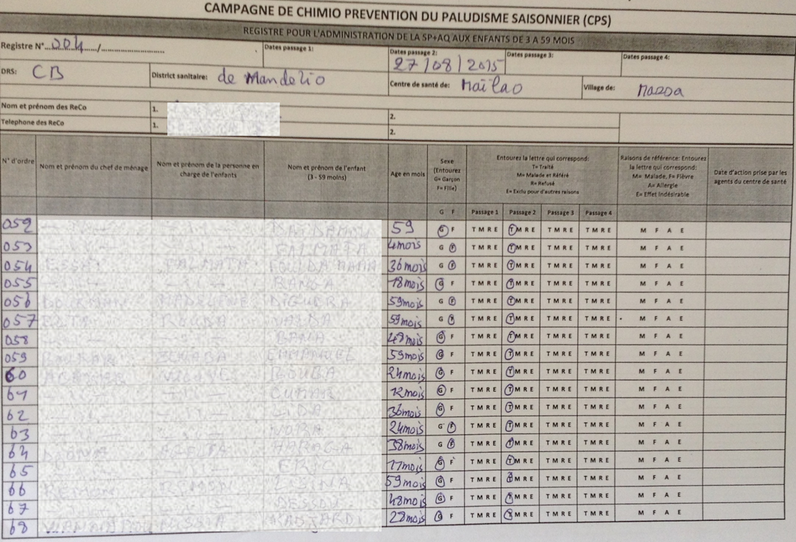
SMC register used in Chad
T treated
M unwell
R refused
E excluded
Notes:
Register is a more permanent record of who had SMC. Record of all months for each child. But difficult to make use of these in surveys.

Slide 14
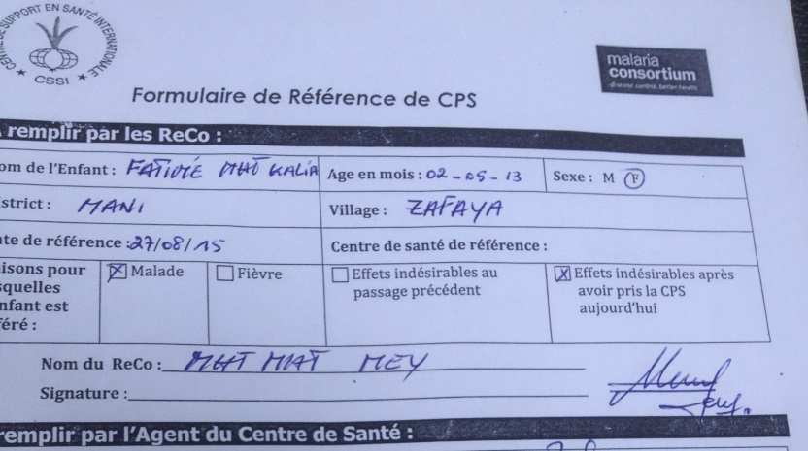
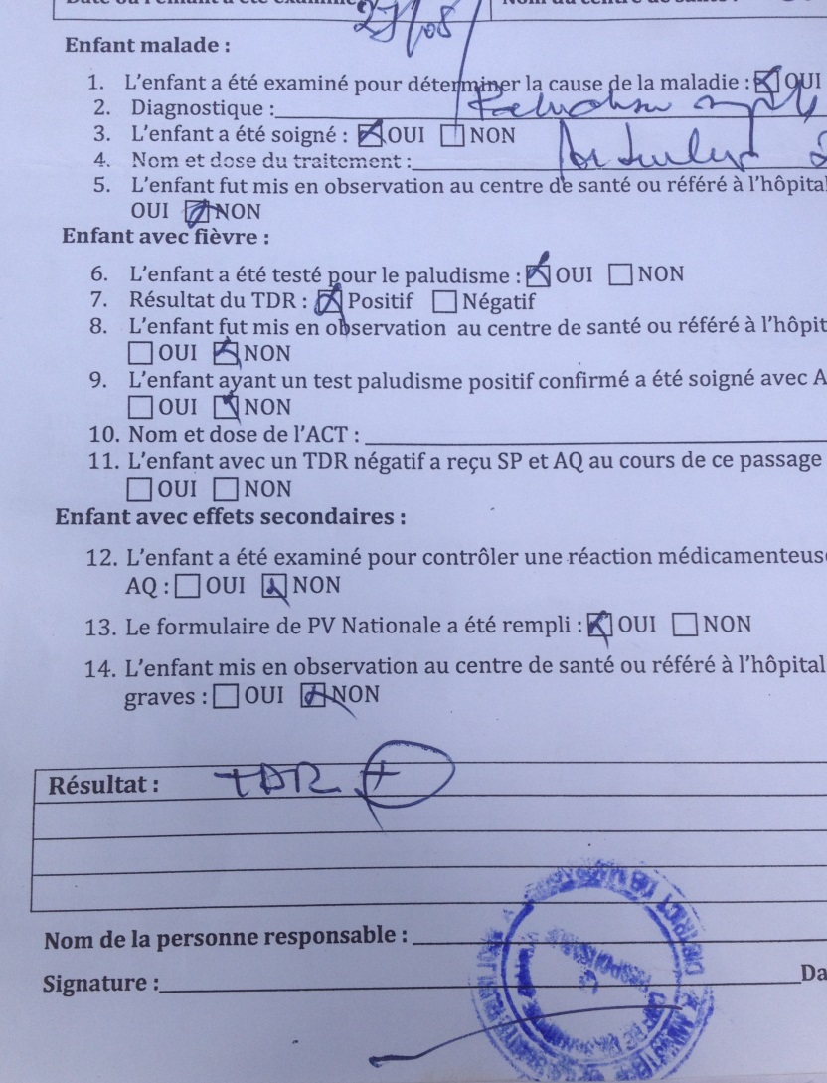
CHW referral form
Children who are unwell are referred for diagnosis and treatment. If appropriate and they do not have malaria they may then receive SMC.
Notes:
SMC acts as a form of screening programme. Febrile children should be tested and get ACT if positive and only get SMC if they test negative. In door to door delivery febrile children referred and given referral slip to take to the clinic. Surveys of coverage capture SMC treatments but do not, currently, capture SMC contacts where the child did not get SMC.

Slide 15
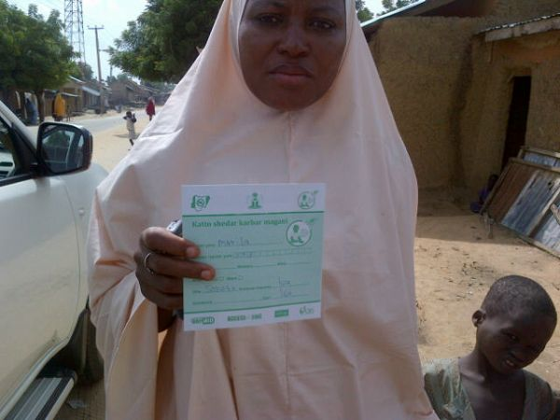
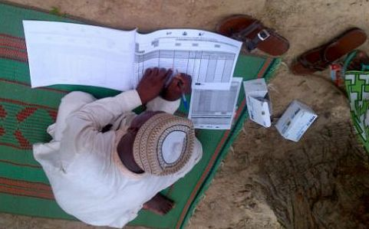
Nigeria
Photos: Malaria Consortium
Notes:
Paper-based system in most countries.

Slide 16
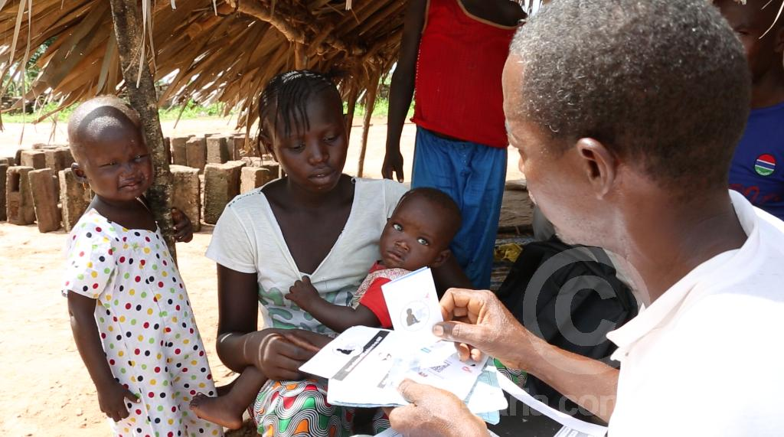
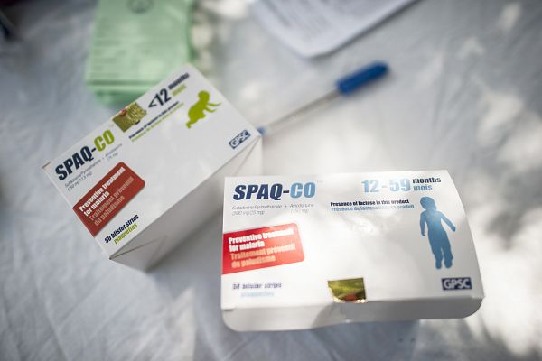
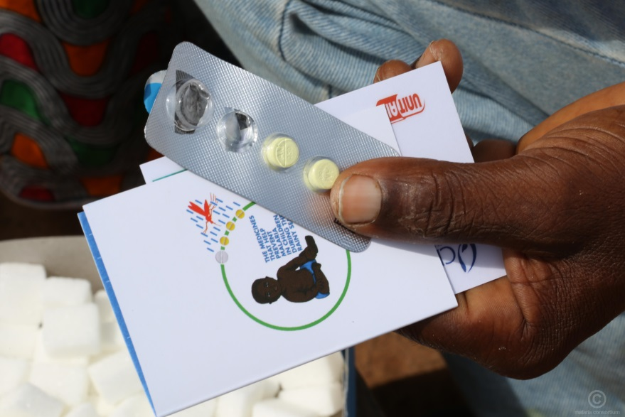
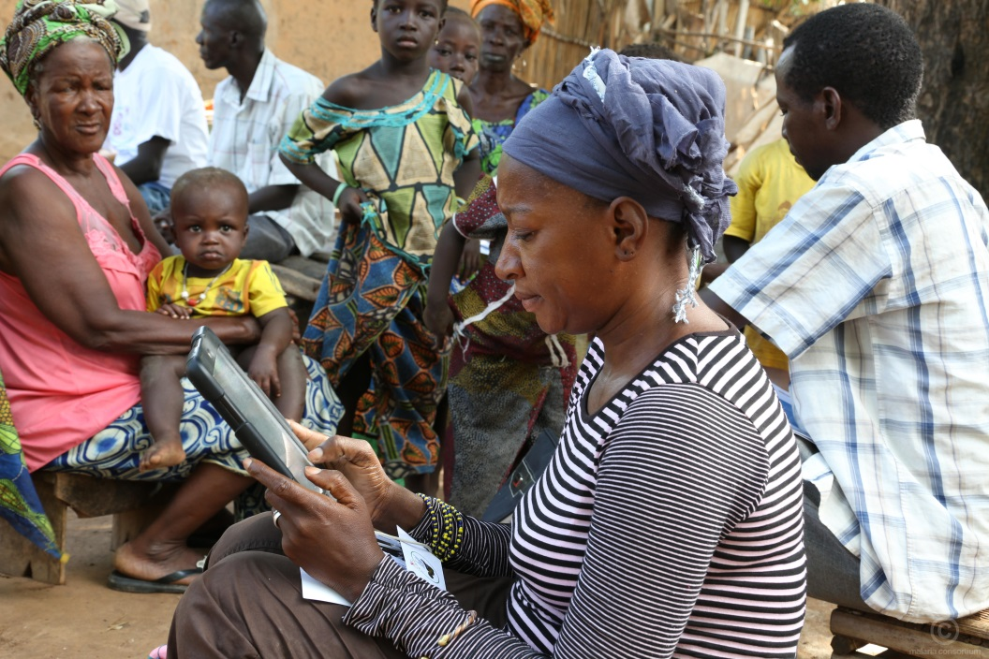
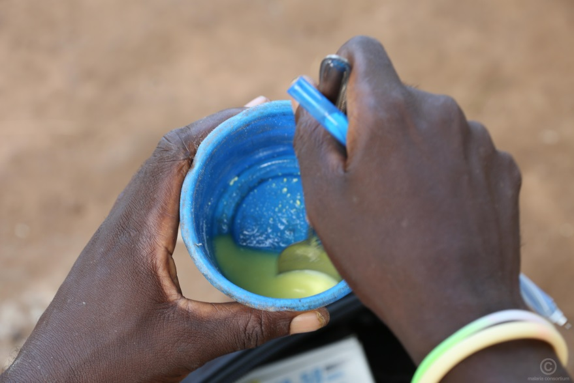
The Gambia
Photos: CRS
Notes:
Use of tablet PC to scan child’s barcode and enter treatment provides a more accurate and permanent record and logs each treatment a child receives. Used in Gambia, and piloted in Mali and Niger.

Slide 17
Target number of children in evaluation areas in 2015 and the average number actually treated per cycle
Country | Delivery method | Number of areas | Target | Average no. treated
Burkina Faso | Door-to-door | 11 districts | 649,693 | 680,433
Chad | Door-to-door | 6 districts | 275,000 | 265,354
Gambia | Door-to-door | 2 regions (17 districts) | 90,925 | 77,208
Guinea | Door-to-door | 6 prefectures | 210,047 | 201,283
Mali | Fixed point (mobile) | 14 districts | 809,638 | 687,838
Niger | Fixed point* | 8 districts | 595,901 | 416,973
Nigeria | Door-to-door | 17 LGAs | 792,133 | 787,467
Senegal | Door-to-door | 16 districts | 623,859 | 565,503
 |  | Total | 4,047,196 | 3,682,059
Notes:
[Senegal to be added]
[add total when Senegal added]

Slide 18
Seasonality of malaria and timing of SMC monthly treatment cycles in 2015
The Gambia
Mali
Burkina Faso
Chad
Senegal
(Kedougou)
Niger
Nigeria
Guinea
Senegal (Tamba, Kolda, Sedhiou)
Seasonality in 2015 shown by the no. of confirmed cases in children in non-SMC areas or in older age groups in SMC areas

Slide 19
Coverage surveys
Conducted at the end of the 2015 transmission season
Representative of areas covered in 2015
Sampling of villages with probability proportional to size
Children up to 7yrs included
Receipt of SMC determined from
  SMC card (where available)
  Caregiver’s recall of SMC cycles

Slide 20
Number of SMC cycles received in 2015
Relatively few children missed SMC altogether
In most countries, more than 80% of children received SMC. Above 90% in 4 countries.
Coverage of 3 cycles was >75% in 4 countries, >60% in all.
Coverage of all 4 cycles was more variable, ranging from 85% in Burkina Faso to <25% in Chad.
Overall (population weighted) coverage of ≥3 cycles was 73%
Fixed
point
Notes:
[Add Senegal to this plot?]
Coverage of the program may be under-estimated if referrals (for fever, malaria) are not documented.

Slide 21
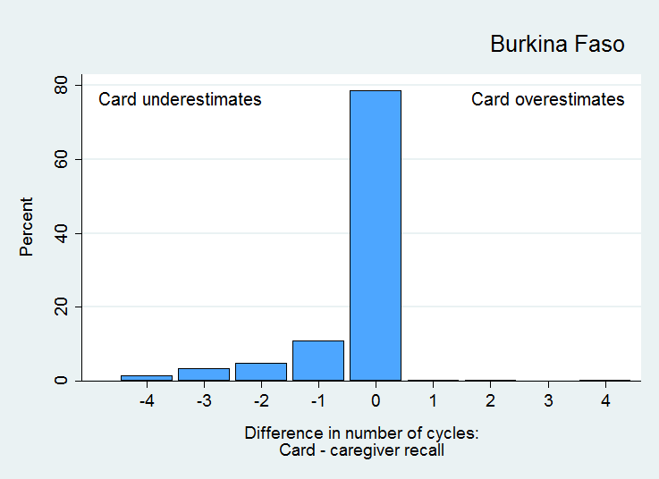
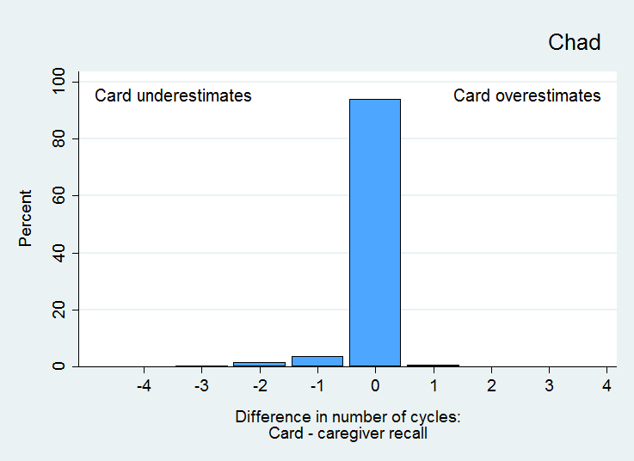
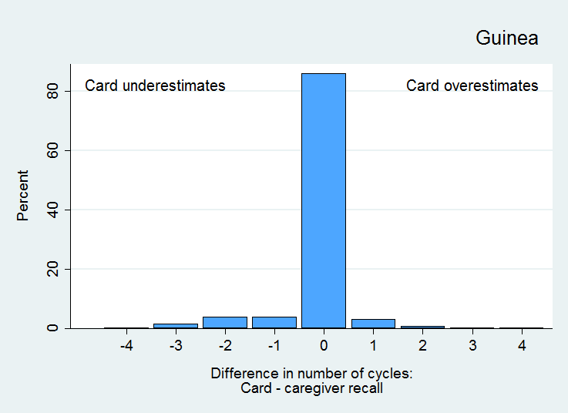
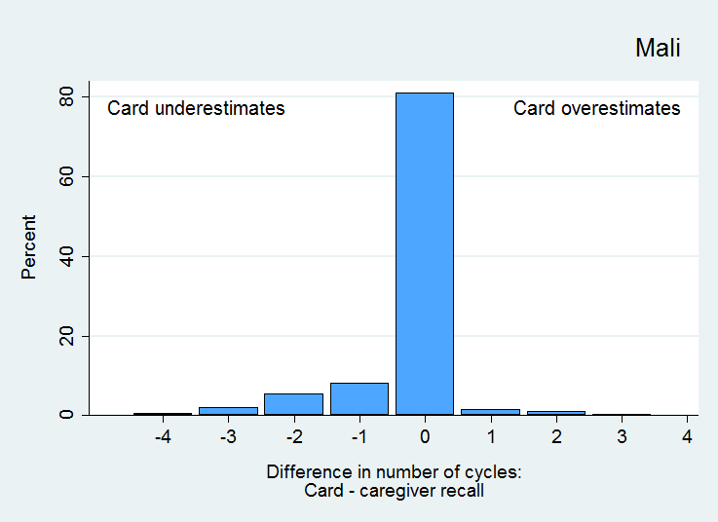
Agreement between SMC card and caregiver recall
Agreement between card and caregiver recall was good, but cards tend to under-estimate coverage because SMC administration is not always documented on the card
* Mothers recall of individual rounds not collected in Nigeria, only recall of blister packs collected in Gambia

Slide 22
Delivery outside age range: coverage in 6 year olds
 | N | Given card | At least 1 | At least 3
Burkina Faso | 105 | 77% | 82% | 71%
Chad | 68 | 63% | 85% | 67%
Gambia | 302 | 30% | 30% | 24%
Guinea | 212 | 82% | 82% | 45%
Mali | 151 | 13% | 16% | 11%
Niger | 676 | 34% | 34% | 21%
Nigeria | 75 | 53% | 61% | 49%
Treatment children above the upper age limit should be kept to a minimum to avoid under-dosing
This was less of a problem where fixed point delivery was used
Notes:
[summarise as sentence on this slide]
[additional slide – dbn of differences between card and caregiver]
[Separate slide]
Focused on those aged 6 because clearly should not have received SMC

Slide 23
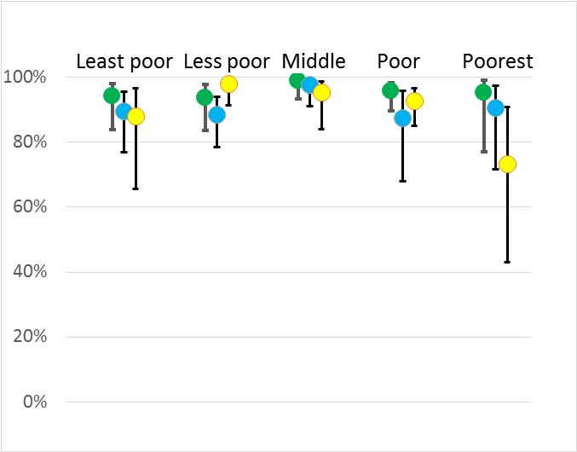
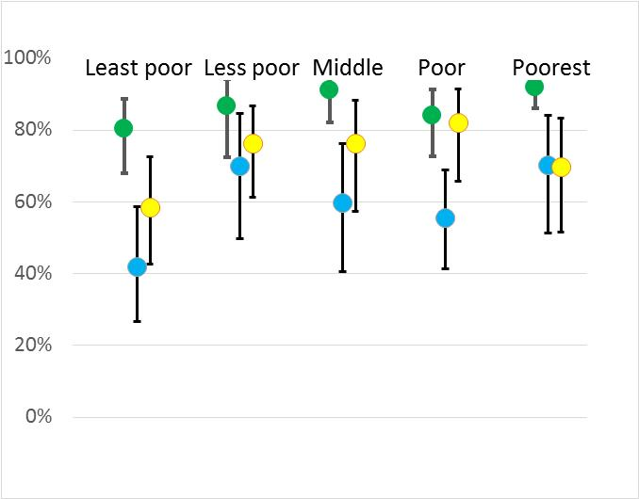
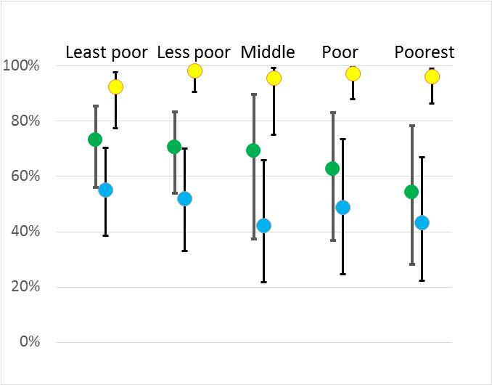
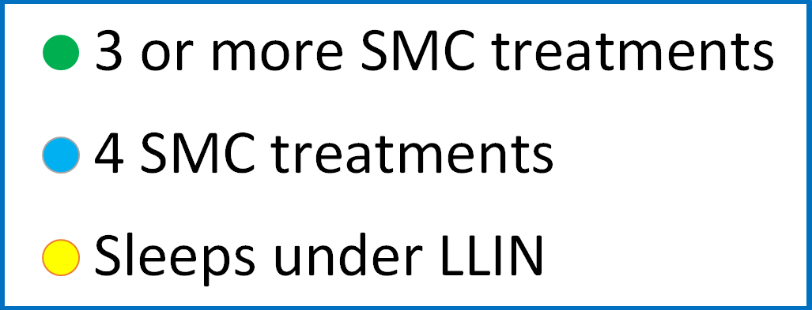
Equitability of SMC coverage
Burkina Faso
Gambia
Mali
Notes:
Burkina – high, equitable coverage. Gambia – lower coverage in wealthier groups in urban areas. Mobile teams (Mali) - lower coverage and less equitable than door to door – but provide a more complete service.

Slide 24
Coverage by gender
Similar coverage in boys and girls

Slide 25
Case-control studies to estimate efficacy against malaria
Cases – clinic attendees aged 3-59 months with slide-confirmed malaria
Controls – 2 x healthy (or RDT negative) children aged 3-59 months from same community as cases
History of SMC collected from card, caregiver, administration records
  Potential confounders: age, SES, LLIN use, mothers education
Logic:
If SMC is protective, then more controls should have recent SMC than malaria cases
If SMC not protective, then SMC receipt should be similar between cases & controls
Controls
No SMC
SMC
Cases
Notes:
Cases were
clinic attendees
aged 3-59 months,
Presenting with fever or history of fever
Malaria infection confirmed by blood slide
No other obvious reason for the fever

Slide 26
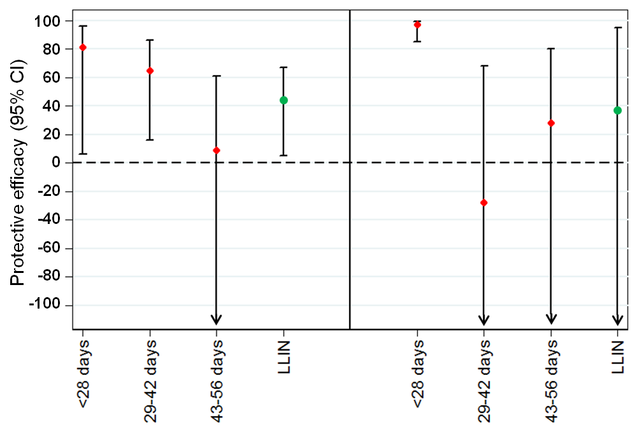
Case-control studies to estimate efficacy against malaria
Cases – clinic attendees aged 3-59 months with slide-confirmed malaria
Controls – 2 x healthy (or RDT negative) children aged 3-59 months from same community as cases
History of SMC collected from card, caregiver, administration records
  Potential confounders: age, SES, LLIN use, mothers education
Gambia Mali
Notes:
Confidence interval around LLIN in Mali is very wide because coverage was 97% among both cases and controls.

Slide 27
Evidence of impact from national malaria surveillance databases
Monthly number of malaria cases in each district, in children <5yrs, and in persons above 5yrs were analysed (facilitated by now widespread use of confirmation by RDT)
Regression model used to predict the expected number of cases without SMC on the basis of year-to-year trends in older ager groups and in children in non-SMC districts
% reduction in cases in SMC areas then estimated by comparing reported with the predicted cases
Limitations: incompleteness, data errors, periods without confirmation, changes in diagnostic guidelines, cases from outside SMC areas, other concurrent control measures, year to year variation in malaria transmission
- these factors tend to obscure the true impact of interventions

Slide 28
Burkina Faso
Examples of districts with SMC in 2015:
More details: JB Ouedraogo Poster 852
Session B Nov 15th, 12pm-1:45
Pama
Ziniare
17 control districts
without SMC
11 ACCESS-SMC districts with SMC in 2015:
Increase in number of confirmed cases in 2015 in non-SMC areas, and in older age groups in SMC areas
The observed number of cases in children in SMC areas was compared with the expected number assuming the same trend would have been seen without SMC
45% reduction in cases <5yrs in 2015

Slide 29
The Gambia
Mali
2015 49%
% reduction 2014: 50% 2015: 60%
Chad
Senegal
2015 24%
2014: 62% 2015: 54%
Number of confirmed cases in SMC areas in older age groups (in red) and in children (in blue).
Dashed blue lines are the expected cases in children if SMC had not been implemented.
Notes:
Senegal – change to RDT testing guidelines in 2015 more cases diagnosed, potential bias if this was done more in young children

Slide 30
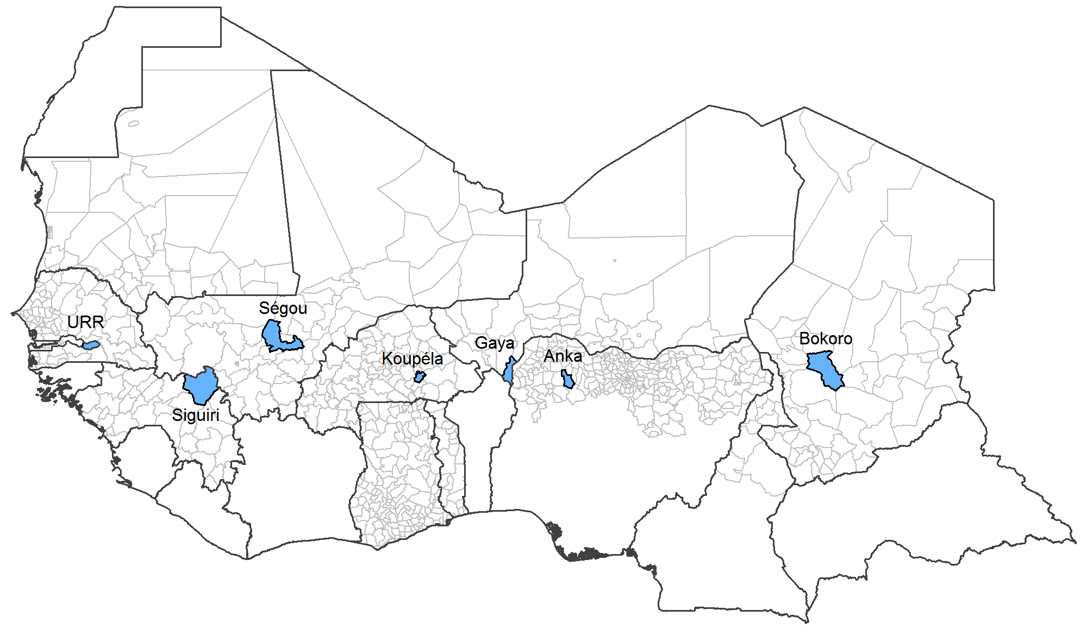
Drug resistance: Sampling for molecular markers
Community surveys in 2015 in areas that had not started SMC (except Gambia which had started SMC in 2014)
2 age groups: after the end of the transmission season: <5years and 10-30 years
2000 individuals in each age group, total target sample size of 28,000
low frequencies of mutations associated with SP resistance, and no samples with AQ resistant genotypes
Four samples (0.14%) carried pfmdr1_YY but only one had CVMNK/CVIET.
Eight samples (0.33%) carried dhfr_triple and dhps_double mutations. None of these samples carried pfmdr1_YY.
More details in the talk by K Beshir
Wed 16 Nov 8am Marriott Atrium A
113: Malaria: Chemotherapy for control and elimination
Notes:
Prevalence of AQ markers reflects the drug combinations most used for first line malaria treatment in recent years

Slide 31
Summary
Countries have been quick to adopt SMC strategy since it was endorsed by WHO in 2012, scale-up has been rapid: 7.5m children in 2015 (3m through ACCESS-SMC), 15m (7m through ACCESS-SMC) in 2016
Despite this, high coverage was achieved in 8 countries in 2015
Treatment efficacy at least 80% over 4 weeks, consistent with low frequency of markers of AQ and SP resistance
Routine HMIS data consistent with a substantial impact of SMC in 2015, against a background of an increase in malaria transmission in many countries despite high LLIN coverage
Timely procurement and effective supply chain are critical for optimum impact - to start SMC cycles on time
Reliable record of child’s SMC dates is necessary for monitoring
4 cycles needed for full protection – need to adapt local strategies to reach children in all 4 cycles
Higher more equitable coverage door-to-door than through fixed points
Testing and treatment of febrile children: advantage of delivery by mobile teams or through community case management, but additional mobilisation needed for mobile teams to achieve high coverage
Careful monitoring is needed to ensure that delivery is effective and that drugs remain safe and efficacious
Recent scale-up of diagnostic testing for malaria has facilitated assessment of impact but malaria information systems need to be strengthened - to guide implementation and to allow better tracking of progress
SMC programmes have benefitted from regional coordination which needs to be maintained

Slide 32
Acknowledgments
Burkina Faso: IRSS, PNLP, MC
Chad: CSSI, PNLP, MC
Gambia: MRC, NMCP, CRS
Guinea: UGANC, PNLP, CRS
Mali: MRTC, PNLP, CRS
Niger: CERMES, EpiCentre, PNLP, CRS
Nigeria: ERIC, JEDIMA, NMEP, MC
Senegal: UCAD, PNLP
SMC Working group: C Rwagacondo, M-R Fabry, H Jakou, M Kalleh, JL Ndiaye, P Batienon
WHO/TDR; WHO Safety and Vigilance; CAPM Rabat; WHO GMP
CRS
MC
LSHTM
UNITAID

Slide 33
Coverage at individual SMC cycles in 2015
Confirmed coverage at cycles shown (where month was recorded on card or month recalled by mother) – will be conservative
Coverage was consistently lower at the final (4th) cycle
Possible access issues at end of rainy season
Reasons for this being explored

