Slide 1


Stock Management, inventory and accountability standards:
What we have learnt, good practice standards

Slide 2
Accountability for stocks that arrive in our countries
Commodity flow
Information flow
  Procurement & shipping
  Port clearance & receiving at CMS
  Distribution from CMS to RMS
  Distribution from RMS to DMS
  Distribution from DMS to HC
  Collection by CHW from HC and use
  Reverse logistics - from CHW to HC
  Reverse logistics - from HC to DMS
  Reverse logistics - from DMS to RMS
  Reverse logistics - from RMS to CMS
  Goods Receiving at CMS
  Distribution plan at CMS/ Issue from CMS
  Receiving at RMS
  Distribution plan at RMS/Issue from RMS
  Receiving at the Districts stores
  Distribution plan at DMS/Issue from DMS
  Receiving at Health Facilities
  Issue from HF to CHWs
  Reverse – Issue from CHWs to HF (receiving)
  Reverse - Issue from HF to DMS (receiving)
  Reverse – Issue from DMS to RMS (receiving)
  Reverse – Issue from RMS to CMS (receiving)

Slide 3
Indicators for Stock Management and Accountability
Output Indicators
  Number of treatments administered to eligible children per cycle
  Proportion of designated storage facilities that have adequate SMC drug supplies at designated time as per their planning document by level (health facility / central store)
  Median duration in days of stock out at medical stores at district level during SMC implementation months
  Percentage of forecasted needs of quality assured SP+AQ supplied to districts
Process Indicators
  Volume of quality assured SP+AQ used/leftover/lost per cycle
  Proportion of districts submitting the LMIS data per country

Slide 4
Status of Stock Accountability, Reporting and Use in Decision-making
Was your country able to provide the required data variables to the M&E database? Challenges faced?
Did you use any of stock management data for decision-making during/between cycles? Examples?
Has your country used data gathered to calculate values for any of the indicators? Which ones?
Have any of your MOH Directors, Program Managers or District Leadership asked you for any stock management information? What were you able to provide?
To be able to do the above, you needed to have good inventory management and logistics management information systems and processes

Slide 5
Inventory Management Systems
What is Inventory Management?
  Fundamentally concerned with maintaining stocks at levels sufficient to satisfy demand
What is the Purpose of Inventory Management?
  Ensures that the system always contains the right goods in correct quantities
  Used for requisitioning and issuing medicines, financial accounting, and preparing consumption and stock balance reports
  Crucial for accurate forecasts with consumption method of quantification
What are the levels of Inventory Management for SMC products?
  CMS, RMS, DMS, Health Facility, CHWs
What is an Inventory Management System?
  It informs the store keeper when to order/issue, how much to order/issue, and how to maintain an appropriate stock level of products to avoid shortages or over supply

Slide 6
Inventory Management
Ordering/ Reordering
Receiving
Should be guided by
SOPs
and based on
accurate
stock records
Issuing
Storing

Slide 7
Logistics Management Information Systems (LMIS)
What is a Logistics Management Information System?
  Manual or computerized system that collects, processes and reports logistics data
What is the Purpose of the LMIS envisioned for SMC in countries?
  To collect data, organize data, report data for use in decision making and accountability
    Comprises all the activities that involve -
      Recording logistics data in records and forms,
      Processing the data into information
      Information presentation and interpretation

Slide 8
LMIS for the benefit of SMC – Considerations
What decisions need to be made?
Number of levels in the logistics system? And decision-making levels.
  e.g. CHW → Health Facility → District → Regional → National → Supra-National
What data items are needed to make those decisions?
What forms or tools are required to collect this data?
How often data is required for decision-making?
  Reporting frequency
How soon is the data is required for decision-making?
  Reporting deadline
Who is responsible for reporting?
  To the different interested parties?
To whom are the reports sent?
  At each level/amongst the interested parties?
How are the reports transmitted?
  Hand delivery, email, uploading
How is feedback provided?
  Content, Format, Distribution flow etc

Slide 9
Data Required | Data sources/Tools | Example of Tools | Provided by Health System | Gap/Tools typically provided by Project
Stock on hand (usable stock available) | Stock keeping records (records that capture information about products in storage) | Stock/Bin cards Inventory control cards | YES | SMC Tally Sheet
Consumption (stock quantity dispersed/used) | Consumption records (records that capture information about products being dispensed/consumed) | Daily Activity Registers Summary report forms | YES | SMC Tally Sheet End of Cycle Health Facility Report
Losses (stock removed from the pipeline for reason other than consumption) and Adjustments (difference between the physical count and what is recorded) | Transaction records (records that capture information about products being moved) | Bill of Laden IRV RIRV (requisition, issue, receipt voucher) | YES | SMC Drug Requisition Form for Health Facilities
Additional elements needed to generate good LMIS reports: Beginning Balance: Stocks at the beginning of the review period Quantity Received: Quantity received during the review period Quantity Withdrawn: Quantity removed from the pipeline during the review period Quantity Expired: Quantity that expired during the review period Quantity Required: Quantity needed for re-supply Early Expiry date and Quantity within the early expiry date

Slide 10
Nigeria Case Study

Slide 11
How did Nigeria improve country capability for stock management and accountability?
  Review of antimalarial supply chain and inventory management – system, tools, personnel, monitoring & supervision
  Review of LMIS (SMC) – system, tools, personnel, monitoring & supervision
  Gap identification and mapping out of an improved process
  Development of detailed plan with activities, inputs, timelines, resource needs (funds, personnel), performance indicators and measurement methods
  Implementation of action plan and continual improvement process from cycle to cycle

Slide 12
Lessons Learnt (1)
Understand the questions and data that you as project /national managers, country stakeholders, the international community, project leadership will have and use to continually upgrade LMIS
Donors and National Control Programs have made lots of investments in building up national PSM systems (processes, tools, experienced personnel) and this must be leveraged
  Gaps that the PSM system will have are – an understanding of project-specific strategies and needs (resolved by clear and early communication, development of SDP tools e.g. consumption tools, guidance)

Slide 13
Lessons Learnt (2)
Be systematic in your assessment of the LMIS
  Design: Does the LMIS collect and report the essential data items for logistics management?
  Operation: Are reporting procedures followed; does data flow in a timely fashion?
  Use: Are managers throughout the program actually using LMIS data for decision making?
Use the UNITAID opportunity to strengthen the LMIS for country’s benefit
Document processes so that there is institutional memory

Slide 14
Indicators for Stock Management and Accountability
Output Indicators
  Number of treatments administered to eligible children per cycle
  Proportion of designated storage facilities that have adequate SMC drug supplies at designated time as per their planning document by level (health facility / central store)
  Median duration in days of stock out at medical stores at district level during SMC implementation months
  Percentage of forecasted needs of quality assured SP+AQ supplied to districts
Process Indicators
  Volume of quality assured SP+AQ used/leftover/lost per cycle
  Proportion of districts submitting the LMIS data per country
  And any other SMC product questions that come from the NMEP, Federal level,
  State directorates, other programs, donors etc…

Slide 15
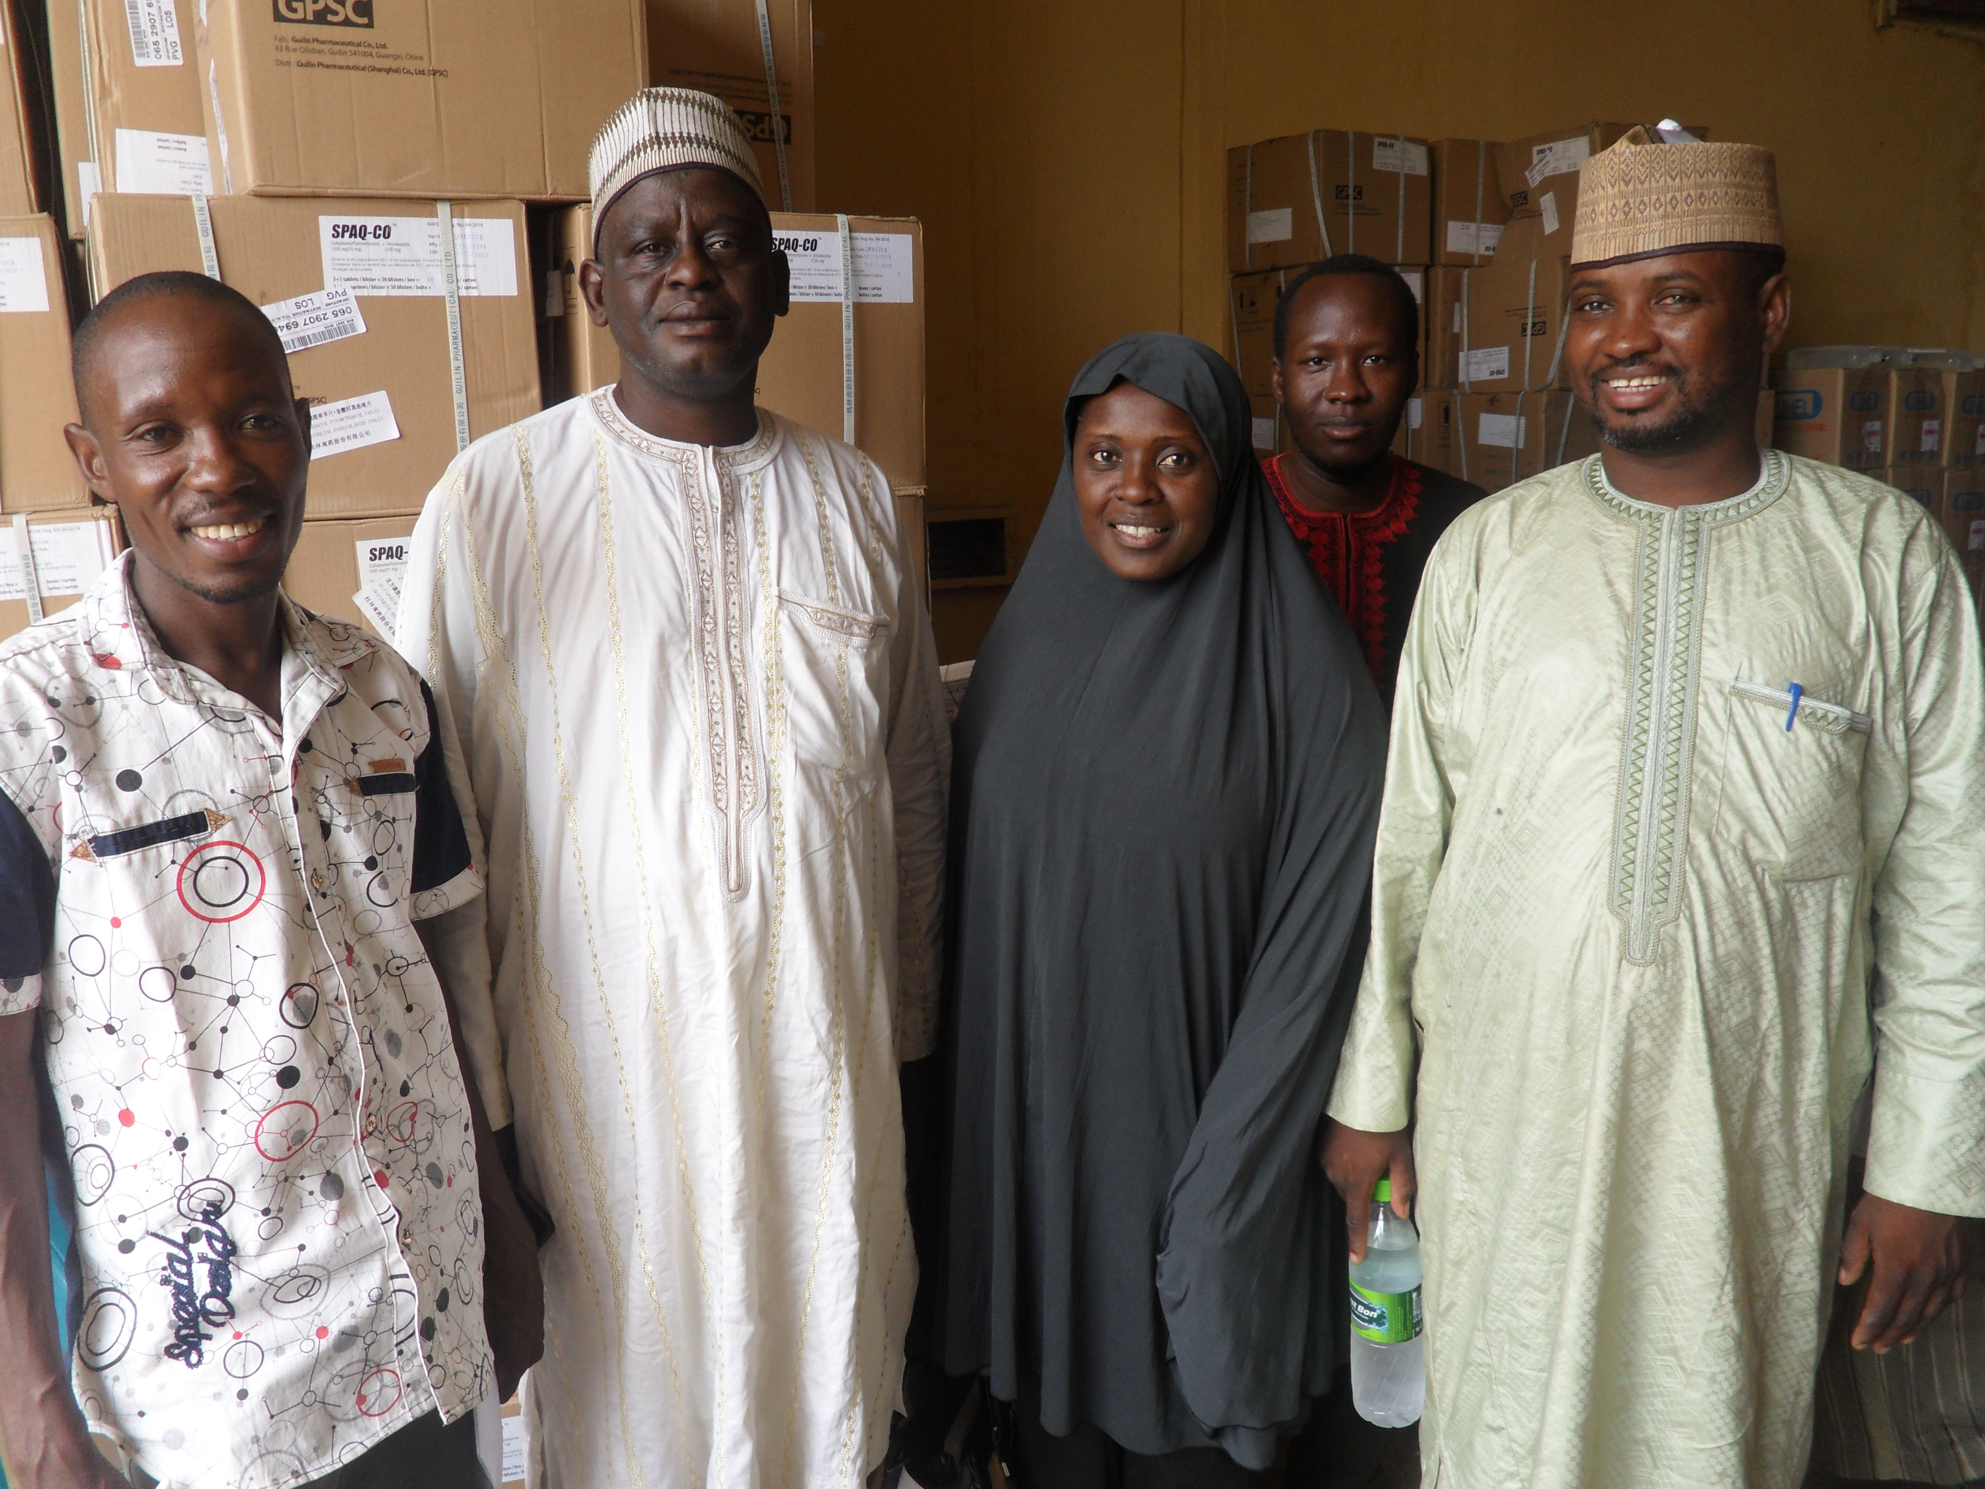
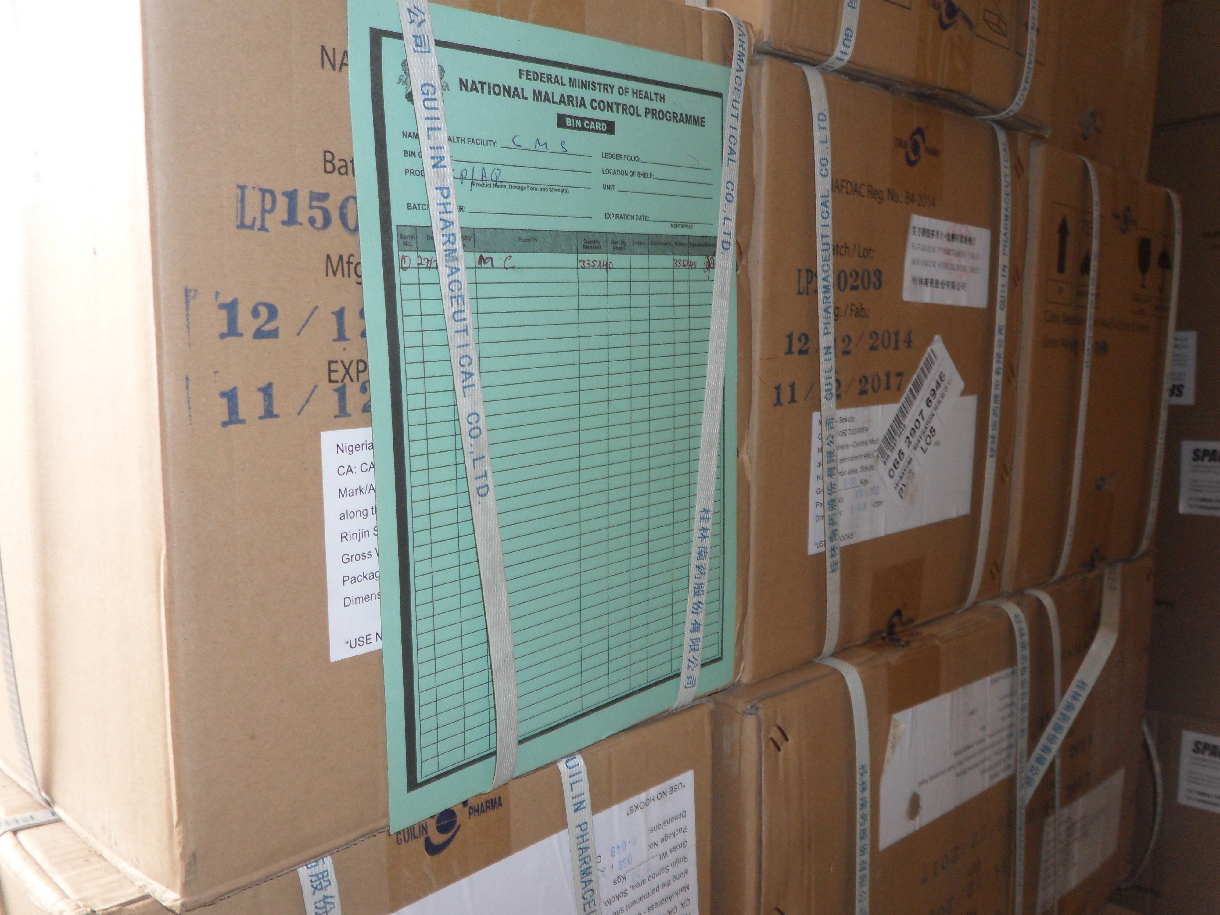
Thank You

Slide 16
