Slide 1
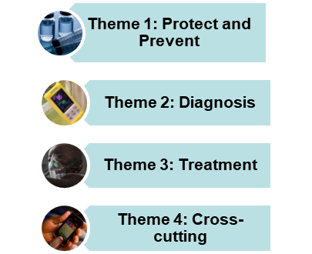
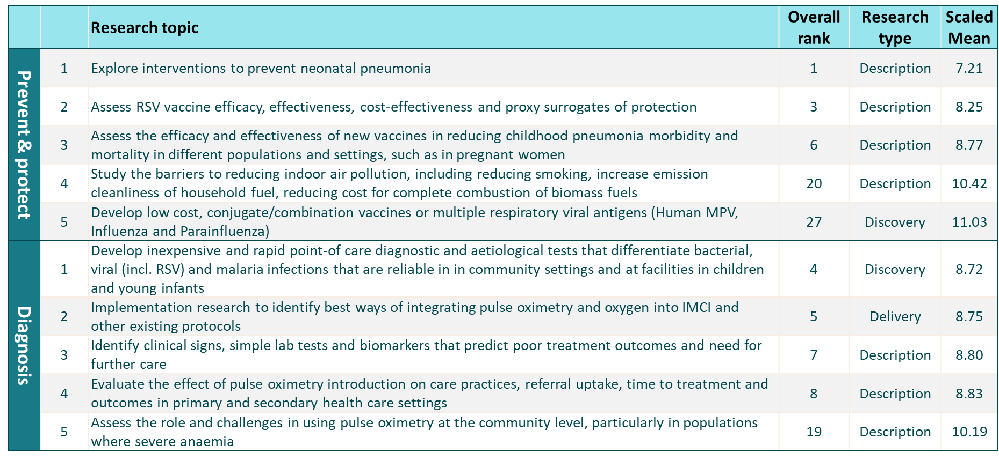
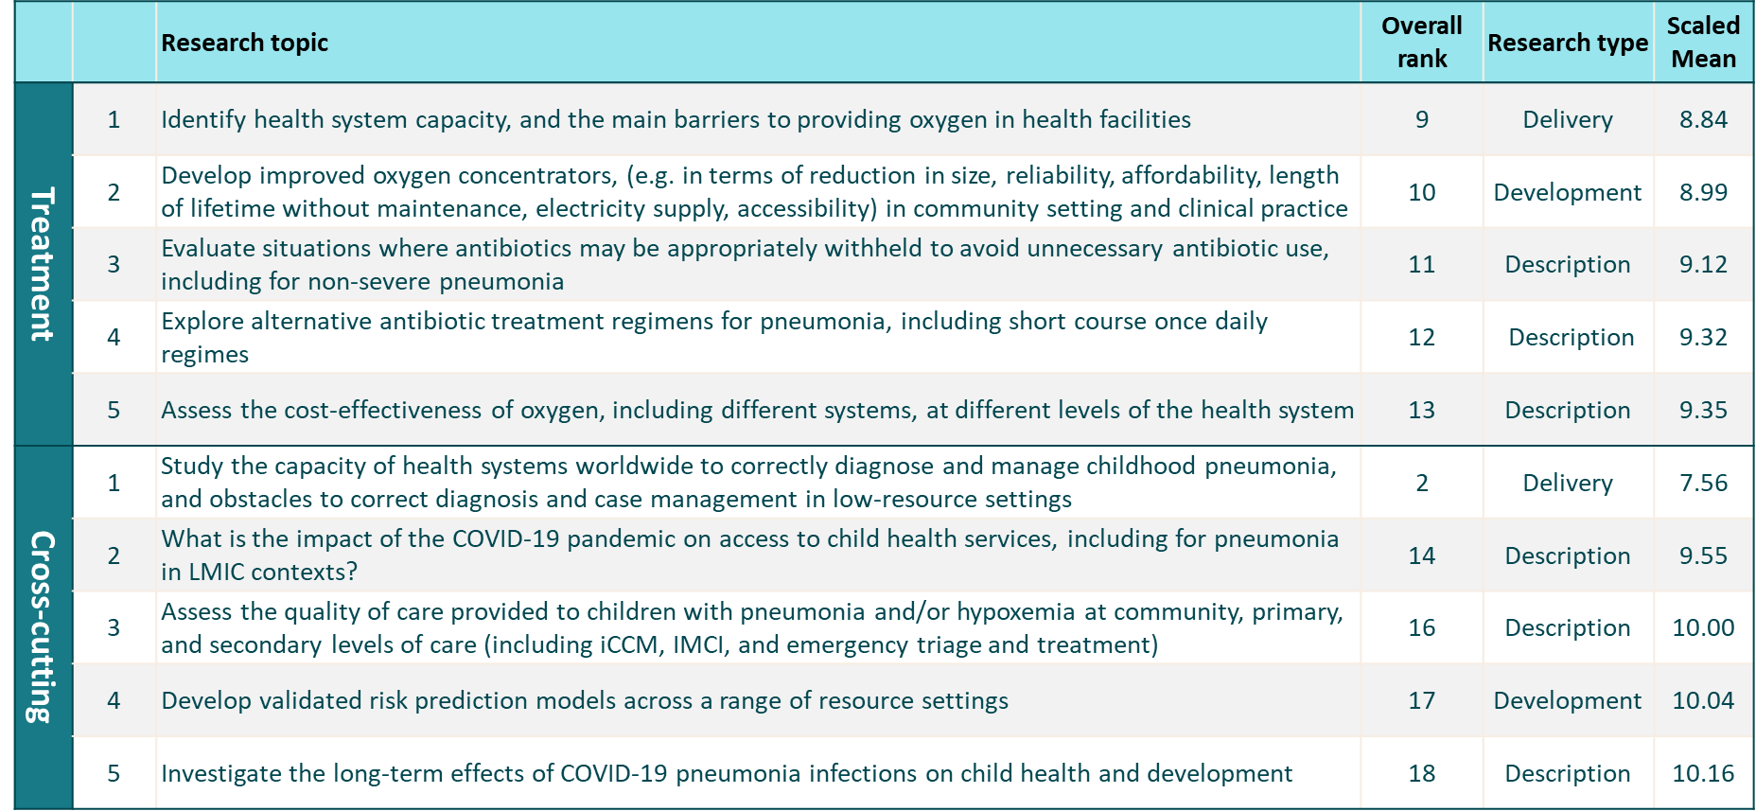
GLOBAL RESEARCH PRIORITY SETTING FOR CHILDHOOD PNEUMONIA: RESULTS FROM AN E-DELPHI STUDY Kevin Baker^{1,3},, Alexa Wharton-Smith¹, Sol Richarson¹, Carina King³
¹Malaria Consortium, UK; ³Karolinska Institute, Sweden
Introduction
Pneumonia is the leading infectious killer of children under-5, causing an estimated 700,000 deaths in 2019.
Continued lack of action and investment in pneumonia will prevent many countries from achieving the SDG 3 agenda goals by 2030, often pneumonia is the “missing piece” and major barrier to reducing child deaths.
The Every Breath Counts Research Group conducted a study to establish a research priority agenda for childhood pneumonia, with the aim of advocating for increased engagement from donors and key stakeholders working in high-burden countries.
Results
304 experts invited to take part (38% women & 43% from LMICs)
108 consented respondents, and 98 completed responses to Round 1
Methods
The e-Delphi method was used to consult over 300 childhood pneumonia experts through a multi-round online survey. Research topics, adapted from Rudan et al (2011), were categorized using the GAPPD framework into 4 themes (Figure 1):
Prevent and protect (vaccination, nutrition, air pollution, care-seeking)
Diagnosis (rapid diagnostic tests, pulse oximetry, respiratory rate counters, aetiology)
Treatment (antivirals, antibiotics, oxygen)
Crosscutting (epidemiology, policy, systems)
Experts could add new topics, including in relation COVID-19 and pneumonia. Experts were invited to participate, via email, based on their experience and/or publications on childhood pneumonia. A representative sample, in terms of country, gender and organisation, was sought. Project oversight is performed by a steering committee of eight content knowledge experts, led by the principal investigator.
Key messages
There is a continued lack of investment in pneumonia research
Pneumonia research priorities were last documented in 2011 (Rudan et al)
The final ranking exercise included 101 research themes
Engaging implementers from LMICs was a challenge.
Large differences in priorities between HIC and LMIC respondents
Focus on implementation and health systems research
COVID-19 specific research questions were not prioritised
Copyright © 2020 Kevin Baker k.baker@malariaconsortium.org

