Slide 1
Piloting Reveal for use in seasonal malaria chemoprevention in Nigeria
Olatunde Adesoro
2020 Annual Meeting of the American Society of Tropical Medicine & Hygiene

Slide 2
Overview
Seasonal malaria chemoprevention (SMC)
Implementing the pilot (usability testing)
The Reveal workflow in SMC
Preliminary coverage results and key findings

Slide 3
Seasonal malaria chemoprevention
Seasonal malaria chemoprevention (SMC) is the administration of full courses of anti-malaria medication in areas of highly seasonal malaria transmission.
It prevents malaria episodes by maintaining therapeutic antimalarial drug concentrations in the blood throughout the period of greatest malarial risk.
Typically, SMC is delivered door-to-door by community distributors (CDs) in four monthly cycles to children 3–59 months.
Typical four-cycle SMC treatment round

Slide 4
Implementing SMC in Nigeria
Malaria Consortium has been implementing SMC in Nigeria since 2013.
In 2020, we reached about 10 million children across 176 local government areas (LGAs) in seven states.
2020 implementation timelines:
Cycle 1: July
Cycle 2: August
Cycle 3: September
Cycle 4: October.

Slide 5
Accurate coverage data and tracking
Some of the challenges of SMC implementation include:
Inaccurate target population estimates for planning
Difficulties in coordinating CDs’ field movements
Inaccurate and untimely coverage data as a result of error arising from paper-based data management.
This leads to inaccurate information on programme coverage, which is essential for maximising effectiveness and ensuring accountability.
Digitisation of SMC data management via the Reveal platform (a geospatial web-based application) is expected to improve data accuracy and optimise intervention coverage.
Spatial mapping to determine the location and number of the target population
Efficient, real-time monitoring of CDs and tracking of coverage
Easy retrieval of electronic data and visuals that will provide accurate intervention coverage information.

Slide 6
Introducing Reveal into SMC implementation
Assessment and development
Stakeholder engagement
Scoping exercise
Validation workshop
Enumeration exercise
In-field testing.
Usability testing
Remote training of trainers
Face-to-face health facility and CD training
Implementation in two health facilities
Easy-to-reach
Hard-to-reach
Trialled on two types of devices (Samsung, Tecno)
Pilot study
Operational research
1
2

Slide 7
Usability study
Aim: Gather evidence about the usefulness, efficiency and learnability of the Reveal platform to different types of users.
Location: One easy-to-reach and one hard-to-reach health facility in Goronyo LGA, Sokoto state.
Design: Mixed-methods.
Objectives:
To understand whether the Reveal platform supports users to complete their specified tasks.
To document the efficiency of task completion using the Reveal mobile client.
To document users’ competency with the Reveal platform immediately after training and after use.
Methods: Focus group discussions, system usability score, think-aloud methodology, extraction and analysis of back-end data.
Timescale: September–November 2020.
Ethical approval: Sokoto state.
Notes:
“Usability” has been identified as a key component of good practice in the development of digital applications (1). The International Organization for Standardization has defined usability as, “the extent to which a product can be used by specified users to achieve specified goals with effectiveness, efficiency and satisfaction in a specified context of use”(2).

Slide 8
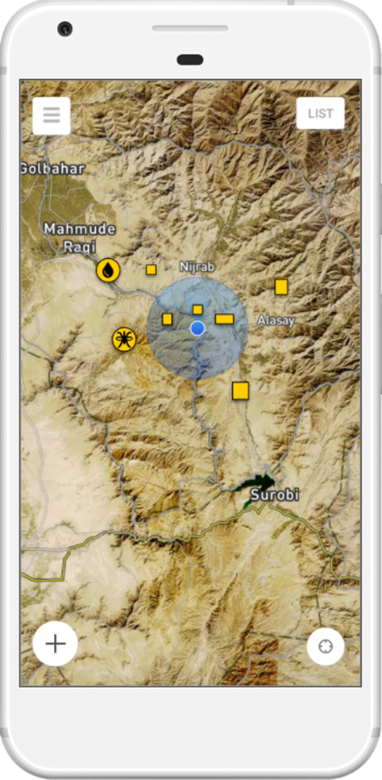
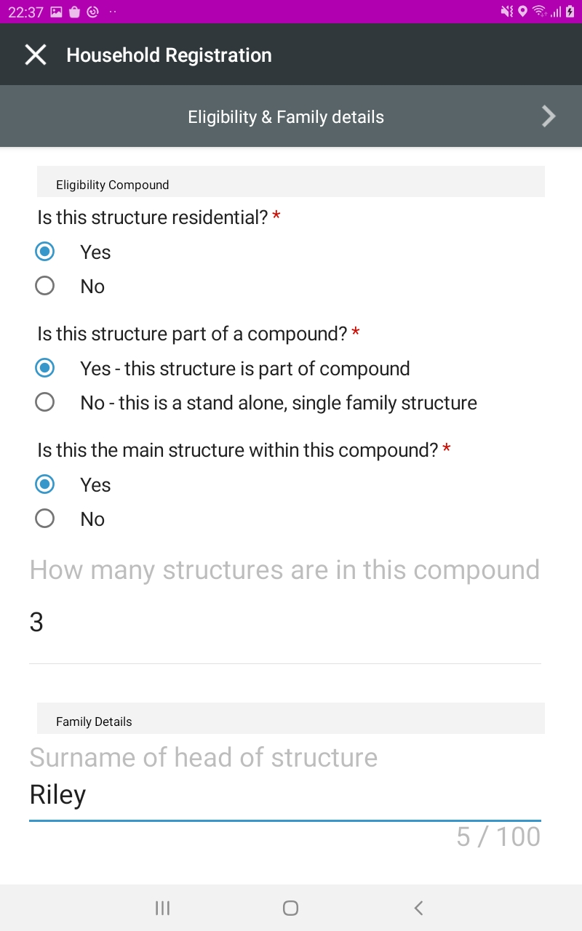
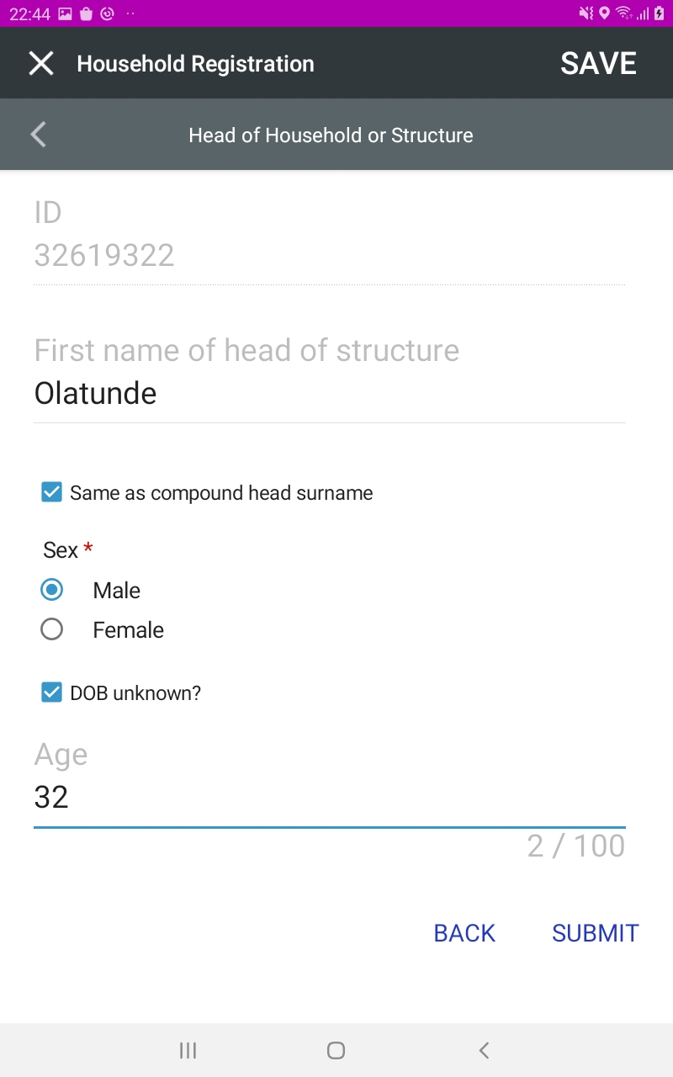
Reveal workflow
Enumeration and mapping: Building structures are identified on satellite maps in SMC distribution areas and loaded onto the Reveal app on the tablets. All structures appear in yellow.
Registration: CDs visit and select a yellow structure, register the structure (as residential/other) and, if residential, register families and children.
CDs can only register structures if they’re nearby.
New structures can be added.
Complete tasks: SMC delivery, re-dosing, referral as applicable for available eligible children.
Complete documentation: Colour of structures changes as visits and distribution progress (see key on next slide).

Slide 9
Monitor and respond: Supervisors monitor through spatial images and the mobile dashboard and respond accordingly.
Blue: operational area and user (i.e. CD)
Yellow: structure not visited
Red: structure visited, no SMC distributed
Purple: structure visited, SMC partially distributed
Green: structure visited, SMC fully distributed
Black: ineligible (not a residential structure).
Response: Options include:
Planning for next visits
Planning to mop-up yellow structures
Planning to revisit purple structures.
Drug reconciliation: Morning and evening.

Slide 10
Monitoring indicators: Mobile/web dashboards
# total structures
# structures visited
# structures not visited
# structures confirmed eligible
# structures complete drug distribution
# structures partial drug distribution
# children eligible (3–59 months)
# children treated
Visitation coverage percentage: # structures found/# total
Distribution coverage percentage: # structures distributed/# total
Structure distribution effectiveness percentage: # structures distributed/# found
Children coverage: # children treated/# eligible

Slide 11
Preliminary findings
Accurate data generated for eligible children.
Electronic distribution route plan.
Easy monitoring and supervision.
Verifiable complete coverage of structures.
Coverage 15 percent higher than previous cycle.
Instructional job aid as part of platform.
Unique child identifier for treatment history tracking.
Untreated children and reason.
Dropout rates.
Easy drug reconciliation.

Slide 12
Challenges
COVID-19 pandemic prevented implementation and technical teams from working together in person.
All training, app development and set-up were undertaken remotely, at times beyond stipulated periods.
Technical hiccups characteristic of new system development and set-ups (e.g. data synchronisation, up/downloads etc.).
Internet connectivity issues in the field.
Security, flooding and bad terrain.

Slide 13
Next steps
Continue usability testing in cycle 4 (October) and assessment (November).
Scale up use of Reveal to all operational areas in Goronyo LGA in 2021 SMC implementation.
Conduct implementation research in 2021 to explore the effect of Reveal on the quality of SMC implementation and accuracy of coverage data.
Expected outcomes of the usability testing, introduction, and implementation research:
Guide decision-making around the future use of Reveal in the SMC programme in Nigeria.
Inform the global malaria control community on the utility of Reveal for SMC.

Slide 14
This usability testing was implemented by Malaria Consortium with technical support from Akros and in collaboration with the National and Sokoto State Malaria Elimination Programmes. Funding was provided from Malaria Consortium’s philanthropic funding for SMC.

