Slide 1
An ecological analysis exploring the impact of seasonal malaria chemoprevention in Burkina Faso using national household surveys (2010–2017)
Monica Anna de Cola, Results Measurement Analyst
2020 Annual Meeting of the American Society of Tropical Medicine & Hygiene
Notes:
Hello, my name is Monica de Cola and I am the Results Measurement Analyst at Malaria Consortium. I am presenting an ecological analysis exploring the impact of seasonal malaria chemoprevention in Burkina Faso using national household survey data from 2010-2017

Slide 2
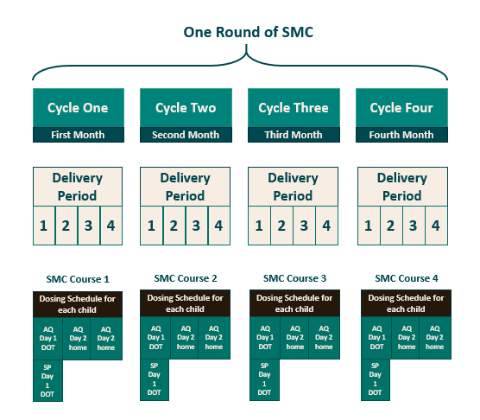
Background
Seasonal malaria chemoprevention (SMC) is the administration of full courses of anti-malaria medication in areas of highly seasonal malaria transmission
sulfadioxine-pyrimethamine and amodiaquine (SPAQ) is administered to children 3–59 months at monthly intervals during the peak transmission season.
Goal: to prevent malaria episodes by maintaining therapeutic drug concentrations in the blood during the highest malaria risk period.
Typical four-cycle SMC treatment round
Notes:
In 2012, the World Health Organization (WHO) issued a policy recommendation for the use of seasonal malaria chemoprevention (SMC) in areas of highly seasonal malaria transmission across the Sahel sub-regions of Africa. The intervention involves the administration of a full treatment course of sulfadioxine-pyrimethamine and amodiaquine (SPAQ) to children 3 to 59 months at four monthly intervals starting at the beginning of the transmission season. The goal is to prevent malaria episodes by maintaining therapeutic drug concentrations in the blood during the highest malaria risk period.

Slide 3
SMC in Burkina Faso
One of the 11 highest malaria burden countries, with an estimated incidence of 398.7 per 1,000 population at risk¹.
Malaria is highly seasonal, with a peak coinciding with the rainy season (Jul–Oct).
The health system is comprised of three levels. The lowest is divided into 70 districts, that are responsible for policy implementation and data reporting.
SMC was introduced in 2014 in seven districts. SMC was then gradually scaled up, reaching all 70 health districts in 2019.
1. WHO, 2020. World Health Statistics 2020: Monitoring Health for the SDGs. Geneva, Switzerland: World Health Organization
Map of health districts by year of introduction
Notes:
Burkina Faso is one of the countries with highest malaria burden. Most of the malaria cases and deaths occur during or directly after the rainy season, which takes place from July to October. Burkina Faso introduced seasonal malaria chemoprevention (SMC) as a control measure in 2014. The intervention was introduced in a phased approach starting with seven health districts in 2014 and was then gradually scaled up, reaching all 70 health districts in 2019.

Slide 4
Effectiveness of SMC
Delivery
Clinical trials indicate SMC prevents up to 75 percent of uncomplicated and severe cases if implemented to quality standards with acceptable levels of resistance.
Supply, training, administration
Coverage
Reach, adherence, and acceptability
Efficacy
Drug resistance and timing
Impact
Reduction in morbidity
Logic model for effectiveness of SMC
Notes:
SMC is safe and effective . Based on results from 7 Randomized Controlled Trials using SPAQ for up to 4 months during the high transmission season, SMC is expected to prevent up to 75% of uncomplicated and severe malaria cases in children under 5. if SMC is delivered to a high quality standard we can expect to reach a certain level of coverage. If there is high coverage in an area with an acceptable level of resistance we can expect to see impact (reduction in malaria)

Slide 5
Measuring impact
Methods of measuring impact
Randomised controlled trials
Establish causality and may not be required or ethical in settings where efficacy has been demonstrated.
Quasi-experimental
Most often used and feasible as they take advantage of programme uptake; may still introduce bias at the group level.
Observational
Must use various methods for counterfactual; introduces bias.
Triangulation
Impact analysis with multiple data sources and methods strengthen the evidence base, establish causality and address biases in quasi-experimental studies and routine data sources.
Notes:
Impact of Public health interventions are evaluated in three main ways each requiring a counterfactual.
First, through randomized control trials, these are often used to establish causality of a new intervention. They may not be required or considered ethical once efficacy is demonstrated. They also may not be feasible in real life settings where the program has not been implemented at random.
The most often used and feasible approach is through Quasi-experimental methods. These are most feasible once the program uptake has started and can take advantage of a phased approach for the counterfactual. However, bias may still be introduced at the group level.
Finally, observational methods are often easy to implement and various methods are used for obtaining a counterfactual, however, there is often bias in these studies.
These three methods all have strengths and limitations. They may provide varying estimates, which may be due to variability in programmatic implementation or it may be due to measurement factors. However, Impact analysis with multiple data sources and methods strengthen the evidence base establishing causality and address biases in quasi-experimental studies and routine data sources.
Evidence of impact of SMC implemented at scale and outside of controlled settings is still limited. Conducting research studies, controlled and observational, to investigate effectiveness at scale over the long term is not sustainable. SMC programmes implemented at scale using routine or administrative data has not shown the expected impact in comparison to experimental settings. Therefore, triangulating data coming from routine and administrative sources with alternate sources adds to the evidence base and strengthens the plausibility of impact of SMC.

Slide 6
Study objective and design
Objective: To investigate if the effect of SMC can be observed in household data collected through the Demographic and Health Surveys (DHS) Programme, and to add to the evidence base of impact of SMC when implemented programmatically at scale
Design: Ecological secondary analysis
Setting: Burkina Faso
Timeframe: Apr 2010–Jan 2011; Sep–Dec 2014; Nov 2017–Mar 2018
Primary outcomes: Odds of having malaria in an SMC district compared to an non-SMC district in children under five, as diagnosed by rapid diagnostic test (RDT) and microscopy
Notes:
The objective of this analysis was to investigate whether the effect of SMC can be observed in household data that has been collected through the Demographic and health Surveys programme. This would add to the evidence base of impact of SMC.
It is an ecological analysis in Burkina Faso using surveys that spanned across April 2010 to January 2011. September 2014 to December 2014 and November 2017 to March 2018. The primary outcome we were looking at was the Odds of having malaria in an SMC district compared to an non-SMC district in children under five, as diagnosed by rapid diagnostic test (RDT) and microscopy

Slide 7
Data sources
DHS: Nationally-representative household surveys collect data on population, health, and nutrition. These include a subset of children 6–59 months tested for malaria via an RDT (detects HRP-2 antigen) and microscopy.
Malaria Indicator Survey (MIS): Stand-alone, smaller scale DHS household surveys collect data on standardised malaria indicators; usually occurs during the high transmission season; includes a subset of children 6–59 months tested for malaria via an RDT (detects HRP-2 antigen) and microscopy.
Rainfall: Total millimetres of rainfall at that cluster for the month before the blood sample was taken using the inverse distance squared method.
Geospatial data: Overlaid spatial data with DHS/MIS cluster location to determine the health district.
SMC programme data: SMC indicators not yet included in the DHS/MIS; programme data was used to identify districts that received SMC
Notes:
To do this analysis we used data from multiple sources.
The first was the Demographic Health Survey. These surveys collect data for indicators on population, health, and nutrition. The last standard DHS survey in Burkina Faso was conducted in 2010 before SMC was introduced in any health districts and serves as baseline for this analysis.
Malaria Indicator Surveys (MIS) are stand-a-lone DHS household surveys that collect information on standardized malaria indicators. The most recent surveys conducted in Burkina Faso were in 2014 and 2017 when SMC was being introduced into the country in a phased approach. Both of these surveys include a subset of children 6-59 months tested for malaria by an RDT and microscopy.
Rainfall was included in the analysis by calculating the total mm of rainfall at that cluster for the month before the blood sample was taken
The DHS and MIS surveys only report data that are representative at the provincial level in Burkina Faso. The GPS coordinates of the clusters from the MIS were overlaid with spatial data to determine which health districts the MIS clusters were located in using QGIS V.3.4.1
SMC indicators are not yet included in the DHS/MIS so programme data was used to identify districts that received SMC

Slide 8
Statistical methods
A multilevel generalised additive model for binary outcomes (case vs no case) with a logit link function with random intercepts for health district
Adjusted by SMC status, year (2014, 2017, 2018), age, sex, use of a net the night before, wealth quintile, residence (urban vs rural), rain, and baseline prevalence (calculated from the 2010 survey before SMC was introduced).
Notes:
We used a multilevel generalised additive model for binary outcomes (case vs no case) with a logit link function. A cubic spline was used to account for seasonal factors beyond rainfall using the mgcv package in R. District was included as a random effects variable to account for clustering at the district level for health interventions as well as transmission intensity.
SMC was included as a variable as SMC in that district during SMC distribution.
The analysis was adjusted by year (2014, 2017, 2018), age, sex, use of a net the night before, wealth quintile, residence (urban vs rural), rain, and baseline prevalence (calculated from the 2010 survey before SMC was introduced).
District level
For this analysis we looked at the data at two different levels.
First we looked at the data at the district level to analyse overall trends in prevalence, rainfall, and malaria intervention coverage through the standard Roll Back Malaria Coverage indicators. This gave us better insight into what adjustments and considerations needed to be accounted for.
Trends in malaria prevalence, rainfall, and malaria intervention coverage analysed to better understand the context and to provide insight into the adjustments/considerations that need to be made/taken into account for the individual level analysis
Malaria prevalence indicator: percentage of children 6–59 months classified as having malaria according to an RDT or microscopy amongst those tested
Confounding was identified by a considerable change in the estimate of the odds ratio (OR) when the variable was added to the model. Collinearity was identified by a considerable change in the log standard errors when the variable was added to the model.
Boxtidwell transformation was to test for linearity of continuous variables.

Slide 9
Results
SMC Protective Period
2017/18 MIS
2014 MIS
Data from 16,723 children were included in the analysis.
GPS location for some clusters were not recorded (6.06 percent).
Survey timing compared to rainy season and SMC protective period:
2010 DHS survey is a much larger survey and took place over a longer period (Apr 2010 – Jan 2011).
2017 MIS started late and had disruptions (Nov 2017 – Mar 2018).
2010 DHS
Survey data collection timing compared to rainy season
Stratum specific characteristics and percent of malaria in children 6-59 months
Variable | Category | n (%) | Malaria (%)
SMC | No | 10,380 (94.46) | 4,623 (44.54)
 | Yes | 609 (5.54) | 258 (42.36)
Year | 2010 | 5,734 (34.29) | 4,269 (74.45)
 | 2014 | 5,936 (35.50) | 3,842 (64.72)
 | 2017/18 | 5,053 (30.22) | 1,039 (20.56)
Notes:
Overall, data from 16,723 children were included in this analysis. GPS from some clusters were not recorded and therefore excluded from the analysis as we could not determine if they were in a district with SMC or match on rainfall.
Malaria in Burkina Faso is highly seasonal and SMC is time dependent, therefore understanding the timing of these surveys in relation to the year is important, especially when analysing the overall trends in prevalence across the three survey years. The top figure illustrates the time of data collection compared to the SMC protective period and high malaria transmission season.
The 2010 DHS survey took place over a longer period spanning from April 2010 to January 2011. There was no SMC distribution during this time period.
The 2014 survey mostly took place during the high transmission season as indicated by the green square. However, in 2014 only 7 districts had SMC distribution.
The 2017 survey started late and had some logistical disruptions so it took place from November 2017 to March 2018. By this year 63 districts had introduced SMC, however the survey mostly took place after the SMC protective period.
The table at the bottom shows the stratum specific characteristics of the survey. Due to the timings of the surveys only 609 children in the data set were allocated to the SMC group. And as you can see, the percentage of children who tested positive for malaria dropped drastically by the 2017 survey, which may also be due to the timing. In 2010 74.45% of children surveyed had malaria, 64.72 percent in 2014 and 20.56 percent in 2017/18.

Slide 10
Results
Adjusted odds ratios for malaria in children 6-59 months in Burkina Faso
Variable | Category | Fully Adjusted OR | Wald P-Value
SMC | No | 1.00 (base)
 | Yes | 0.44 (0.32–0.61) | <0.001
Year | 2014 | 1.00 (base)
 | 2017 | 0.52 (0.31–0.86) | <0.001
 | 2018 | 0.39 (0.23–0.66) | <0.001
Age | 6–11 months | 1.00 (base)
 | 12–23 months | 1.41 (1.18–1.69) | <0.001
 | 24–35 months | 2.03 (1.70–2.42) | <0.001
 | 36–47 months | 2.33 (1.96–2.77) | <0.001
 | 48–59 months | 2.29 (1.92–2.73) | <0.001
Sex | Female | 1.00 (base)
 | Male | 0.96 (0.88–1.05) | 0.85
Net Use | No | 1.00 (base)
 | Yes | 0.92 (0.84–1.02) | 0.05
Wealth | Poorest | 1.00 (base)
 | Poor | 0.93 (0.81–1.06) | 0.37
 | Middle | 0.81 (0.70–0.93) | 0.04
 | Richer | 0.70 (0.60–0.81) | <0.001
 | Richest | 0.36 (0.28–0.47) | <0.001
Residence | Rural | 1.00 (base)
 | Urban | 0.40 (0.33–0.49) | <0.001
Malaria diagnosis by microscopy:
Odds ratio: 0.44, 95% CI 0.32–0.61, p<0.001
Malaria diagnosis by RDT:
Odds ratio 0.38, 95% CI 0.28–0.50, p<0.001
Notes:
After adjustment for co-variables, there remained very strong evidence of an association between living in a district with SMC and malaria as diagnosed by microscopy (p<0.001). Children living in a district with SMC distribution had lower odds of a malaria compared to those living in a district without SMC with an estimated Odds Ratio of 0.44, 95% CI 0.32-0.61, EDF=1.36).
Similar results were seen with RDT confirmed malaria (Odds Ratio 0.38, 95% CI 0.28-0.50, EDF=1.65)
Given the magnitude observed. these findings adds evidence for the plausibility of impact of SMC. Although there are still biases in the analysis, DHS surveys and MIS surveys can be used for similar analyses or even for obtaining information on context and co-variables for other analyses. These results also can be triangulated with other data sources.

Slide 11
Discussion
Limitations
SMC exposure was implied at the population level.
Displacement of GPS locations of clusters may result in children being assigned an alternate SMC status.
HRP-2 RDTs can show a positive result for malaria four to five weeks after clearance of the parasite.
Transmission intensity and other interventions was accounted for by random effects grouped at the district level.
Next Steps
Include other co-variables such SMC programme indicators and temperature.
Assess for decaying effect after SMC protective period.
Triangulate with routine data.
Notes:
In terms of the limitations of the analysis: With all ecological analyses, exposure was implied at the population level so we can not be certain that the children we assigned with an SMC status actually received SMC. Additionally, the DHS program displaces GPS coordinates for anonymity this may result in children being assigned an alternate SMC status if the cluster is located close to a district border.
It’s also important to note that HRP-2 RDTs can show a positive result for malaria four to five weeks after clearance of the parasite when interpreting the results for the RDT.
Finally, Transmission intensity and other interventions was accounted for by random effects grouped at the district level.
Next Steps for the analysis are to Include other co-variables such SMC programme indicators and temperature, assess for a decaying effect after the SMC protective period, and triangulate these findings with routinely collected data

Slide 12
Acknowledgements
Co-authors: Benoit Sawadogo¹, Sol Richardson², Christian Rassi², Arantxa Roca-Feltrer²
¹Malaria Consortium Burkina Faso
²Malaria Consortium
Thanks to the Demographic and Health Surveys Program; the Burkina Faso Meteorological Agency; the Burkina Faso Mapping Institute; Lucy Okell and Patrick Walker at Imperial College London

Slide 13
Malaria | 2010 |  | 2014 |  | 2017
 | No SMC | SMC | No SMC | SMC | No SMC | SMC
Negative | 1465 (25.6%) | -- | 1743 (32.7%) | 351 (57.6%) | 4014 (79.4%) | --
Positive | 4269 (74.5%) | -- | 3584 (67.3%) | 258 (42.4%) | 1039 (20.6%) | --
Total | 5,734 (100.00%) | -- | 5,327 (100.00%) | 609 | 5053 | --
Variable | Category | n (%) | Malaria (%)
SMC | No | 10,380.00 (94.46) | 4,623.00 (44.54)
 | Yes | 609.00 (5.54) | 258.00 (42.36)
Year | 2010 | 5734 (34.29) | 4269 (74.45)
 | 2,014 | 5,936.00 (35.50) | 3,842.00 (64.72)
 | 2,017 | 5053 (30.22) | 1039 (54.72)
Year | No SMC n (%) | SMC n (%)
2010 | 5734 (100.00) | 0 (0.00)
2014 | 5327 (89.74) | 609 (10.26)
2017 | 5053 (100.00) | 0 (0.00)

Slide 14
Results
SMC protective period
Data from 16,723 children were included in the analysis.
GPS location for some clusters were not recorded and therefore excluded from the analysis (6.06 percent).
2010 DHS survey is a much larger survey and took place over a longer period (Apr 2010 – Jan 2011).
2017 MIS started late and had disruptions (Nov 2017 – Mar 2018).
SMC protective period
Number of participants per month, by survey year
Notes:
Overall, data from 16,723 children were included in this analysis. GPS from some clusters were not recorded and therefore excluded from the analysis as we could not determine if they were in a district with SMC or match on rainfall.
The 2010 DHS survey took place over a longer period spanning from April 2010 to January 2011. This time period did not have SMC distribution.
The 2014 survey took place during the rainy season as indicated by the blue square. However, in 2014 only 7 districts had SMC distribution.
The 2017 survey started late and had some logistical disruptions so it took place from November 2017 to March 2018. Although, by this year 63 districts had introduced SMC, the survey took place after the SMC protective period.
As malaria in Burkina Faso is highly seasonal and SMC is time dependent, understanding the timing of these surveys in relation to the year is important, especially when analysing the overall trends in prevalence across the three survey years.

Slide 15
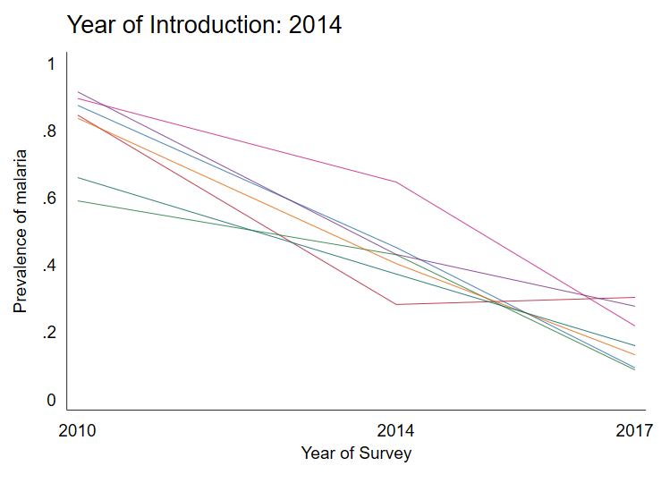
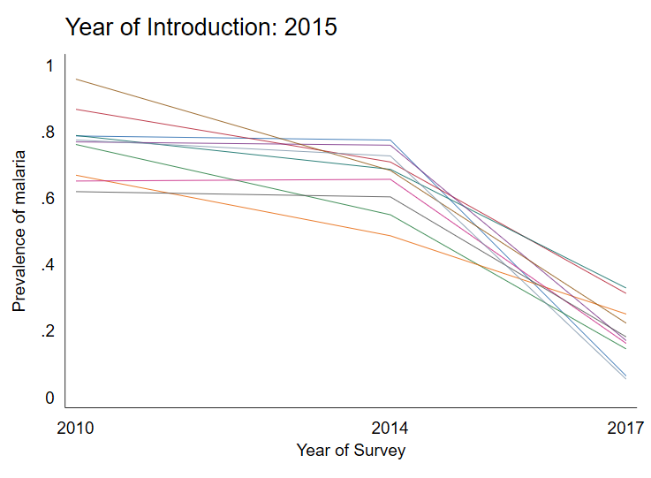
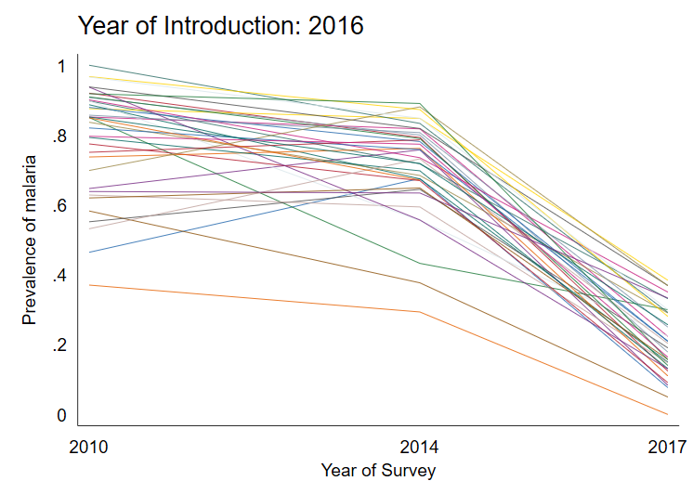
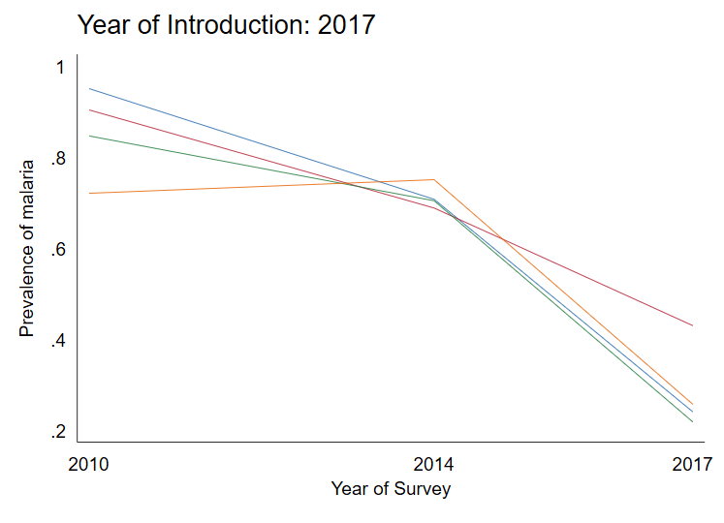
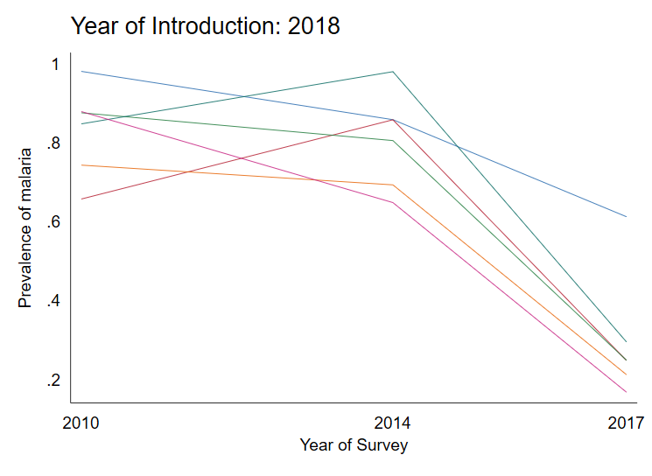
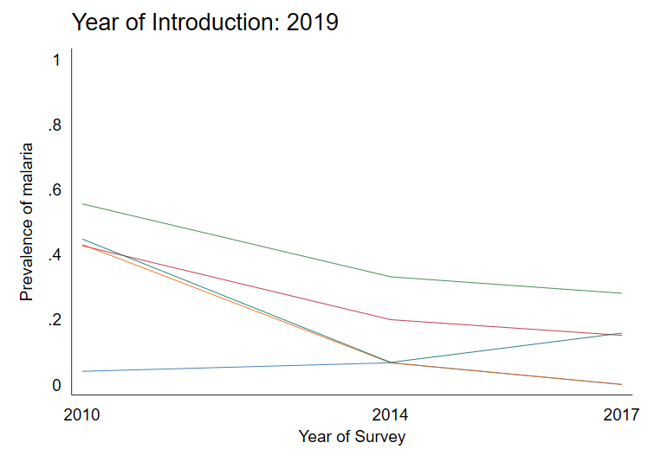
Prevalence of malaria in districts that introduced SMC by year of introduction
Red line indicates time of SMC introduction in relation to surveys
*no SMC
*no SMC
Notes:
I am presenting the overall change in prevalence of malaria in districts over the three survey years (2010, 2014, and 2017/18) by the year of introduction in that district. So these are the prevalence calculated at the three survey time points, they are connected by lines to show the direction of change across the years. The red line indicates the time that SMC was introduced in the districts in relation to those surveys.
Overall you can see there is a downward trend in malaria prevalence. This is likely due to the 2017 survey taking place just after the rainy season.
The districts that introduced in 2018 and 2019 did not have SMC distribution at all during the survey times. The districts that introduced in 2019 were the urban Ouaga districts that had lower prevalence across the survey years in comparison to the other districts
The first graph shows the district that introduced SMC in 2014. In 2010 there was no SMC, in 2014 at the time of the survey these 7 districts had SMC and there was a noticeable drop in prevalence compared to the other districts which introduced SMC in variable years after the 2014 survey.

