Slide 1
Scaling up access to seasonal malaria chemoprevention in the Sahel ACCESS-SMC
Diego Moroso
April 17, 2018

Slide 2
Seasonal malaria chemoprevention (SMC)
Intermittent administration of full treatment courses of antimalarial
medicines to children under 5 in areas of highly seasonal transmission
malaria transmission / bulk of clinical malaria cases (> 60%) concentrated within high transmission season / short rainy season (~4 months)
clinical attack rate > 0.1 attacks / child / transmission season
sulfadoxine-pyrimethamine plus amodiaquine SP+AQ (if efficacious)

Slide 3
Evolution of SMC
2008-2011
2012
2012-2014
Since 2015
Clinical trials
Effectiveness studies
Evidence review
(WHO, LSHTM, Malaria Consortium, UCAD, CHAI)
WHO SMC guidelines
Policy adoption in-country
Small-scale implementation
(MSF, PMI, CHAI, Malaria Consortium, CRS )
Scale-up:
Unitaid/ACCESS-SMC (2015)
World Bank (2016)
PMI & Global Fund (2017) onwards

Slide 4
Evolution of SMC
Countries | SMC policy adoption (year) | SMC adoption in the strategic plan | SMC first implementation
Burkina Faso | 2013 | 2013 | 2014
Cameroon | 2013 | 2013 | 2016
Chad | 2013 | 2014 | 2013
Ghana | 2013 | 2014 | 2015
Guinea | 2013 | 2013 | 2015
Guinea Bissau | 2015 | 2016 | 2016
Mali | 2013 | 2013 | 2012
Niger | 2013 | 2014 | 2012
Nigeria | 2013 | 2013 | 2013
The Gambia | 2013 | 2013 | 2014
Togo | 2013 | 2013 | 2013
Senegal | 2013 | 2013 | 2013

Slide 5
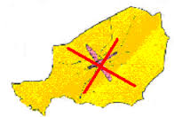

Slide 6
Strategic intent
Influence the market
Demonstrate feasibility, safety and effectiveness at scale

Slide 7
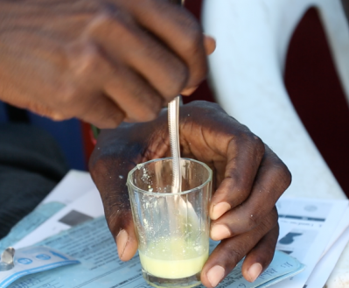
Market evolution
Limited funding and reliable institutional demand
No co-blistered SP+AQ up to 2013
API bottlenecks: no PQed API for sulfadoxine (2015) or pyrimethamine (2017)
Limited API sourcing and production capacity
(-> capped 2015 output)
One QA-approved manufacturer
(-> insufficient capacity)
Inadequate formulation
(-> hard tablets, bitter taste)

Slide 8
Shaping the market
SMC market trends (2014 – 2017)

Slide 9
Shaping the market
SMC market trends (2014 – 2017)

Slide 10
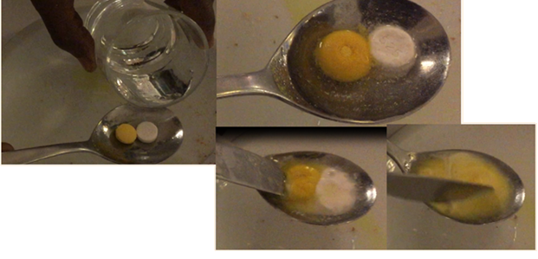
Shaping the market
Supported the introduction of child-friendly, dispersible SP+AQ
Administrative support (registration, packaging)
Advocating for accelerated ERP process
By 2017, all orders were dispersible
Support to additional manufacturers
Expected Spring 2019

Slide 11
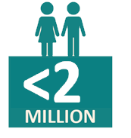
Scale-up of SMC
Expand SMC coverage and
overcome barriers to access
2014

Slide 12
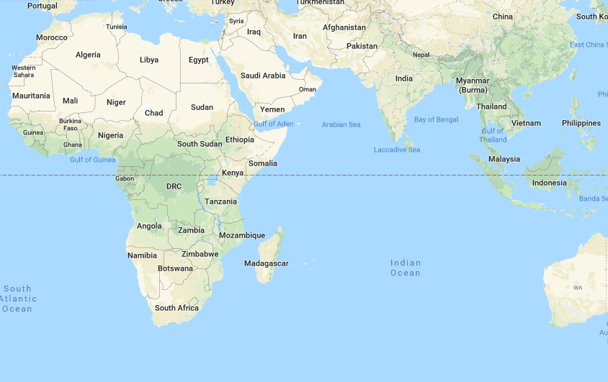
Scale-up of SMC

Slide 13
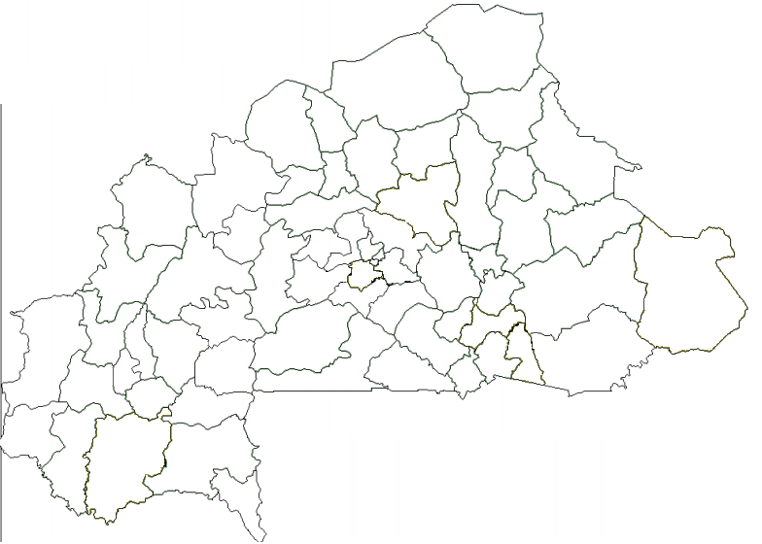
Strategic intent

Slide 14
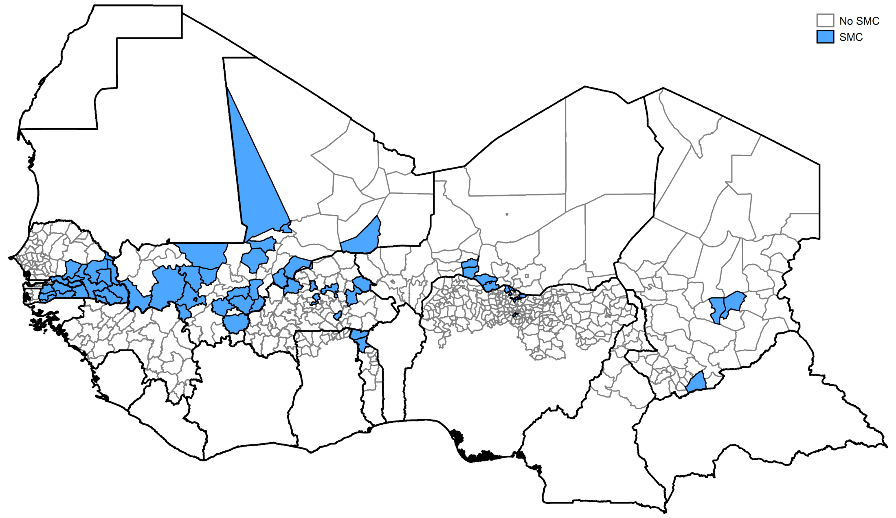
Scale-up of SMC
2014

Slide 15
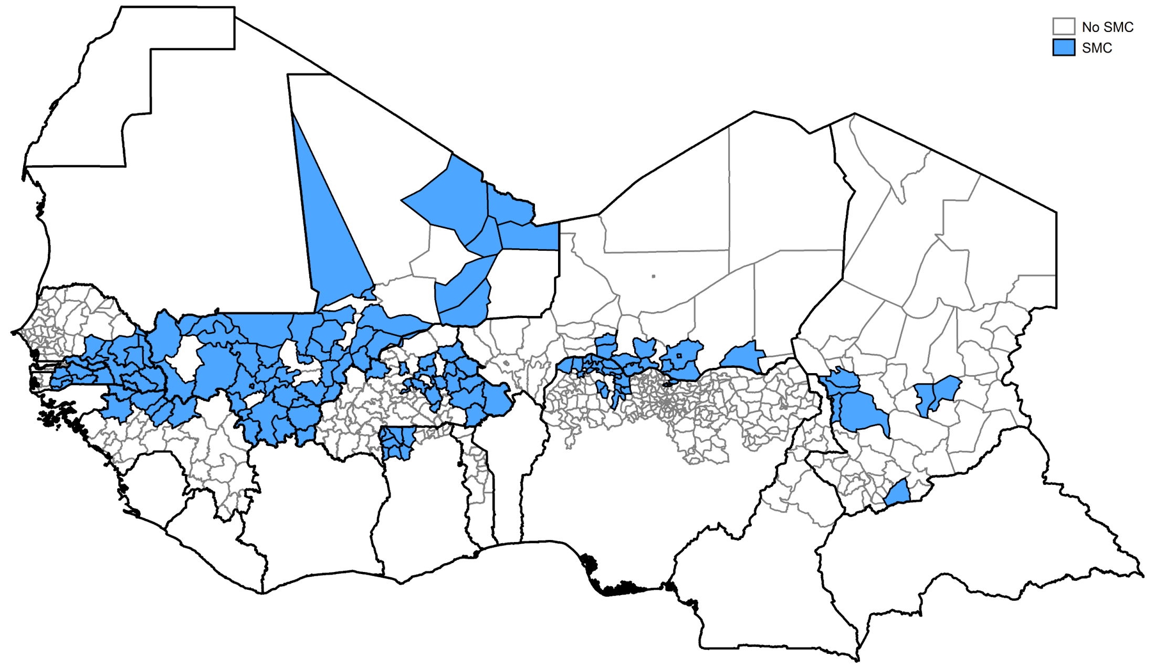
Scale-up of SMC
2015

Slide 16
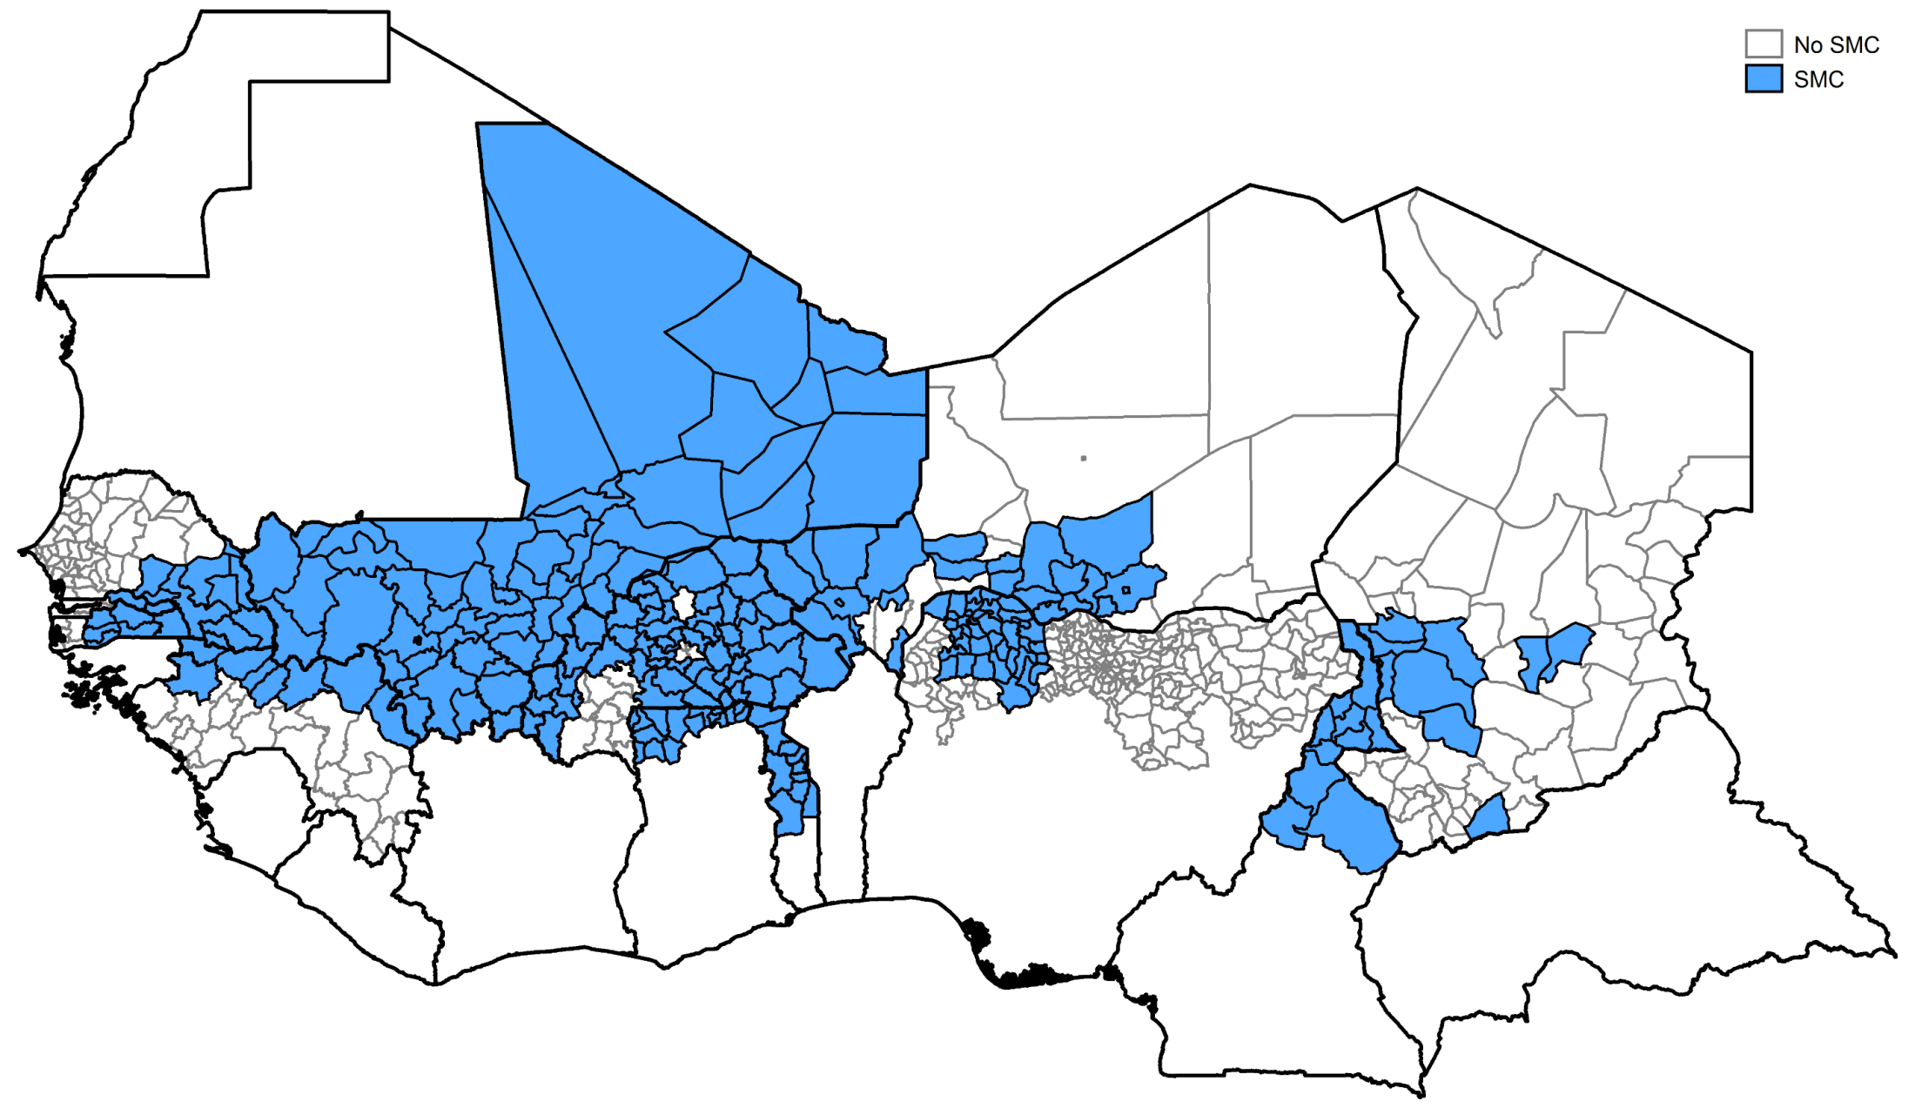
Scale-up of SMC
2016

Slide 17
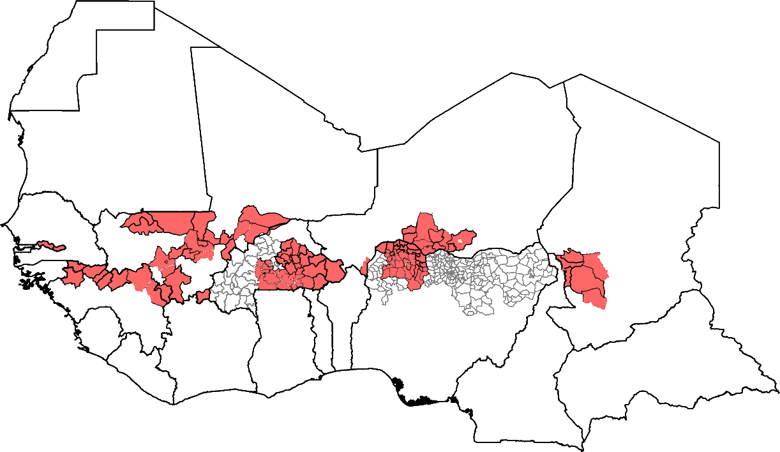
Scale-up of SMC
2016

Slide 18
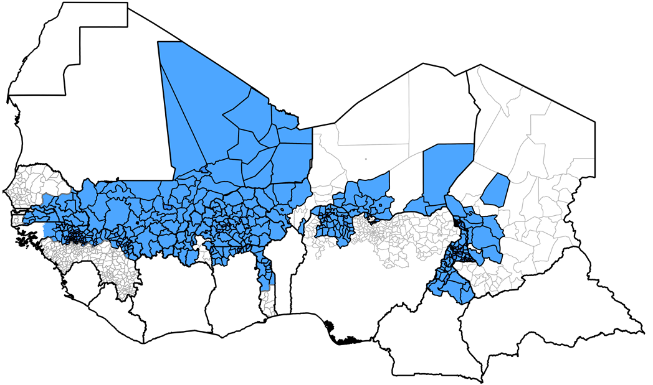
Scale-up of SMC
2017

Slide 19
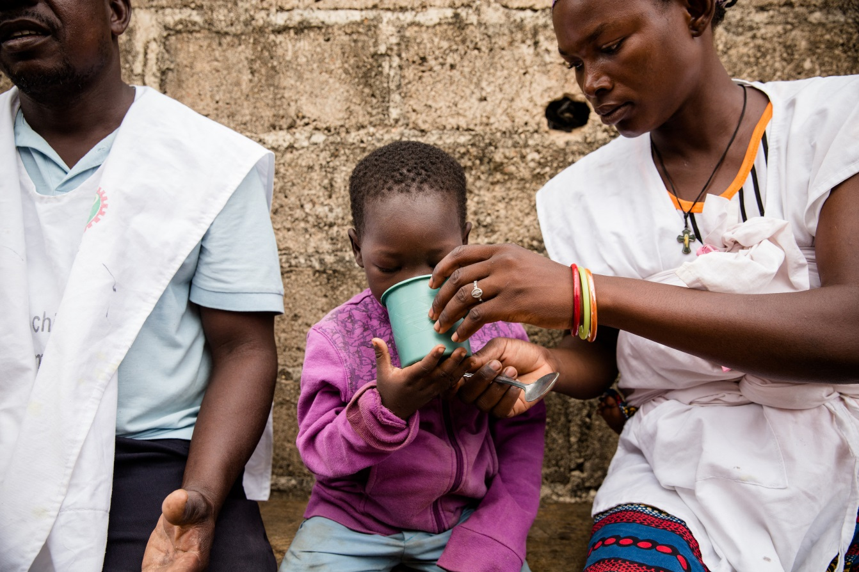
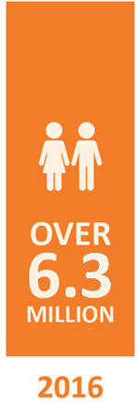
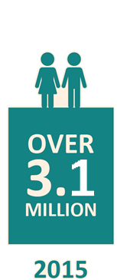
Feasibility at scale
2017: 3.9M in Burkina Faso, Chad
& Nigeria

Slide 20
Feasibility at scale
Administrative coverage (2015 & 2016)

Slide 21
Feasibility at scale
Administrative coverage (2017: Burkina Faso, Chad & Nigeria)

Slide 22
Feasibility at scale
Administrative coverage (2017)

Slide 23
Coverage issues and barriers to access
Accurate populations estimates
Appropriateness of delivery approaches and tools
Door-to-door vs. fixed points
Timing of administration
Hard-to-reach populations
Insufficient communication
Limited community awareness
Insufficient inclusion of local authorities
Limited physical access
Floods / impassable rivers
Security

Slide 24
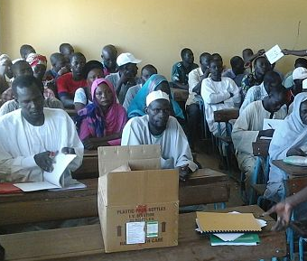
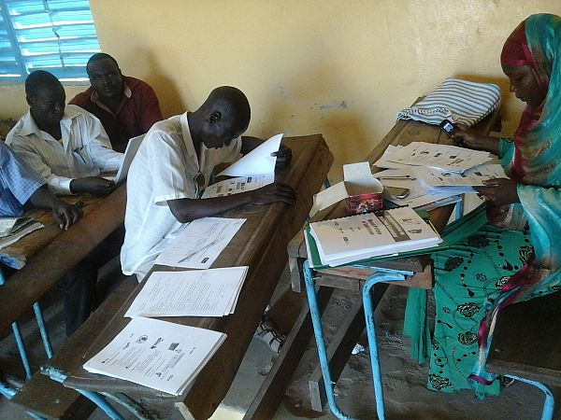
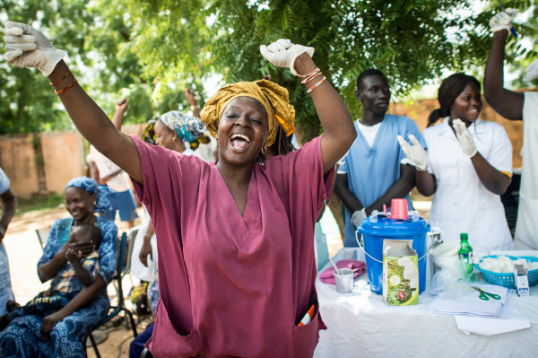
Coverage issues and barriers to access
Human Resources

Slide 25
Coverage issues and barriers to access
Human Resources
Skills
Selection
Training
Tasks
Gender considerations
Motivation
Adequate supervision & monitoring
Right numbers (→ adequate financial resources)

Slide 26
Feasibility at scale
Coverage assessed through surveys:
Are the right children reached (age / geography)?
Are they reached during all 4 cycles ’ effectively protected throughout the transmission season?

Slide 27
Feasibility at scale
Coverage assessed through surveys:
Are the right children reached (age / geography)?
Are they reached during all 4 cycles ’ effectively protected throughout the transmission season?
ADMINISTRATIVE DATA | 2015 | 2016
Weighted average coverage in the region | 91% | 90%
SURVEY DATA
Received at least 4 treatments: | 55% | 53%
Received at least 3 treatments: | 73% | 70%

Slide 28
Feasibility at scale
Coverage assessed through surveys:
Are the right children reached (age / geography)?
Are they reached during all 4 cycles ’ effectively protected throughout the transmission season?
Burkina Faso
ADMINISTRATIVE DATA | 2015 | 2016
Weighted average coverage in the country | 105% | 99%
SURVEY DATA
Received at least 4 treatments: | 86% | 86%
Received at least 3 treatments: | 91% | 91%

Slide 29
Feasibility at scale
Coverage assessed through surveys:
Are the right children reached (age / geography)?
Are they reached during all 4 cycles ’ effectively protected throughout the transmission season?
Chad
ADMINISTRATIVE DATA | 2015 | 2016
Weighted average coverage in the country | 97% | 109%
SURVEY DATA
Received at least 4 treatments: | 24% | 12%
Received at least 3 treatments: | 63% | 40%

Slide 30
Feasibility at scale
Coverage assessed through surveys:
Are the right children reached (age / geography)?
Are they reached during all 4 cycles ’ effectively protected throughout the transmission season?
Chad
ADMINISTRATIVE DATA | 2015 | 2016 | 2017
Weighted average coverage in the country | 97% | 109% | 104%
SURVEY DATA
Received at least 4 treatments: | 24% | 12% | 70%
Received at least 3 treatments: | 63% | 40% | 85%

Slide 31
Feasibility and effectiveness
Coverage assessed through surveys:
Are the right children reached (age / geography)?
Are they reached during all 4 cycles ’ effectively protected throughout the transmission season?
89%
efficacy
Efficacy studies and resistance monitoring of SMC drugs:
Do local parasites remain sensitive to the drugs?
Will widespread use lead to the selection of drug resistant parasites ’ loss of efficacy
Assessment of effectiveness on disease burden:
What is the protective effect of SMC at scale?
Over 60,000 deaths and 10 million malaria cases averted

Slide 32
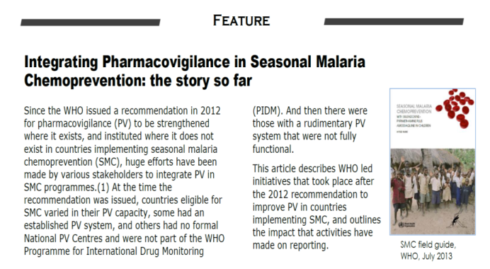
Safety at scale
Safety monitoring and support to pharmacovigilance:
Are there any major safety concerns in distributing SMC to a large target population?
Training workshops for national PV coordinators and NMCP staff 2014, 2015, 2016, 2017
PV training for HF staff and CHWs included in cascade training for SMC delivery
Job aid and reporting forms distributed to facilities in SMC areas
All SMC countries now members of WHO safety monitoring
All countries have reported events
Severe adverse reactions uncommon
No cases of SJ syndrome/Lyell syndrome in ACCESS-SMC
Safety review 2017 ACSoMP, no safety concerns

Slide 33
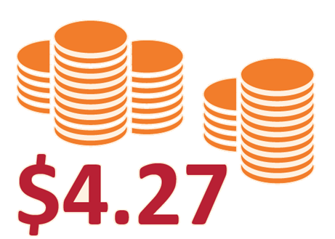
At what cost?
What are the key cost drivers?
Is SMC expensive?

Slide 34
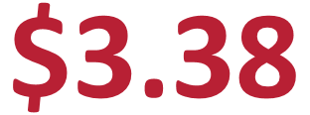
At what cost?
What are the key cost drivers?
Is SMC expensive?
What are the benefits?
Is SMC cost-effective at scale?

Slide 35
Summary of ACCESS-SMC achievements
Contributed to shaping the market:
Influencing supply
Driving the introduction of a child-friendly formulation
Introduced standard tools and procedures now used across all ACCESS-SMC countries
SMC at this scale is:
Feasible
Reasonably priced
Safe
Effective if all conditions are met

Slide 36
Challenges to universal access
Market & Product
Monopolistic market with capped production capacity
Slow international QA processes
Lack of coordinated demand (procurement planning)
Long-term questions around efficacy
SP resistance in other seasonal contexts
Planning, coordination and country ownership
Late operational planning → linked to funding streams
Inefficient quantification (unreliable estimates)
Incoherent approaches and tools
Inappropriate / inefficient delivery approaches

Slide 37
Beyond ACCESS-SMC
Uncertainties about funding / transition to other sources:
Timing of funding
Expand further
Cost-saving initiatives:
Innovative delivery approaches
Prospects for integrating interventions
Government ownership (beyond MoH/NMCPs):
Financing strategy

Slide 38
Beyond ACCESS-SMC
Evaluation & Research
Joint data collection, monitoring & evaluation (impact, resistance, PV)
Targets and duration of SMC
Plan for the potential development for drug resistance
Expand the geographical scope to SP-resistant areas
Expand the target group

Slide 39
Conclusions
SMC is NOT a magic bullet, but in the Sahel it is an effective complementary prevention approach to malaria control. ACCESS-SMC showed that implementing SMC at scale is possible and necessary to reduce the burden of malaria
Now is the time to invest in SMC, while drugs are still efficacious, and in line with a multi-pronged effort to reduce malaria-related cases and deaths (WHO Malaria Strategy)
Continued support to evaluation and research is necessary to monitor effectiveness and drugs efficacy, and to optimise coverage in areas where coverage surveys have indicated delivery problems
Over 12M children who could potentially benefit from this intervention currently are not, mainly due to lack of funding

Slide 40
Thank you
www.access-smc.org

