Slide 1
Mitigating gender and cultural barriers for a successful seasonal malaria chemoprevention campaign. Lessons from ACCESS-SMC project/ Nigeria.
J. Dada, O. Olusola, A.Luqman, JT Kayode, H. Kivumbi et al
Notes:
See acknowledgement for list of contributors. Contractual branding standards maintained

Slide 2
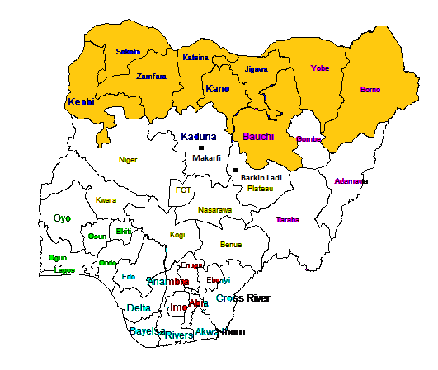
SMC in Nigeria
States of Sokoto and Zamfara
1.7 million children under 5 targeted
SMC delivered mostly door-to-door
Malaria Consortium is the lead partner collaborating with the states of Sokoto and Zamfara in Nigeria under ACCESS-SMC targeting over 1.7 million children under five
Notes:
Since 2015, Malaria Consortium is the lead partner collaborating with the States of Sokoto and Zamfara in Nigeria in scaling up access to SMC, targeting over 1.7 million children under five through the ACCESS-SMC project. In Nigeria, SMC is delivered mostly through door-to-door distribution approaches.

Slide 3
Multi-pronged SBCC Approach
Town announcers & local radio stations
Dialogues to engage community leaders (village & religious leaders)
Interpersonal communication by drug distributors
Description of SMC in simple terms & local languages
Use of local languages on drug packs & materials
1 simple visual logo + tagline adapted to audiences with low-literacy
Same set of key messages in all materials (what, why, who, where, how)

Slide 4
Unique visual identity
For whom?
Young children 3-59 months
What?
Medicines
Why?
Malaria
ACCESS-SMC created a single visual identity, re-used each year to ensure clear recognition of the intervention.
Positive, easy to understand and appealing to rural audiences
Translated into local languages
When?
Rainy season
Key features
Result?
Protection
Notes:
Pretested, adapted to each country with slight variations + translated into LOCAL LANGUAGES
SM: highlight the focus on interpersonal communication and packaging key information for low-literacy audiences. The message here is that SMC is a complex intervention but can be successfully explained to low-education audiences if sufficient attention and investment given to SBCC research and design. SBCC for health interventions should go beyond “advertising” to create social and community support and participation in the intervention. This can also help solve some supply side bottlenecks: does anyone have an example of community providing some local resource to solve a service delivery problem during SMC campaigns??
Talking points
SBCC important for community ownership, to create community demand for the intervention
SBCC useful for supporting community members to understand SMC so they will come to demand to have it from the health system, as has been the case with other malaria prevention interventions like the LLINs. Also, to encourage community support for CHWs/volunteers to motivate them, alongside other motivators like financial compensation for services.
Need to invest in SBCC strategies, resources to make tools and knowledge available
SBCC is shifting from the traditional approach and evolving towards a new, context specific strategy
What is the way forward for SBCC?

Slide 5
2015 SMC Acceptability in Nigeria
Gender Cultural Barriers
Cultural and religious norms do not allow men to enter other men's households, especially if women are present
Women are not allowed to leave the house unless absolutely necessary
Children’s caregivers participating in the campaign are mostly women
Local authorities recruited mostly male volunteers because they were more literate and experienced
Field guide and standards require distributors to enter households
Notes:
Issues identified in 2015 campaign though gender-based challenges had been anticipated but not well integrated in planning. it was difficult to recruit females as drug distributors for the 1st round. Why? Factors included: Low literacy level of females in this region of the country, health authorities and local leadership more inclined to recruit males as they had more experience than females
Because men were not allowed inside there was limited and weak supervision and interpersonal communication HW and beneficiary caregiver, poor community mobilization
Field guide and standards: Door-to-door opportunity for better interpersonal communication between HW and beneficiary caregiver to build trust, improve coverage and acceptability; quality assurance through directly observed treatment and supervision and to explain how to administer at home doses

Slide 6
Integrating Gender & Culture Considerations in SMC: Community Mobilization and Distribution
Remedial action 2016 campaign
More female distributors and supervisors were recruited
Sensitisation of political, cultural and religious leaders before the campaign to foster community engagement
Community and religious leaders and traditional public announcers used as community mobilisers
Notes:
2016 Approach
Nigeria adopted an approach that was practical in its setting, recruit mostly females for front-line work n Sokoto and Zamfara, as SMC distributors and supervisors and then follow the standards, ie get in house observe treatment etc
Recognizing that only women are permitted to enter households in this cultural setting and that men are key to health decision making community and religious leaders and traditional public announcers were used as community mobilisers, these are almost exclusively males. After the male mobilizers spoke to other men, husbands would allow the female distributor to enter and for their wives to accept and adhere to SMC treatment.
Buy-in by mostly male cultural and religious leaders through dialogue and sensitisation events, helped improve access to eligible children

Slide 7
Results and Lessons Learned
SMC reach (at least one cycle) for both years was above 80%
Sensitised community leaders improved acceptance at the individual level
Increasing number of female distributors and supervisors improved interpersonal communication, administration and monitoring quality
Men, and religious and cultural leaders are key to health-related decisions-making
However
Gender issues remain a key determinant of acceptance
Adherence to four SMC cycles remained poor → >30% drop in coverage for cycles 3 / 4
Notes:
While administrative coverage of the SMC campaign was above the 80% target in 2015 and 2016; in-depth analysis of coverage results showed significant differences among target areas and adherence to the four SMC cycles was poor
>30% drop out of beneficiaries uptake 3 or 4 cycles
Recent surveys reveal gender issues such as male dominance in health decision-making remains a key determinant of acceptance
Sensitised religious and cultural leaders helped address instances when male household heads refused SMC.
Increased number of female distributors and supervisors; plus a focus on using male leaders as campaign allies were key to quality SMC administration and monitoring within households in this setting with deep rooted social cultural barriers.
Men, religious, cultural leaders are key to health decision making
This case study informs future community-based preventive health interventions involving door-to-door distribution on importance of adopting strategies that mitigate gender cultural barriers.

Slide 8
Continuous Quality Improvement
Integrated in SMC Campaigns
Implementation Research and QI integrated in SMC campaign
Planning: macro and micro plans
Training, SBCC, data
Action:
campaign implementation +SBCC (4 cycles)
Review:
restitution meetings daily & after each cycle
Learning
meetings:
national,
multi-country (regional)
Notes:
So: http://www.natpact.info/qof/assessortraining/dwn2/21030/index.htm
Quality and Outcomes Framework (QOF) reflects a cycle of continuous quality improvement. This involves:
Planning – working out aspiration levels and specific ways to deliver this, using available resources.
Action – delivering high quality services and recording achievement on practice systems.
Review – using the QMAS feedback facility and QOF visit to review progress.
Learning – reflecting on how quality and points score could be increased for next year …… which in turn leads into the next cycle.

Slide 9
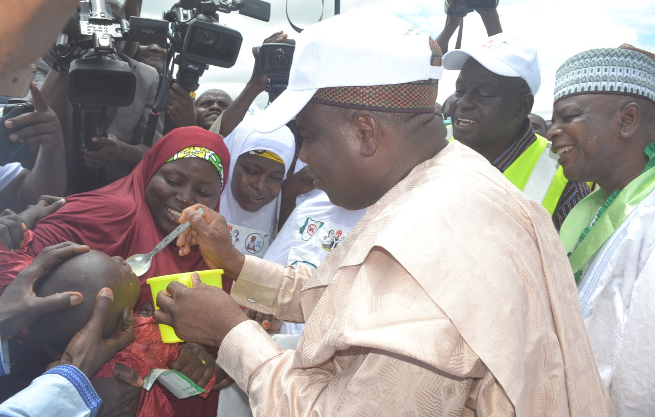
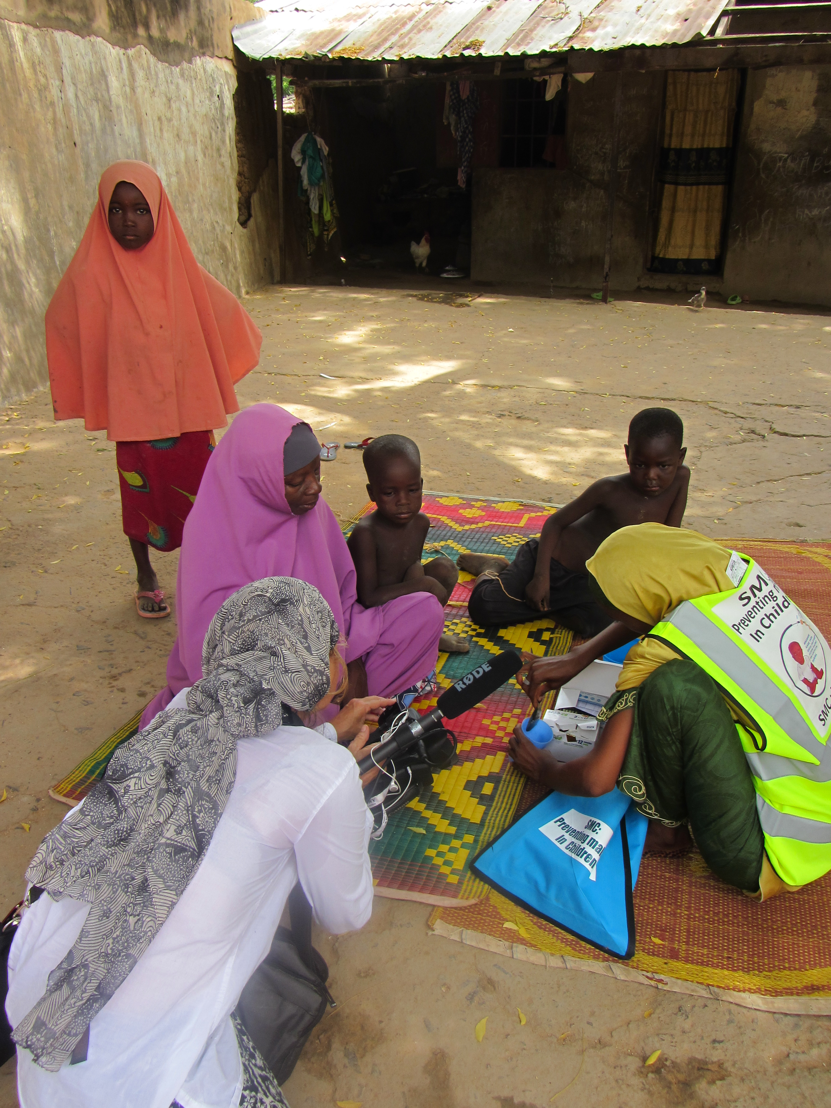
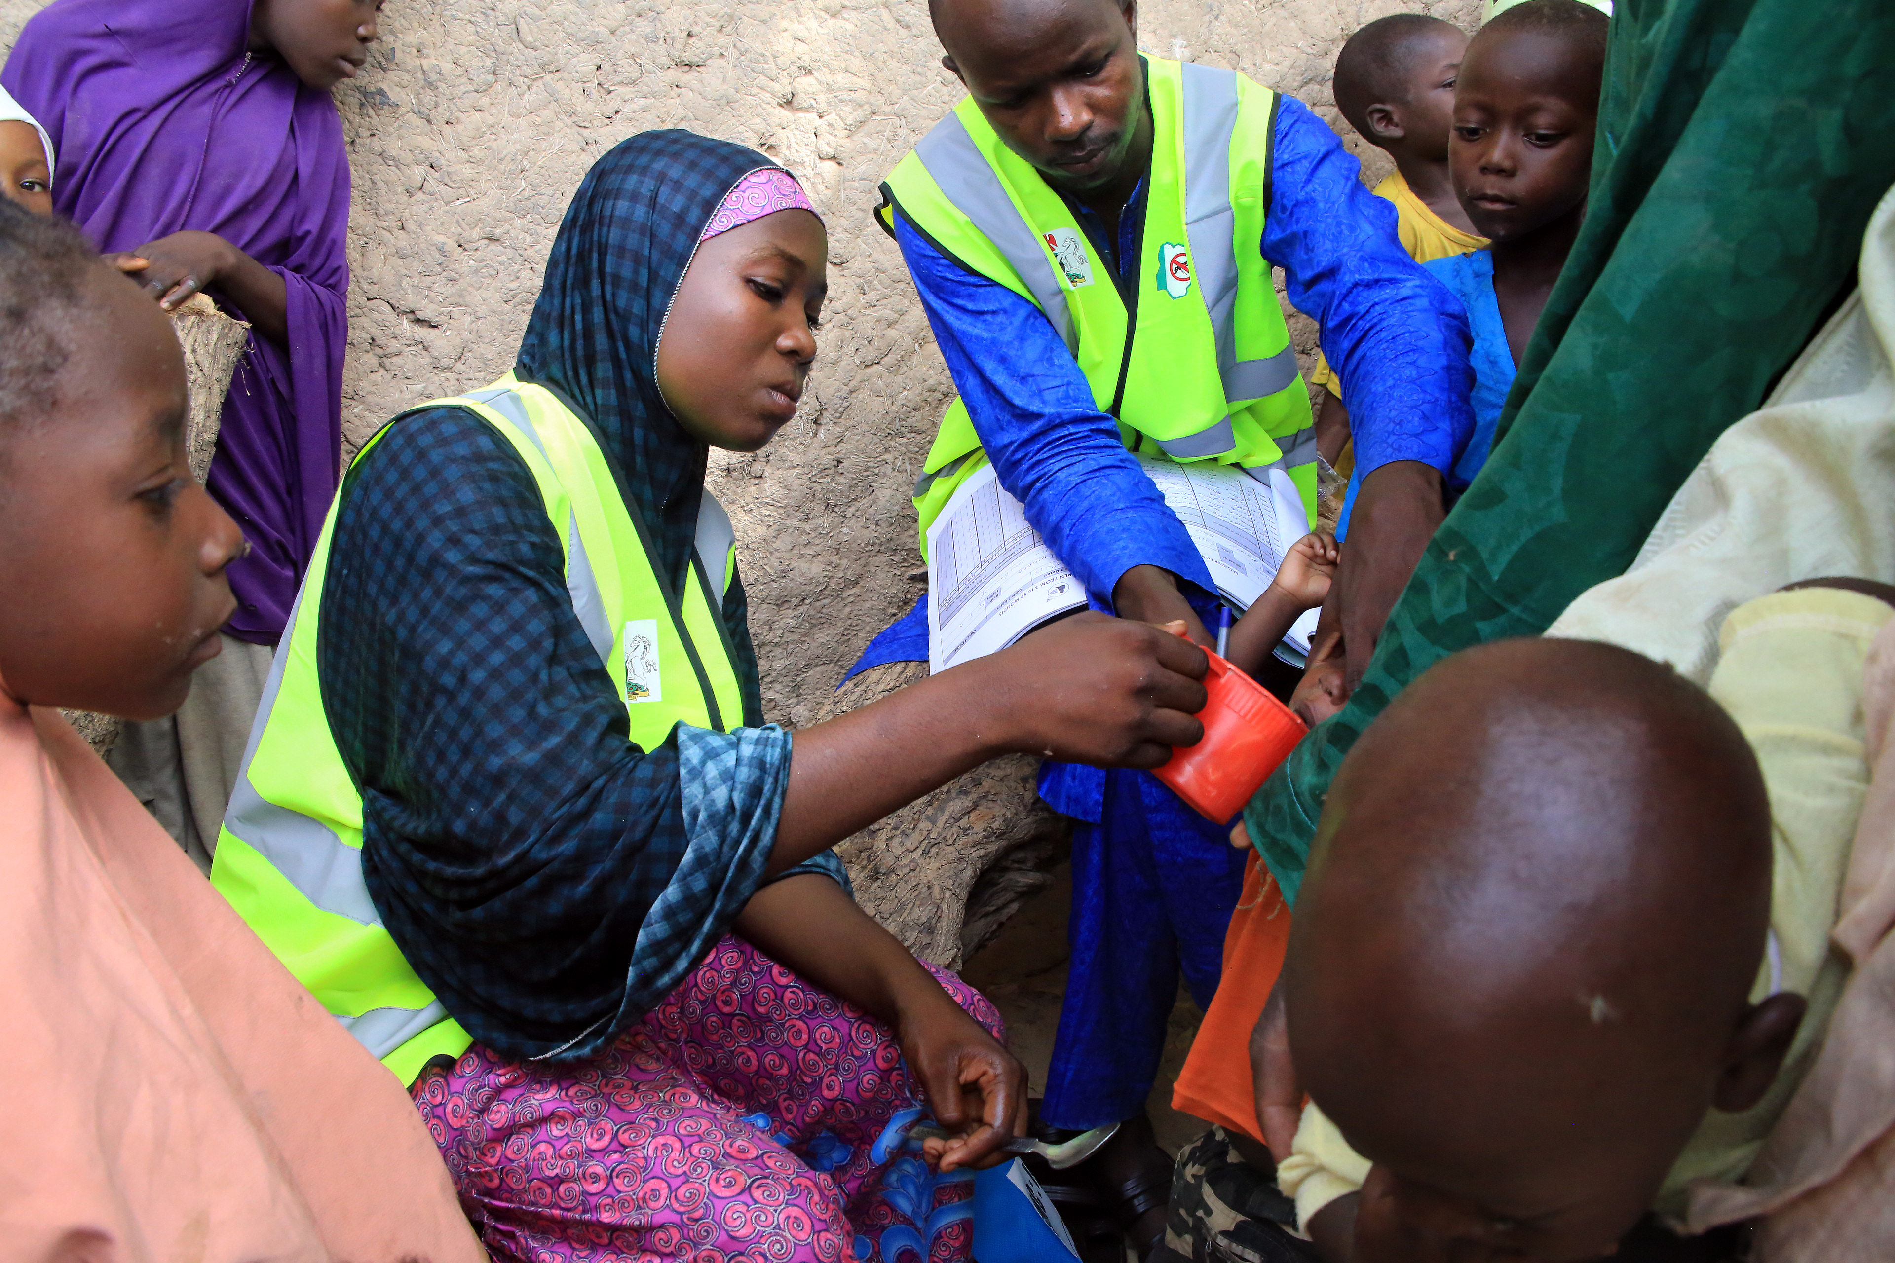
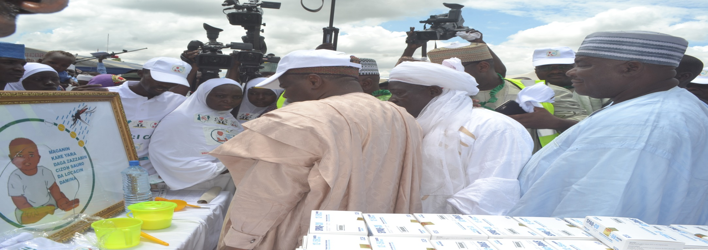
Notes:
The Governor of Sokoto, His Excellency Aminu Waziri Tambuwal launched the SMC Campaign in 2016, more than 1 million religious, traditional and cultural leaders attended. The CEO Malaria Consortium paid a courtesy call on the Governor, and His excellency decided to lead the campaign

Slide 10
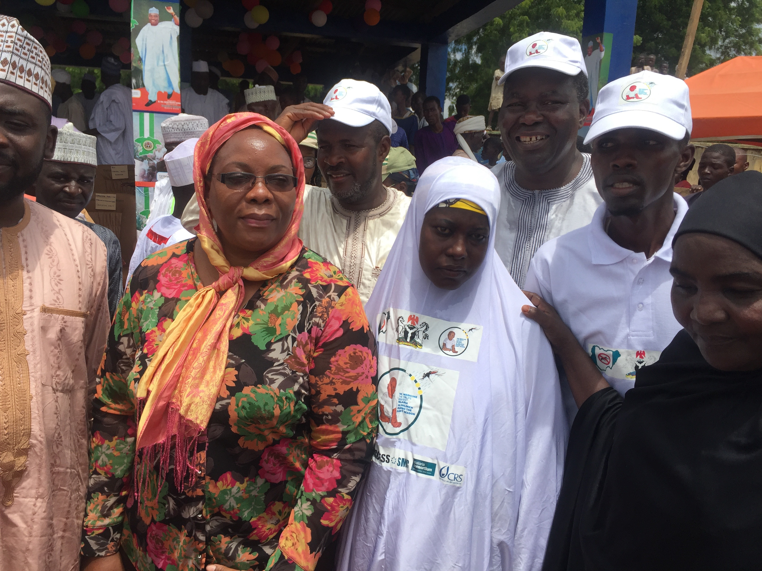
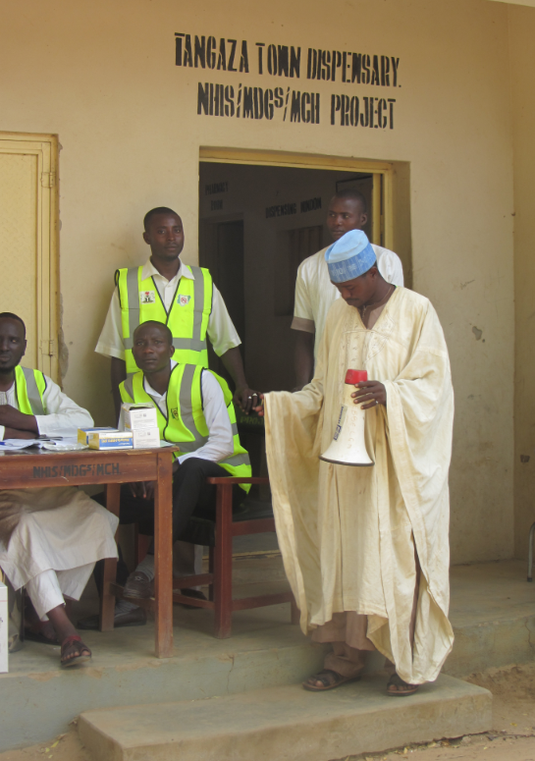
Notes:
Female CHWs, Hijab with IEC materials replaced T-shirts, Malaria Consortium staff

Slide 11
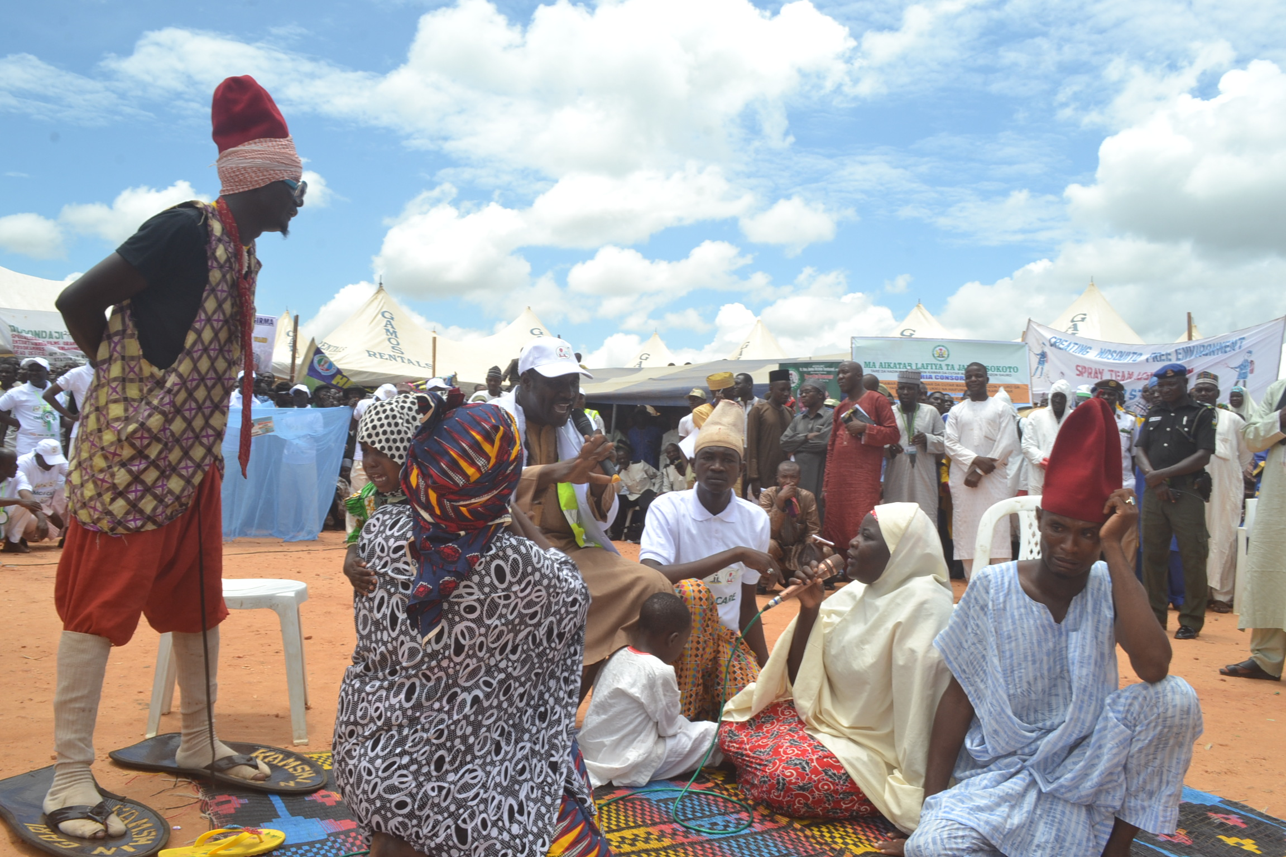
Notes:
Drama community group – family that rejected SMC is miserable while one that accepted benefited

Slide 12
Credits and Acknowledgements
Study participants: Caregivers of SMC recipients, CHWs, and community leaders
Federal Ministry of Health and Sokoto and Zamfara State Ministries of Health in Nigeria
Malaria Consortium teams in Nigeria: Luqman Ahmed, Edward Idenu, Maxwell Kolawole and the field teams in Sokoto and Zamfara
Malaria Consortium Global Technical Team: James Tibenderana, Hellen Counihan, Sandrine Martin, Alexandra York
Malaria Consortium’s ACCESS-SMC project partners

Slide 13
Thank You
Notes:
ACCESS-SMC is a UNITAID funded project led by Malaria Consortium in partnership with Catholic Relief Services, which aims at scaling up SMC in the Sahel. The project is supported by LSHTM, MSH, MMV and Speak up Africa, and it’s implemented in collaboration with the Ministries of Health in Burkina Faso, Chad, Guinea, Mali, Niger, Nigeria and the Gambia. During its life it will have provided approximately 45 million treatments to about 7 million children in these seven Sahelian countries.

