Slide 1
Exploring community response to Seasonal Malaria Chemoprevention. What are the factors associated with social acceptability of SMC in different contexts? D
H. Kivumbi, S. Martin et al.
Notes:
See acknowledgement for list of contributors. Contractual branding standards maintained

Slide 2
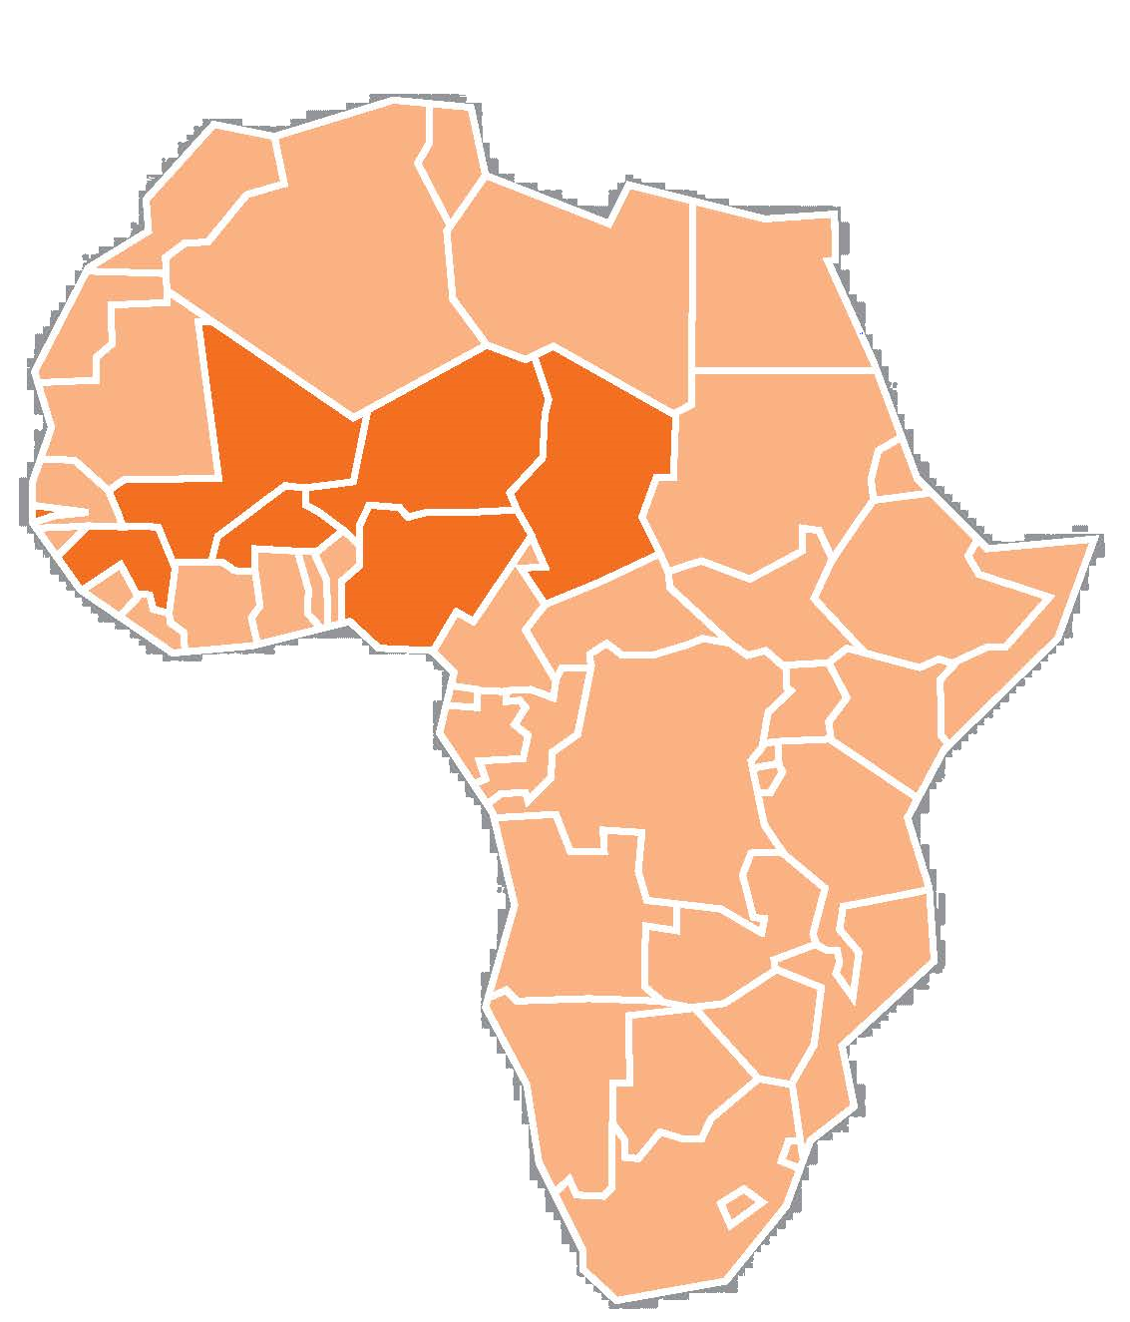
Seasonal Malaria Chemoprevention (SMC)
Through ACCESS-SMC
Over 3 million in 2015
Sulfadoxine-pyrimethamine + amodiaquine (SP+AQ)
Over 6.4 million in 2016
Reduction in malaria morbidity and severe malaria
75%
Supported National Malaria Control and Elimination Programs in 7 countries
Notes:
Seasonal malaria chemoprevention with sulfadoxine-pyrimethamine + amodiaquine (commonly called SMC) is shown in clinical trials to have the potential to reduce malaria morbidity, and severe malaria, by at least 75 percent in areas with high seasonal transmission. Approximately 80 percent of the 30 million SMC medicines delivered to countries in 2016 were in a dispersible, sweetened child-friendly formulation, which was easier to administer and more palatable to children.
ACCESS-SMC is a UNITAID funded project led by Malaria Consortium in partnership with Catholic Relief Services, which aims at scaling up SMC in the Sahel. The project is supported by LSHTM, MSH, MMV and Speak up Africa, and it’s implemented in collaboration with the Ministries of Health in Burkina Faso, Chad, Guinea, Mali, Niger, Nigeria and the Gambia. During its life it will have provided approximately 60 million treatments to about 7 million children in these seven Sahelian countries.
ACCESS-SMC was the leader in catalyzing the scale up of access to SMC. During the first campaign in 2015, the project administered over 12 million treatments of SMC to over 3 million children. In 2016, this number more than doubled, with over 25 million treatments being administered to over 6.4 million children during the second campaign. The average recurrent cost to administer one child one monthly cycle of SMC is just over a dollar, thus it may cost under $5 at scale to provide full treatment to a child each year.

Slide 3
ACCESS-SMC (2014-2017):
Public Health Goal
Reach 7 million children aged 3-59 months by 2016
Distribute 30 million doses of SP+AQ by 2016
Demonstrate validity of existing evidence: SMC is efficacious and cost effective
Achieve the largest SMC undertaking to date
Demonstrate the feasibility, safety and effectiveness of SMC at scale and promote wider adoption of SMC
Building on the 2012 WHO policy guidelines on SMC implementation
Notes:
The WHO 2012 policy guidelines on SMC were based on evidence from 7 studies on SMC/IPTc that using SP+AQ monthly for up to 4 months during the malaria transmission season in children 3-59 months of age in the Sahel:
Prevents approximately 75% of all malaria episodes
Prevents approximately 75% of severe malaria episodes
May result in a decrease in child mortality of around 1 in 1000
The other goal was shaping the market: Use its funded demand as leverage in order to encourage the development of child-friendly, dispersible formulations.

Slide 4
Rationale: Project Baseline and Evaluative Studies
Baseline studies
HH coverage surveys 2015/16
Perception of SMC varies with:
Country
Local context
Timing
Particular changes or shifts in the political, economic, social and economic environment
(Wharton-Smith et al, 2015)
Burkina Faso consistently reached coverage above 80% during all 4 SMC cycles
Nigeria and Chad had high dropout rates, with many children failing to complete all 4 cycles of SMC treatment
Failed adherence to all 4 cycles necessitated investigations on acceptability concerns
(Milligan P et al, 2015 and 2016)
Notes:
Baseline studies involved extensive literature review, Wharton A, et al., and since ACCESS-SMC was a pioneer project and acceptability of SMC not yet well assessed, literature focused on acceptability of IPTp-I and other MDAs. We hypothesized that key drivers of SMC may include
Caregiver’s inherent desire to protect child health
Knowledge of malaria, its disease burden and associated high mortality
Perceived/observed effectiveness of treatment
Relationship with health workers: respect, fear, TRUST
Relationship between the community and drug distributors
Social and family support and encouragement
Free access to SMC treatment (available at no cost to family)
Time saved to caregivers from bringing sick child to a health facility
Distribution strategy (door to door better perceived than fixed points)
Interpersonal communication channel
Evaluative studies were integral part of the scale up implementation research. In particular, coverage surveys at households were done at the end each year’s campaign

Slide 5
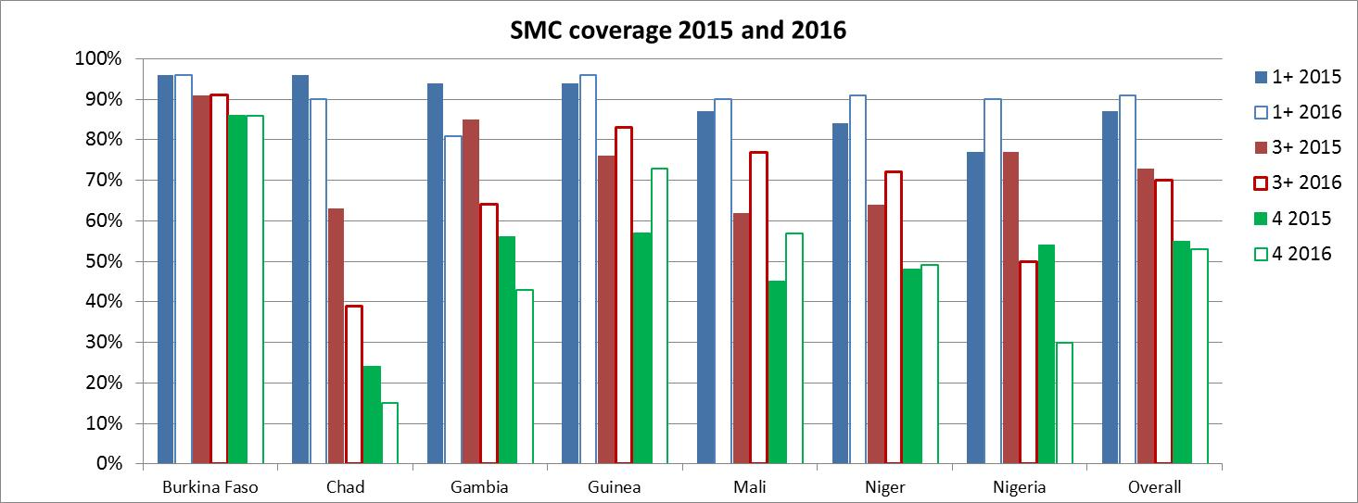
Preliminary Results- HH Surveys
Notes:
Graphs show results recently released by Paul Milligan et al, LSHTM,
Compare performance over two years; for 7 ACCESS-SMC countries
Disseminated at Ouagadougou meeting in February 2017
In blue, children who received at least one cycle, coverage high in all countries. In red and green, three and four cycles respectively
Chad and Nigeria graphs imply dropouts and poor adherence to 4 SMC treatment cycles. Dropouts in Mali and Niger also significant; yet there are good examples of success such as Burkina Faso and Guinea.
We need to keep in mind that the scale in 2016 was double that of 2015.

Slide 6
Factors Influencing Acceptability of Mass Drug Administration Campaigns
Social acceptability
Service delivery
Recipients’ perception of needs, risks and benefits
Intervention adaptation to local social norms
Social acceptability defined as: ‘determining how well an intervention is received by the target population and the extent to which the new intervention or its components meets the expectations of the target population and organizational setting’
Ref: (Ayala & Elder, 2011).
Notes:
Framework built on community uptake drivers previously identified and the definition of social acceptability is presented
A literature review showed that there is
A strong demand for an effective malaria prevention intervention to address child morbidity and mortality; this is compounded by the perceived effectiveness of SMC, in spite of the minor concerns around side effects and challenges associated with home administration of the drug.
Service delivery elements also appeared to affect uptake, especially effective distribution mechanisms that beneficiaries can rely on, the trust in health workers and relationship with drug distributors, as well as support from community leaders for the intervention.
(Wharton-Smith et al, 2015a)

Slide 7
SBCC for SMC
Build TRUST
Manage EXPECTATIONS
Ensure ADHERENCE
Inform and mobilize local leaders and communities
Ensure what SMC can and cannot do is understood and valued and people are aware of how the SMC campaign is delivered
Ensure caregivers understand how and when to administer SMC and know how to manage fever or side-effects
Notes:
(as already presented by … if the case) This slides summarizes the SBCC framework that has guided SMC SBCC work under ACCESS-SMC
Build TRUST: mobilize leadership and communities to support and participate, i.e. come to distribution points/allow distributors in their homes and accept SMC medicines (safe, easy and effective)
Manage EXPECTATIONS: stakeholders, communities and caregivers understand/value what SMC medicines can (and cannot) do and how SMC campaign is delivered
Ensure ADHERENCE: caregivers understand how and when to administer SMC to their eligible children, including how to manage fever or side-effects after taking the medicines

Slide 8
Framework for Behaviour Change
SMC uptake broken down into a set of specific behaviours expected from caregivers of children eligible for SMC
All potential factors influencing these specific behaviours are organized and grouped in to 3 categories (Michie et al., 2011):
Capability (knowledge and skills)
Motivation (beliefs, values, motives)
Opportunity (access to services/commodities; social norms)
Notes:
The conceptual and analytical framework shown here represents the many factors that can affect uptake and adherence to SMC. It was tested through the study and can be used in the future, in other contexts, to ensure evidence-based and researched SBCC programming for improved uptake and adherence
It was meant to
1) define the specific behaviours affecting SMC uptake,
2) organize factors influencing these behaviours , categorizing them in terms of capability (def) opportunity (def), motivation (def).
(Capability) that is the individual’s physical and psychological capacity to engage in a behaviour, such as knowledge/awareness, perceived risk/susceptibility, and skills (know how to perform the behaviour).
(Opportunity) that is those factors that lie outside the individual’s control and that make the behaviour possible, or prompt it: access to services/commodities, cost (or no cost), packaging and characteristics of medicines, religious or cultural norms, and social support.
(Motivation) that is the brain processes that energize and direct behaviour, including emotions and analytical decision-making, attitudes, beliefs (necessity, efficacy, concerns regarding adverse events), perceived/subjective norms, expected outcomes/goals, self-efficacy.

Slide 9
Three Country Case Studies
Key question
What are the factors associated with social acceptability of SMC at recipient level in different contexts after two rounds of SMC?
Perceptions
Understanding
Knowledge of SMC Intervention
Satisfaction with SMC Intervention
Notes:
Through the study we wanted verify factors associated with social acceptability of SMC by beneficiaries in different settings, after two SMC rounds, comparing areas of high and low adherence to the campaign in Chad, Burkina Faso and Nigeria
The main Objective was to assess social acceptability of the SMC intervention from the perspective of beneficiaries, the key questions being
What are beneficiaries’ perceptions, understanding, knowledge and satisfaction with SMC intervention in particularly high uptake areas?
What are beneficiaries’ perceptions, understanding, knowledge and satisfaction with SMC intervention in particularly low uptake areas?
How do these compare with findings from the initial situation analysis conducted at the onset of the ACCESS-SMC project on factors that drive or hinder acceptability of SMC?

Slide 10
Design: Qualitative Enquiry, Case Studies
Focus Group Discussions
Case study approach allows in-depth, multi-faceted understanding, to explain, describe or explore how a new intervention is being implemented and received on the ground.
Ref: Crowe et al., 2011; Yin, 2009; Stake, 1995
10-15 were conducted in each country
Gender disaggregated recipient’s caregivers or parents
10-15 were conducted in Burkina Faso with community leaders and community health workers
Jan-Feb 2017 by national consultants after ethical clearance and informed consent participants
Compare three country contexts to present a collective case study
Key Informant Interviews
Notes:
It was a collective case study, as defined by Stake (Stake, 1995), looking at three contrasting country contexts.
Independent consultancy firms were hired for collecting data at field level, through a mix of approaches such as FGD and KIIs

Slide 11
Data Analysis
Qualitative analysis: interviews transcribed from local language to French and English entered in to MS Word document
Content analysis built on conceptual framework and identified recurring themes manually (Chad and Nigeria)
Codebook developed using pre-identified codes based on conceptual framework themes using N’Vivo 10 software (Burkina Faso)
Positivist approach used for case study by looking at pre-conceived variables of SMC acceptability as per conceptual framework and fit to findings
Analysed each interview by applying coding category and factor type to the matching word groups
Exported transcripts from MS Word to N’Vivo, using the software’s framework analysis module to highlight occurrences for each node.
Notes:
All interviews were recorded on digital media. They were then transcribed in French or English and entered in a MS Word document.
The data analysis was primarily deductive, in compliance with the scope of analysis selected, and built manually on identified recurring themes in Chad and Nigeria. Also, according to this scope, we developed a codebook detailing the encoding procedure through Nvivo 10 software in Burkina Faso, explaining the various pre-identified encoding categories.
Building on the conceptual framework, we used a positivist approach to the case study by looking at pre-conceived variables of SMC acceptability identified in the framework, exploring whether they fit in with the findings from the real-life case studies.
The approached segregated 3 types of factors influencing the acceptability as:
i) Factors more specifically influencing the compliance to the 4 cycles,
ii) Factors more specifically influencing the compliance to treatment at home,
iii) Factors more specifically influencing behaviours in terms of recommended care-seeking.
These were compared against the categories in the conceptual framework:
Capability (knowledge and skills),
Motivation (beliefs, values, incentives)
Opportunity (access to services / products, social standards).

Slide 12
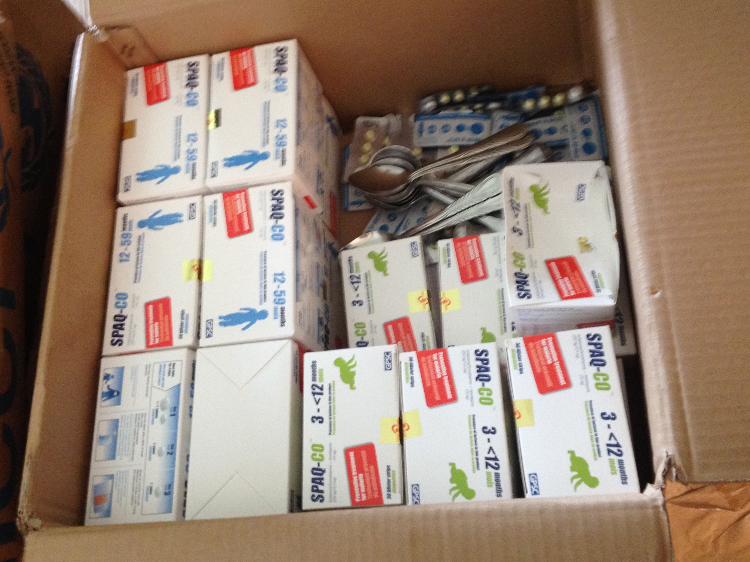
SP+AQ Supplies
Chadian community distributor at work
SMC campaign launch in Fada Ng'oum Burkina Faso, 2015
Notes:
CHWs distributing at HH level in Chad, and in Burkina Faso CHWs at the campaign launch
Above is the box of SMC supplies
Images all photos h.kivumbi

Slide 13
Lessons Learned: Why SMC is Acceptable
“…Since we started using the drugs our children don’t fall sick anymore. We are happy with it and thankful” –Focus group discussion with caregivers/parents
“Because the medicine is given free… clear difference between children that take the medicine and one that didn’t take” –Focus group discussion with male heads of households
“People no longer go to the hospital because the rate of malaria infection has reduced drastically” –Community Leader
“…We appreciate the drugs because we are seeing its positive impact on the health of our children” –Focus group discussion with female caregivers in Nigeria
Notes:
This slides provides a summary of some of the recurrent feedback from interviewees, which reflect perceived positive impact of the intervention.
add
This is what you put in the notes: could be used for slide itself:
Positives:
Perception about effectiveness, benefits and advantages derived from participating in the intervention were found to be the driving force for the high acceptance and adherence of care givers to the SMC intervention in all locations.
Comprehension about the SMC cycles and treatment regimen were found to be higher among female CGs, as compared to HHHs and community gate keepers.
Negatives:
Study findings further revealed that negative notions and misconceptions still exist about the SMC intervention as some community members still equate the intervention to another attempt to force family planning or immunization
Ignorance regarding side effects
No trust in public health system: few of care givers reported patronize the chemist instead of the health facility in response to adverse drug reaction.
Socio-cultural issues, precisely male dominance and religion were found to be impediments to successful implementation of the ACCESS-SMC intervention
---
But there are also reasons mentioned as to why SMC is not acceptable. For instance, during FGD, caregivers or parents reported how Some parents have the false notion that the drugs are actually for family planning … or polio”. “…Some people are against modern medication, preferring traditional medicine…” or that “...husbands instruct mothers not to give medicines to children as they are not sick
There were also reports that “…Some parents rejected the drugs because they complained that they were given only drugs instead of food and mosquito nets.”, so there is a dimension around beneficiaries expectations around aid.
There were also examples of “Some insecure places that were left out”

Slide 14
Burkina Faso Context (high uptake)
Opportunity
Good knowledge of malaria and SMC, implying access to quality information that resulted in high acceptability and uptake
Acceptability of SMC directly linked to peoples’ perception of malaria burden and their knowledge of the benefits of prevention strategies (similar in Nigeria and Chad)
Door-to-door administration strategy and free medicines make SMC geographically and economically accessible
Use town criers as informers
Use of more child-friendly dispersible medicines
Considerations for improvement
Notes:
BF study was by GRAS
The study showed good knowledge by beneficiaries of malaria and SMC, implying that there was and is a good access to quality information that positively affects acceptability and uptake. It must be highlighted that in general acceptance of preventive campaigns in Burkina is relatively high.
It was shown that acceptability was directly linked to perceptions of the malaria burden (generally considered heavy) and their knowledge of the benefits of prevention strategies. While the relationship exists in Chad and Nigeria as well, in Burkina is mostly in the direction of acceptance.
Nigeria -awareness/ knowledge, understanding and satisfaction with the SMC intervention ACCESS-SMC intervention was very high, in all LGAs. Perception about effectiveness, benefits and advantages derived from participating in the intervention were found to be the driving force for the high acceptance and adherence of care givers to the SMC intervention in all locations. Comprehension about the SMC cycles and treatment regimen were found to be higher among female CGs, as compared to HHHs and community gate keepers. The study findings further revealed that negative notions and misconceptions still exist about SMC
Door-to-door administration and free drugs were highly appreciated, representing a clear enhancing opportunity linked to economic accessibility.
A number of suggestions were also provided, including an increased use of public announcers as key informers, and the use of child-friendly drugs (from areas with no dispersible drugs in 2016).

Slide 15
Nigeria Context (medium uptake)
Missed opportunity due to stock-out of drugs or other supplies (e.g., registration cards for children)
Inadequate supervision of community health workers in some local government areas
Lack of confidence in health system, leading to caregivers seeking care from the private sector when adverse drug reactions were present in children
Negative notions and misconceptions existed about SMC as forced family planning or immunization
Some caregivers were either not at home during campaigns, feared side effects or were discouraged by husbands
Male dominance, religious beliefs versus western medications
Notes:
From country report- Nigeria, Dr Julian Nathaniel et al
While there similar positive trends as in Burkina Faso
Some community members still equate the intervention to another attempt to force family planning or immunization interventions on the communities. The roles of TAs seem to be duly recognized in most communities.
Some caregivers were not available at their households during the mass drug administration, but in other cases ignorance regarding side effects negatively affected decision on whether to accept the drugs.
Socio-cultural issues, and more specifically male dominance and religious beliefs, were found to be impediments to successful implementation of the ACCESS-SMC intervention
There were also some operational dysfunctionalities that affected loyalty to the intervention: especially during cycle 1, a large beneficiary turnout was met by inadequate supply of SMC drugs due to administrative delays in country (registration). Inadequate supervision were reported in some areas, with CHWs attitudes / practices possibly affecting lower turnout in subsequent cycles.

Slide 16
Chad Context (low adherence)
Improve communication & information resources
CHW attitudes calls for supervision as some skipped households despite caregivers being present
Poor and non-informative or inadequate information were provided by CHWs – Skills issues
Caregivers, due to lack of information and guidance, fled from the distributors and feared side effects
Suspicions on why the medicines were free of charge –negative intentions
Radios were not available or not used by all
Neighbors chiefs / village leaders considered better and more effective sources of information than public announcers - underused
Too short of a notice was given for campaigns (one day before) - caregivers suggest that cycle be announced one week earlier
Notes:
In Chad, communication (or lack of it) seems to be a key factor of acceptability, with improvements required in future campaigns:
For instance, choice of radio as a means of communication – heavily used in Chad - may not be the best (with a few exceptions in urban areas such as N’djamena);
There is instead a preference for village leaders / neighbors chiefs as more effective sources of information;
There were also comments around the timing of the information, too close to the distribution dates, which didn’t leave time for households to adjust their schedules. This may be true in many areas where seasonal agriculture is a key driver for geographical mobility.
CHWs supervision may need to improve as lack of motivation resulted in houses being skipped. Skills issues became evident as well, as beneficiaries reported lack of appropriate explanation, guidance, communication on adverse effects.
A specific element of suspicion in Chad related to the perceived negative association between free drugs and hidden negative intentions.

Slide 17
Implications and Key Messages
Social acceptability of SMC like other MDAs is context-specific, driven by:
knowledge and understanding of the benefits (real and perceived)
its impact on economic savings
Actual reduction of malaria illness and death incidence
Caregivers have strong desire to protect children with proven accessible preventions
Positive relations with CHWs and community leaders is paramount
Resistance to SMC exists in certain contexts, especially around:
gender
religion
fears & lack of trust
lack of knowledge & information
poor health worker attitudes
Calls for focussed, evidence-based, context-specific SBCC strategies, with periodical studies to continually validate available data
Assurances around availability of supplies (no stock-outs)
Notes:
Findings confirm the obvious, that SBCC approach should be context specific

Slide 18
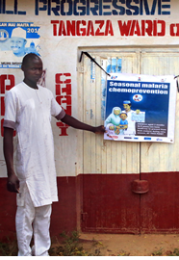
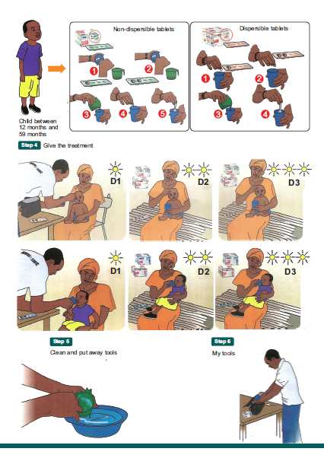
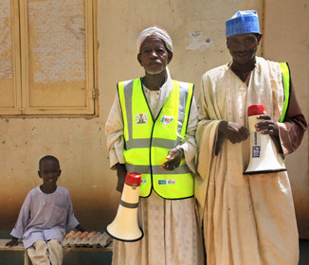
SBCC Materials Developed
Notes:
SMC posters, Key messages for Town Criers (top right)
and community leaders (bottom right)….

Slide 19
Conclusion
Findings aligned to baseline data on SMC uptake
The social acceptability conceptual framework designed on factors that affect uptake and adherence to SMC have been tested through this study
The social acceptability framework should be integrated in to SMC program management in different contexts. This will ensure evidence-based, researched SBCC and management choices for improved SMC uptake and adherence.
Recommendation
Notes:
To conclude, the social acceptability conceptual framework designed on factors that affect uptake and adherence to SMC have been tested through this study, and the findings are aligned to baseline information on SMC uptake.
In light of the findings, the social acceptability framework should be integrated in to SMC program management and adapted to different contexts at planning stage, and regularly reviewed, to ensure evidence-based, researched SBCC and management choices for improved SMC uptake and adherence.
Perspectives:
More in general, in countries with low or stagnant uptake, SBCC can only be part of the solution, as a successful SMC campaign is dependent on multiple factors, including appropriate planning, training, adequate and timely supply, contextual factors. A potential focus may be also SBCC work to change attitudes of frontline workers, which came out regularly in both qualitative studies and supervision reports as in need of improvement. This could be an interesting area of SBCC work in the coming years.

Slide 20
Credits and Acknowledgements
Study participants: Caregivers of SMC recipients, CHWs, community leaders, Ministries of Health in Chad, Burkina Faso and Nigeria
Malaria Consortium, Speak Up Africa, CRS and ACCESS-SMC project partners
Malaria Consortium teams in-country and research partners: GRASS in BF, CSSI in Chad and Dr. Juliana Nathaniel and team from Nigeria
Malaria Consortium Global Technical Team: James Tibenderana, Hellen Counihan and Alexandra York
for the generous support to scaling up SMC

Slide 21
Thank You

