Slide 1
Improving health worker performance through text messaging: pilot intervention designed to increase coverage of IPTp

Slide 2
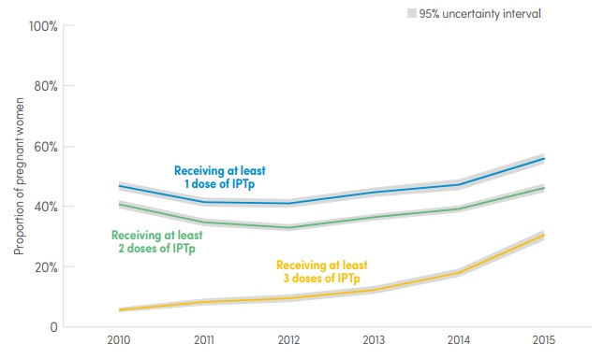
Background
Even though antenatal care (ANC) coverage in African countries is generally high, many countries have struggled to achieve high levels of uptake of intermittent preventive treatment in pregnancy (IPTp).
In Uganda, about 90% of women attend ANC at least twice, while only 45% of women receive at least two doses of IPTp.
Formative research carried out in 2013-14 found that key barriers to achieving high coverage of IPTp in Uganda were health workers’ inadequate knowledge of the IPTp provision guidelines and poor provision practices^{1,2}.
Fig 1. Proportion of pregnant women receiving IPTp in sub-Saharan Africa, 2010-2015
Source: World Malaria Report 2016

Slide 3
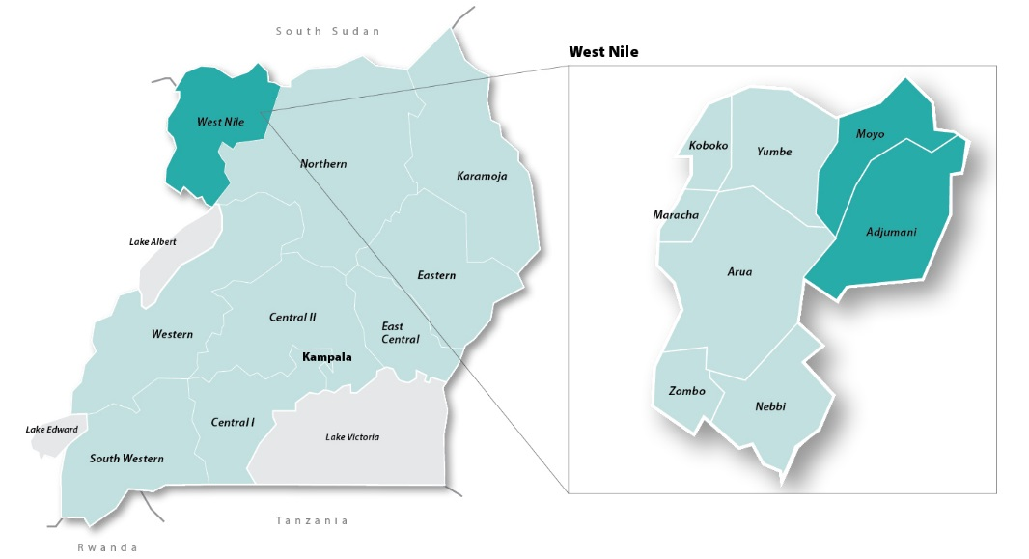
Intervention
Objectives:
To improve health worker performance with regard to IPTp provision and increase coverage of IPTp, Malaria Consortium conducted a pilot study in 2015-16, which involved testing a mobile health (mHealth) intervention.
Setting:
The study was conducted in two districts of West Nile, Uganda.
Fig 2. Study districts.

Slide 4
Intervention
Intervention components:
Provision of classroom training on malaria in pregnancy
Sending a series of educational text messages reinforcing the training content
Study design:
Health workers at eight health facilities in one district received classroom training followed by text messages (‘intervention’), while health workers at eight health facilities in the other district only received classroom training (‘control’).
Classroom training
Baseline evaluation
Text messages (intervention only)
Endline evaluation
May 2015 June 2015 June/July 2015 December 2015
Fig. 3. Study timeline.

Slide 5
Intervention
Classroom training:
The training followed the standard approach of selecting a group of health workers to attend the training and tasking them with cascading information to colleagues who did not attend (‘cascade model’).
In each district, 24 health workers with responsibility for ANC received a three-day training on malaria in pregnancy and IPTp.
Text messages:
A total of 24 text messages were sent to all health workers with responsibility for ANC in the intervention district (n=49).
One message was sent every weekday over a period of five weeks to health workers’ personal mobile phones.
Messages were sent via mTrac³, an SMS platform owned by the Ministry of Health and typically used to text information from health facilities to the District Health Office.

Slide 6
Images/materials/audio-visual
Pregnant women should receive a drug called SP monthly beginning in the second trimester to prevent adverse consequences of malaria. This is called IPTp.
More doses of IPTp increase women’s protection from malaria. IPTp should be given repeatedly as long as there are 4 weeks between doses.
Most women trust health workers. When providing IPTp, tell women why IPTp is important and that it is safe. Encourage them to take the medication as DOT.
Fig. 4. Sample text messages.

Slide 7
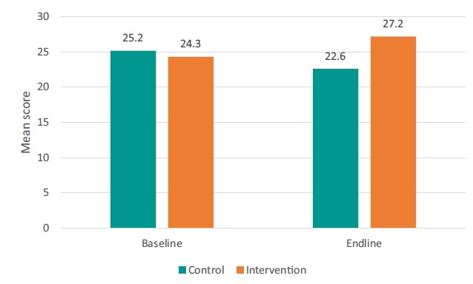
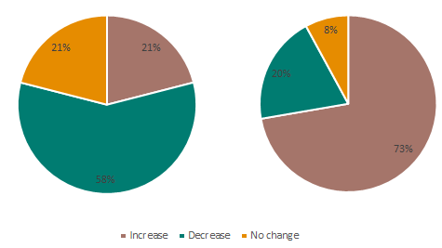
Monitoring and evaluation
Health worker knowledge of IPTp:
At baseline, health workers’ knowledge of IPTp (measured using a multiple-choice knowledge questionnaire) was not statistically different in the two study districts.
At endline, knowledge among health workers in the intervention district was significantly higher than in the control.
Control
Intervention
Fig. 5. Mean knowledge scores at baseline and endline (out of a possible 40).
Fig. 6. Change in individuals’ knowledge scores (baseline and endline).

Slide 8
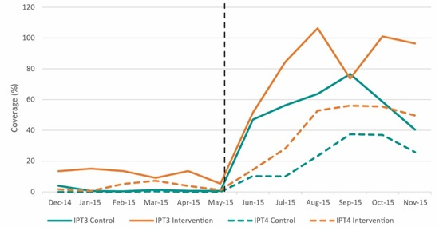
Monitoring and evaluation
IPTp coverage:
During the six months leading up to the training, there was no significant difference between intervention and control (data extracted from facilities’ ANC registers).
During the six months after the training, coverage increased in both districts, but the increase was significantly higher in the intervention.
Fig. 7. IPT3 and IPT4 coverage pre-/post-classroom training.

Slide 9
Lessons learned
All health workers owned a personal mobile phone.
Technical issues appeared to delay rather than preclude reception of messages.
Health workers generally stated that the messages were helpful in reinforcing the training content. Another key benefit was that they reached those who could not attend the classroom training.
Frequency and content of the messages were seen as adequate.
Sending the messages did not pose significant challenges to District Health Office staff, as a familiar system was used.
“They are a good idea because most times people after the training, they tend to forget. But once the messages are forwarded to them, they remember -- ah this was taught. So it [was] helpful.”
Health worker, intervention
“It is part of what I do, so I feel that I was doing my due responsibilities. So I feel it didn’t do any additions to this.”
District health office staff, intervention

Slide 10
Key messages
Text messaging, in combination with other capacity building tools and approaches, is a promising, low-cost approach for improving health worker performance in resource-poor settings.
In this study, the approach was feasible and very well accepted by health workers and district health officials.
There are also strong indications that it resulted in increased knowledge and coverage of IPTp compared with classroom training only.
The approach may be applicable beyond malaria in pregnancy, especially where mobile phone use among health workers is widespread and text messaging platforms already exist.

Slide 11
Credits
Malaria Consortium gratefully acknowledges the support received from the Republic of Uganda’s Ministry of Health, in particular the National Malaria Control Programme, Reproductive Health Division and Resource Centre.
The study was conducted through COMDIS-HSD, a Research Programme Consortium funded by the UK government. It also received Programme Partnership Arrangement funding from the UK government. However, the views expressed do not necessarily reflect the UK government’s official policies.

Slide 12
References
¹Rassi C, Graham K, King R, Ssekitooleko J, Mufubenga P, Siduda Gudoi S. Assessing demand-side barriers to uptake of intermittent preventive treatment for malaria in pregnancy: a qualitative study in two regions of Uganda. Malaria Journal. 2016;15(1):530.
²Rassi C, Graham K, Mufubenga P, King R, Meier J, Gudoi SS. Assessing supply-side barriers to uptake of intermittent preventive treatment for malaria in pregnancy: a qualitative study and document and record review in two regions of Uganda. Malaria Journal. 2016;15(1):341.
³World Health Organization. Strengthening accountability chains for maternal, newborn and child health in Uganda – mTrac; 2014.
A research brief providing more information on the study and its results is available from Malaria Consortium’s website.

Slide 13
For more information about the study, please contact:
Christian Rassi
COMDIS-HSD Project Coordinator
T +44 (0)207 5490223
E c.rassi@malariaconsortium.org

