Slide 1
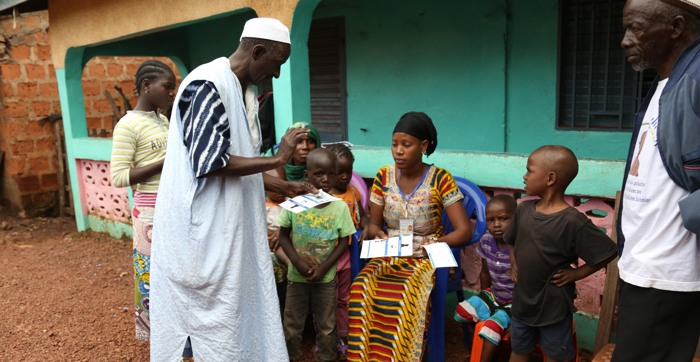
SMC Cost Analyses
Presented by David Collins and Colin Gilmartin (MSH) Ouagadougou, Burkina Faso
February 14, 2017

Slide 2
ACCESS-SMC Methods (1)
“Ingredients” approach with a mix of standard and actual costs
‘Reality-check’ - sample of health centers visited in each country
Recurrent cost categories include:
SMC drugs and supplies
Remuneration of distributors
Management
Supervision
Meetings
Trainings
Other (e.g. equipment, social mobilization, etc.)

Slide 3
ACCESS-SMC Methods (2)
Not included in this analysis:
Above-country management costs of UNITAID and implementing NGOs
Capital costs (vehicles, motorcycles, or health facilities)
Non-financial costs (e.g. volunteer time and recipient/family costs)
Pharmacovigilance and management of adverse effects
Coverage surveys and drug resistance monitoring

Slide 4
ACCESS-SMC – Program Overview (2015)
 | Burkina Faso | Chad | Guinea | Mali | Niger | Nigeria | Gambia
Target Pop (3-59 mo.) | 649,693 | 275,000 | 210,047 | 809,638 | 595,901 | 792,133 | 90,925
Total SMC provided | 2,721,731 | 1,061,417 | 805,131 | 2,751,353 | 1,667,890 | 3,149,867 | 308,830
*Equivalent children receiving 4 cycles | 680,433 | 265,354 | 201,283 | 687,838 | 416,973 | 787,467 | 77,208
Admin. Coverage | 104.73% | 96.49% | 95.83% | 84.96% | 69.97% | 99.41% | 84.91%

Slide 5
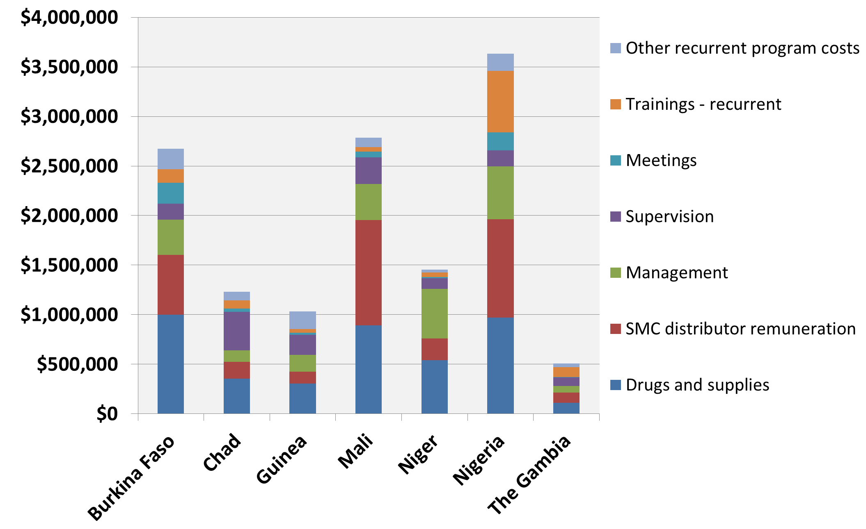
ACCESS-SMC - Total Recurrent Program Costs (2015)

Slide 6
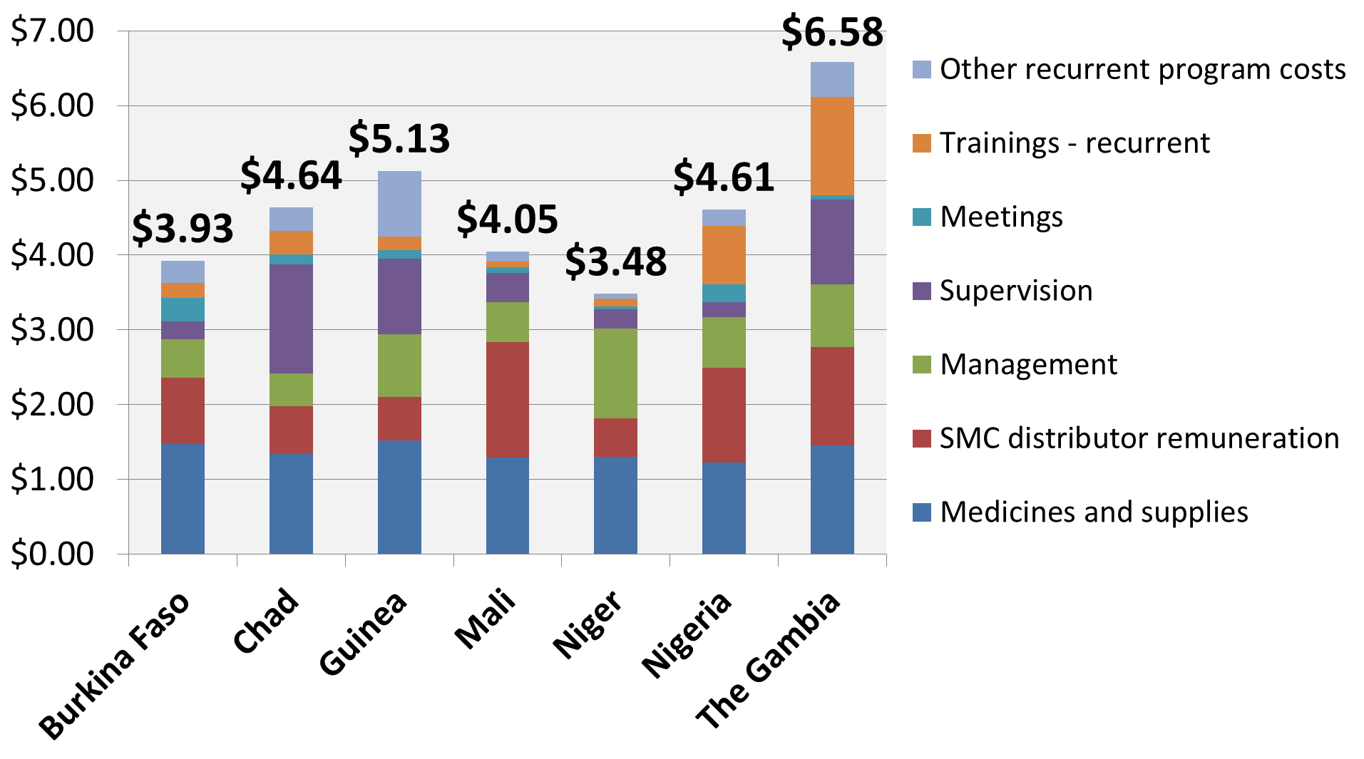
ACCESS-SMC - Recurrent Cost per Child - 4 doses (2015)
*
*
*
Average weighted cost
$1.07 per 1 cycle
$4.27 per 4 cycles
* Use of Health Center Personnel & Volunteer Distributors

Slide 7
ACCESS-SMC – Recurrent Costs Breakdown (2015)
 | Burkina Faso | Chad | Guinea | Mali | Niger | Nigeria | Gambia
Drugs & supplies | 37% | 29% | 30% | 32% | 37% | 27% | 22%
SMC distributor remuneration | 23% | 14% | 11% | 38% | 15% | 27% | 20%
*Management | 13% | 9% | 16% | 13% | 35% | 15% | 13%
Supervision | 6% | 32% | 20% | 10% | 7% | 4% | 17%
Meetings | 8% | 3% | 2% | 2% | 1% | 5% | 1%
Trainings | 5% | 7% | 4% | 2% | 3% | 17% | 20%
Other | 8% | 7% | 17% | 3% | 2% | 5% | 7%
* Include MoH costs (salaries) incurred for program management

Slide 8
Médecins Sans Frontières - Niger (2014)
 | Switzerland | France ¹ | Belgium ² | Spain | Global
Global costs (less OH) | $467,115 | 4147,011 | $301,713 | $446,228 | $1,362,067
Beneficiaries reached | 102,364 | 35,309 | 67,091 | 116,987 | 321,751
Cost/child | $4.56 | $4.16 | $4.50 | $3.81 | $4.23
¹ MSF France included SMC in preventive package done at health center
² MSF Belgium moving to only first dose DOT
Cost decreased (from 2014) due to lower support costs and integration of SMC with other health activities.
Notes:
However, no decrease in direct activity costs 2014, linked to high direct HR and transport costs.
Bigger teams; multiple interventions (bednets, etc.)
9 person teams → 6 person teams → mobile teams
Lots of coordination support at central level
Belgium: each dose was DOTs

Slide 9
USAID/PMI – Mali and Senegal (2016/17)
 | Senegal |  | Mali
Category | 2016 | 2017 | 2016 | 2017
Drugs | $932,500 | $950,000 | $412,612 | $1,560,000
Ops Costs | $1,606,039 | $1,540,000 | $584,607 | $1,700,000
M&E | $250,000 | - | - | $100,000
SBCC | - | $100,000 | $59,910 | -
Total Cost | $2,788,539 | $2,590,000 | $1,057,129 | $3,360,000
Target children | 625,000 | 633,000 | 307,883 | 800,000
Estimated cost/child | $4.46 | $4.09 | $3.43 | $4.20
Weighted Cost: $4.12 (2016)
$4.16 (2017)

Slide 10
Strengthening the Investment Case for SMC
SMC costing methodologies should be harmonized and include essential costs of monitoring and pharmacovigilance
More analysis needed to determine:
Cost savings to health systems and beneficiaries/households due to SMC
Cost-effectiveness and equity of SMC distribution methods (door-to-door, fixed point, and mobile) and integration with other health services

Slide 11
Conclusions
SMC is a low cost intervention (> US $5 per child for 4 cycles)
SMC can significantly reduce malaria burden: 24% in Chad, 45% in Burkina, 49% in Mali, 65% in The Gambia (LSHTM, 2015)
SMC can result in savings to health system:
$8.75 - $22 / case of simple malaria treated (RDT+ACT) [iCCM] (MSH, 2013 Burkina Faso)
$66.50 / case of severe malaria (artesunate treatment)
(economic costs, sub-Saharan Africa, Lubell et al)
SMC will result in reduced economic costs faced by families

Slide 12
Acknowledgements
Erin Eckert of USAID/PMI
Estrella Lasry of MSF
UNITAID
Malaria Consortium
Project Partners: CRS, LSHTM, MMV, Speak Up Africa
National Malaria Control/Elimination Programs
SMC distributors and supervisors
MSH technical and support staff – especially Gladys Tetteh and Alexandra Kyerematen

Slide 13
Thank you! Merci!

