Slide 1

UNITAID
Overview
Joint Consultation on Seasonal Malaria Chemoprevention
Ouagadougou, Burkina Faso, 13-15 February 2017

Slide 2
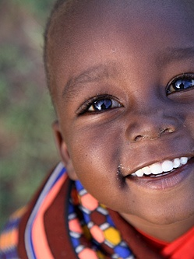

Our mission
Maximize the effectiveness
of the global health response
by catalyzing access
to
better health products

Slide 3



UNITAID connects the upstream to the downstream
Academia
Industry
PDPs
BMGF
Grand Challenges
others
Upstream
Innovation & Availability
Quality
Affordability
Supply & Delivery
Projects with grantees
Demand & Adoption
Governments & Partners
Medicines
Devices
Systems
Downstream
HIV / AIDS
Tuberculosis
Malaria
...

Slide 4

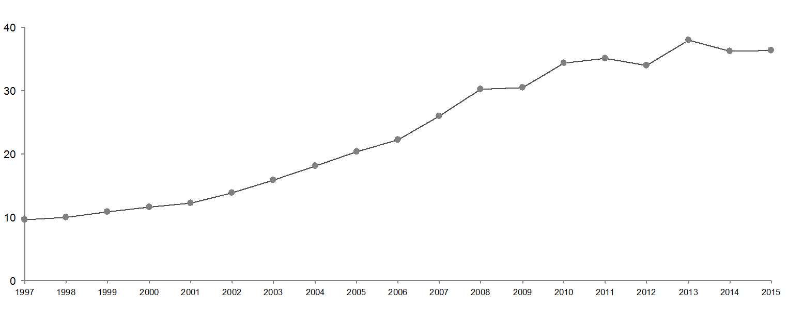













UNITAID is part of the global response
Joint Health System
Platform (2009)
Global strategy for women's and children's health
2006
Development assistance for health ($bn)
Source: IHME (Institute for Health Metrics and Evaluation)
Notes:
Between 2011 and 2012, strong decrease in DAH from USA and from World Bank

Slide 5

UNITAID has a role to play at three critical moments
Moment 1
Product is available
Moment 2
Product is adopted
Moment 3
Product is scaled-up
Maximize the effectiveness of the global health response...
Product coverage
... by catalyzing access...
... to better health products
Objectives
Innovation
Access
Scalability

Slide 6
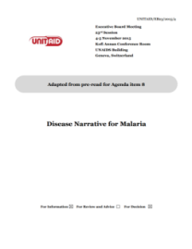
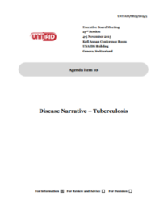
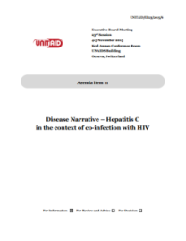








UNITAID translates global goals into concrete projects
Global Goals
Disease Narrative – Malaria
Disease Narrative – Tuberculosis
Disease Narrative – HIV
Disease Narrative – Hepatitis C
in the context of co-infection with HIV
Challenges
Disease narratives
Opportunities
HIV
E.g. Scale-up of PrEP
TB
E.g. Latent TB
Malaria
E.g. IPTp
Areas for
interventions
HCV
E.g. Simple, rapid diagnosis of HCV
Areas for intervention
Calls for
proposals
Projects
Projects

Slide 7






Portfolio funding overview
~10%
~10%
~10%
2006-2012
2013-2016
2017-2021
average
average
average
~60%
~10%
~20%
~45%
~20%
~25%
~45%
~20%
~25%
Higher share of portfolio supporting integration
HIV
TB
Malaria
Cross-cutting / Enablers
Integration

Slide 8

UNITAID's Areas for Intervention
HIV
Scale-up of PrEP & linkage to test
Adult antiretroviral therapy improvement
TB
Preventive TB treatment
Better, shorter treatment for MDR-TB
Scale-up of better TB treatment in children
Malaria
Preventive treatment in pregnant women
Innovative vector control tools
Treatment of severe malaria
Malaria vaccine trial
New insecticides for bed-nets
HCV
Simple, rapid diagnosis of HCV

Slide 9
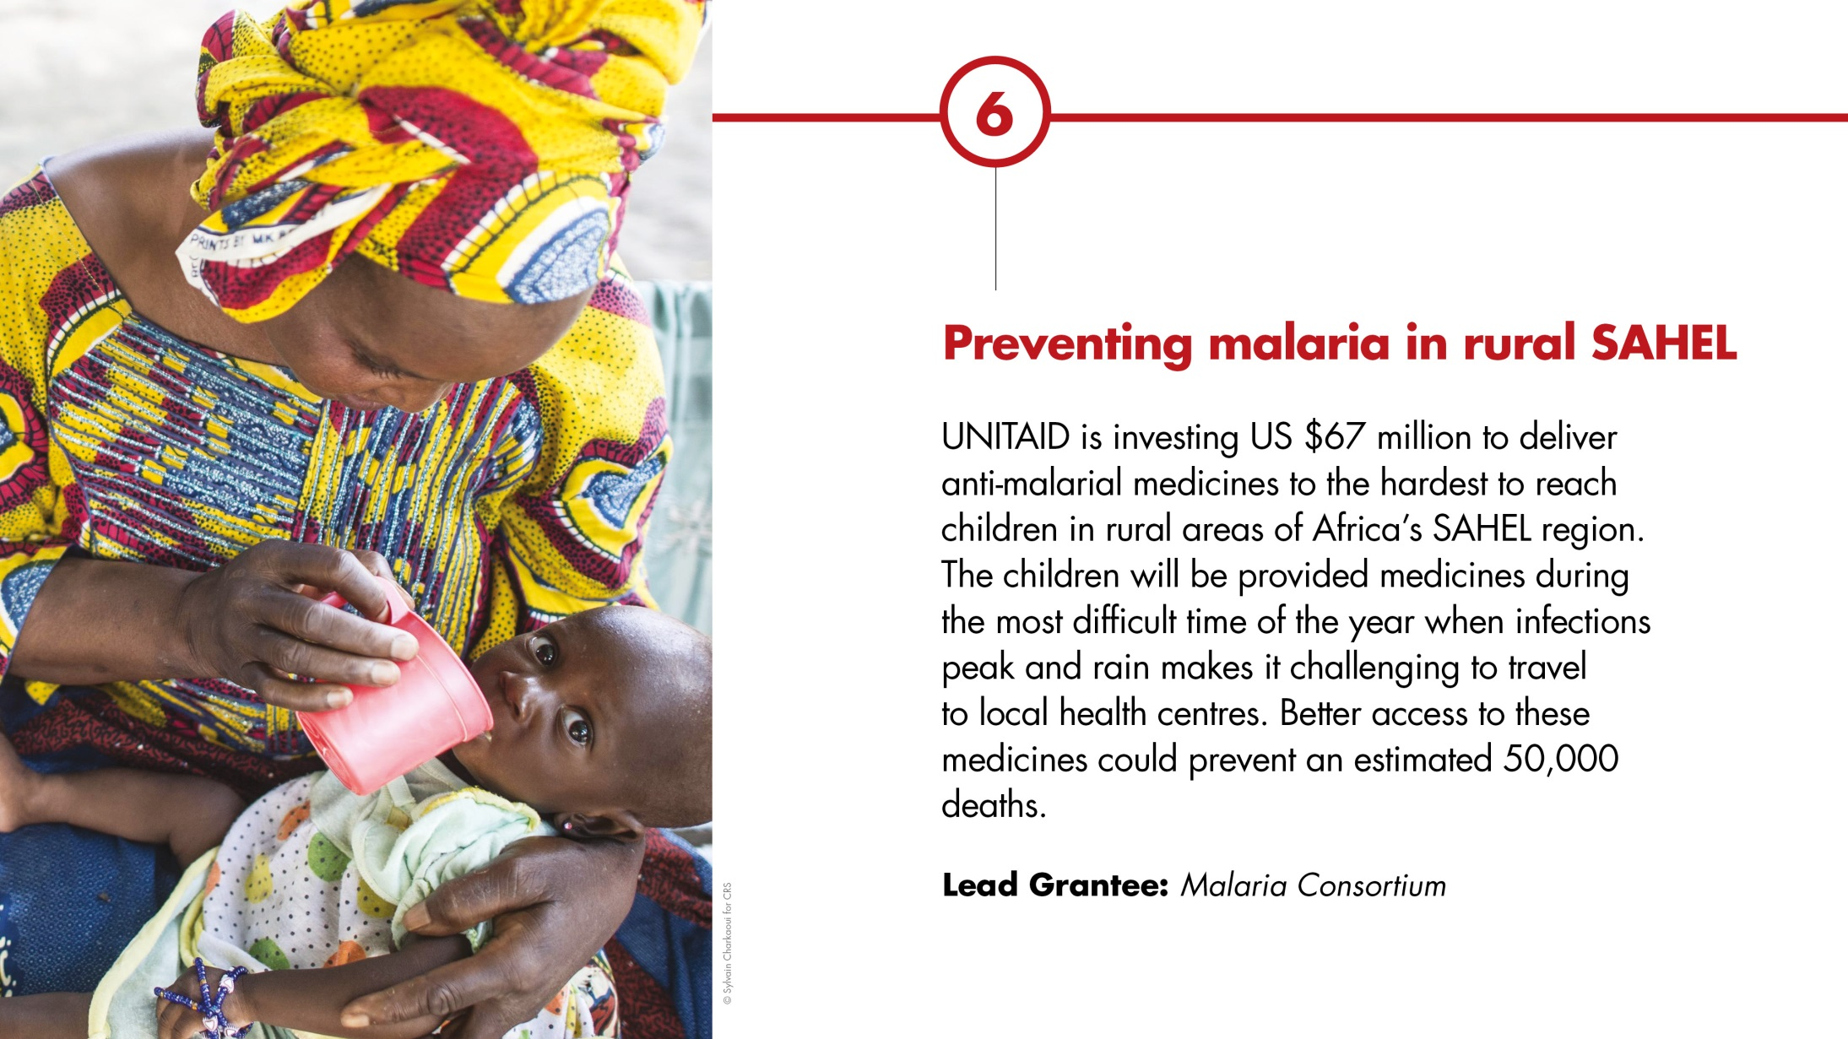

Slide 10
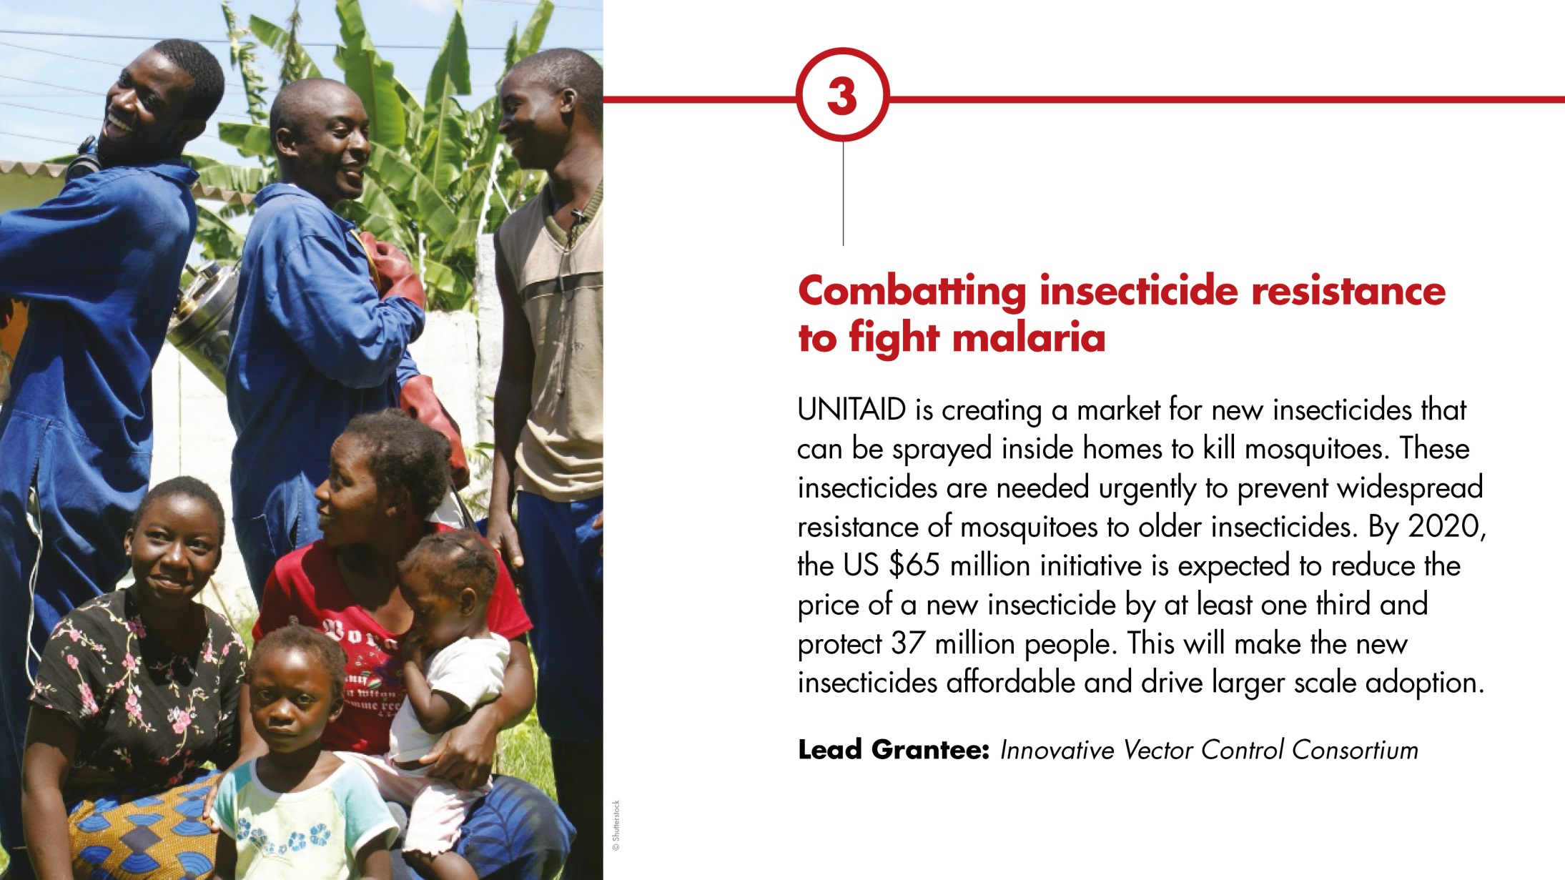

Slide 11
